Slide 1
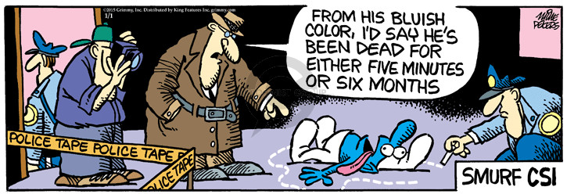
Teaching Forensics presented by Gretchen Williams
Clover Park High School in Clover Park School District
Can contact me by email: gkwillia@cloverpark.k12.wa.us

Slide 2
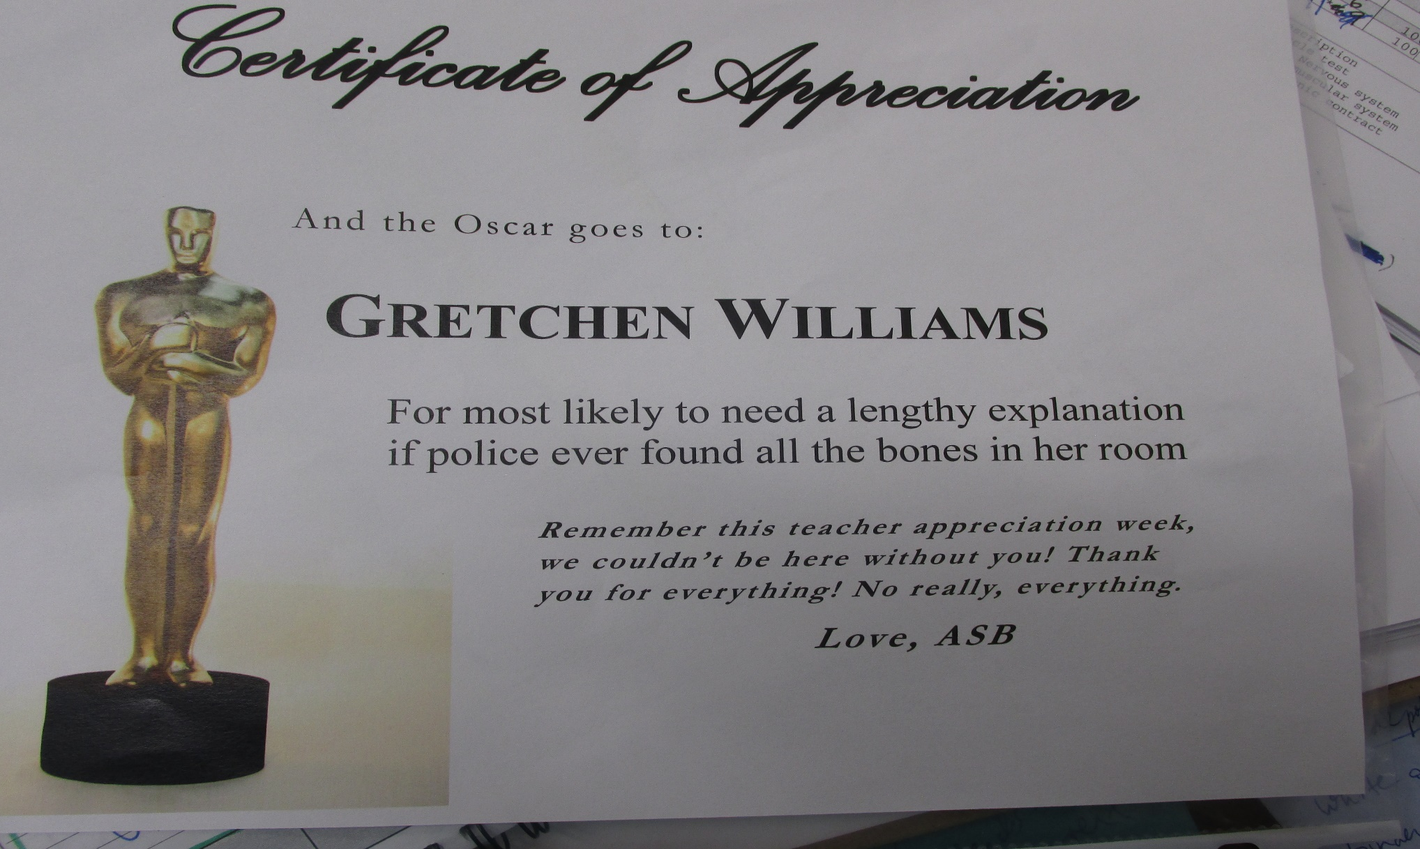
Introduction—who am I?

Slide 3
The best way to teach forensics is to teach it like it is really done in the field—use authentic resources and documents
I talk about real cases from the coroner’s office. Students are fascinated by the gross and bizarre. Forensics lends itself well to this criteria.

Slide 4
Introduction--Employability skills
Students apply for a job like pathologist, entomologist, CSA by writing a resume, cover letter, interviewing for the job
learn the skills for that job throughout the semester: entomologists and photographers get sent out to the body farm early
do that job for the final

Slide 5
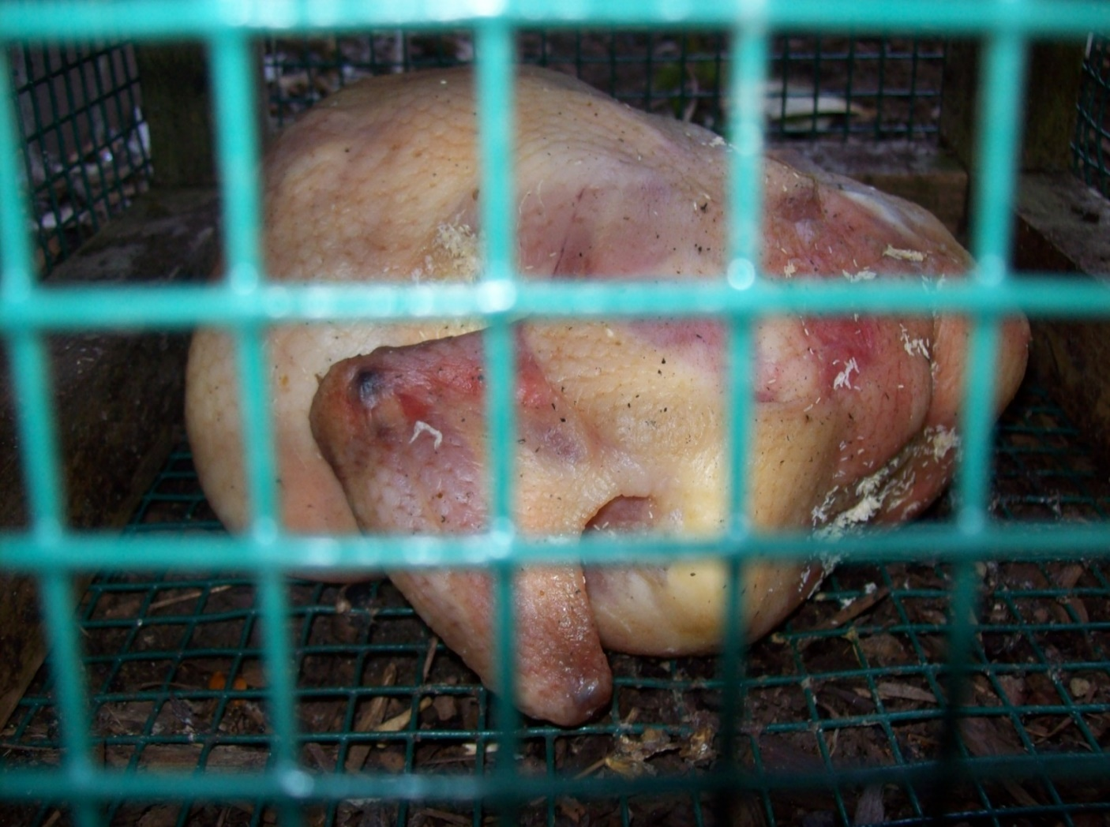
Creating a body farm using a chicken fryer
Use it to learn the life cycle of flies
Use it to build your own forensic entomology inventory
Use it to calculate post-mortem time interval A.K.A. when the fly eggs appear

Slide 6
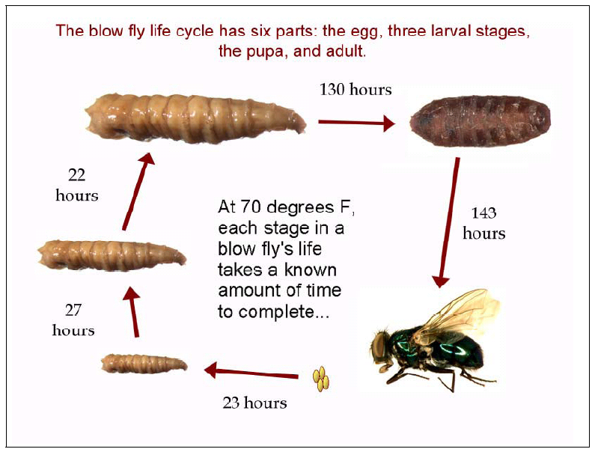
Temp X Time= ADH
3rd instar
pupa
2nd instar
eggs
adult
1st instar
Image: http://www.nlm.nih.gov/visibleproofs

Slide 7
Calculating PMI from
Accumulated Degree Hours (ADH)
From | To | Temp | Hours | ADH | Cumulative ADH
Egg | 1st Instar | 70° F | 23 | 70 X 23= 1610 ADH | 1610
1st Instar | 2nd Instar | 70 ° F | 27 | 70 X 27= 1890 ADH | 1610+ 1890
2nd Instar | 3rd Instar | 70 ° F | 22 | 70 X 22 = 1540 ADH | 1610+1890+ 1540
3rd Instar | Pupa | 70 ° F | 130 | 70 X 130 = 9100 ADH | 1610+1890+ 1540+9100
Pupa | Adult Fly | 70 ° F | 143 | 70 X 143 = 10010 ADH | 1610+1890+ 1540+9100 +10010=24,150
Notes:
24100 ADH

Slide 8
Calculating ADH from Climate Data with Sylvia Hunt Case, a real case

Slide 9
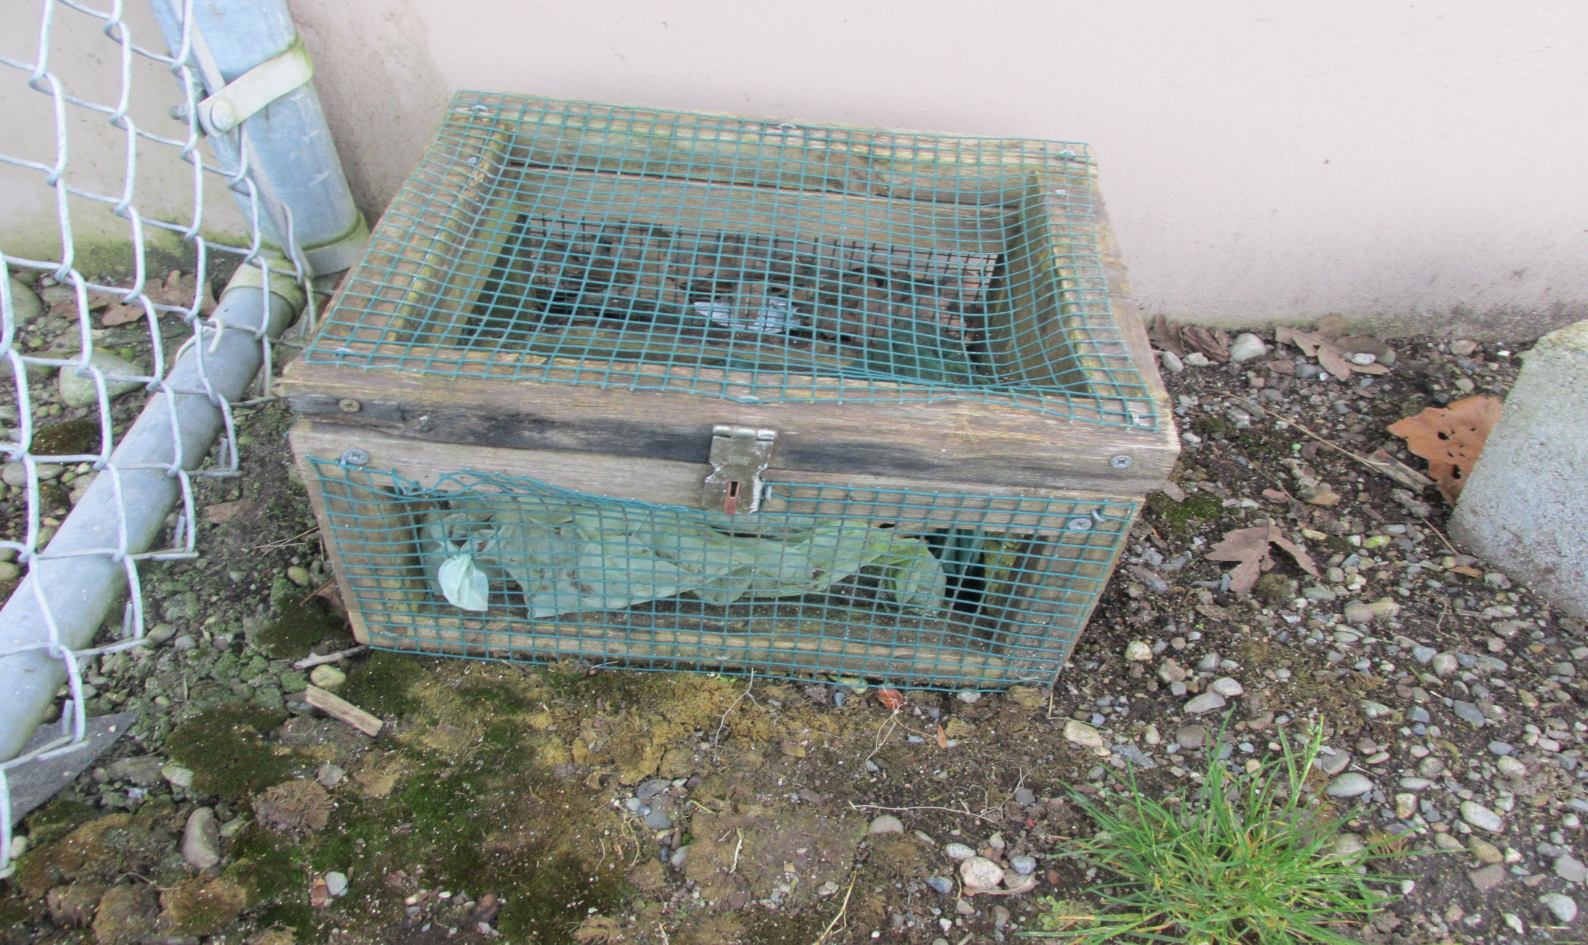
You can see things in a small body farm that you would see at a real crime scene

Slide 10
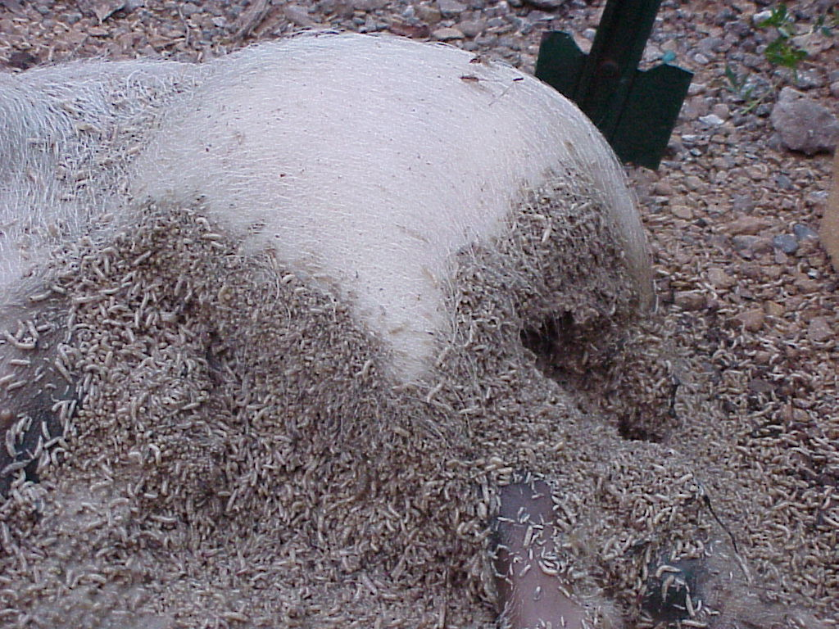
Maggot mass’s temperature is shown to be 15-20 degrees above ambient temperature; this has been observed even with our chicken

Slide 11
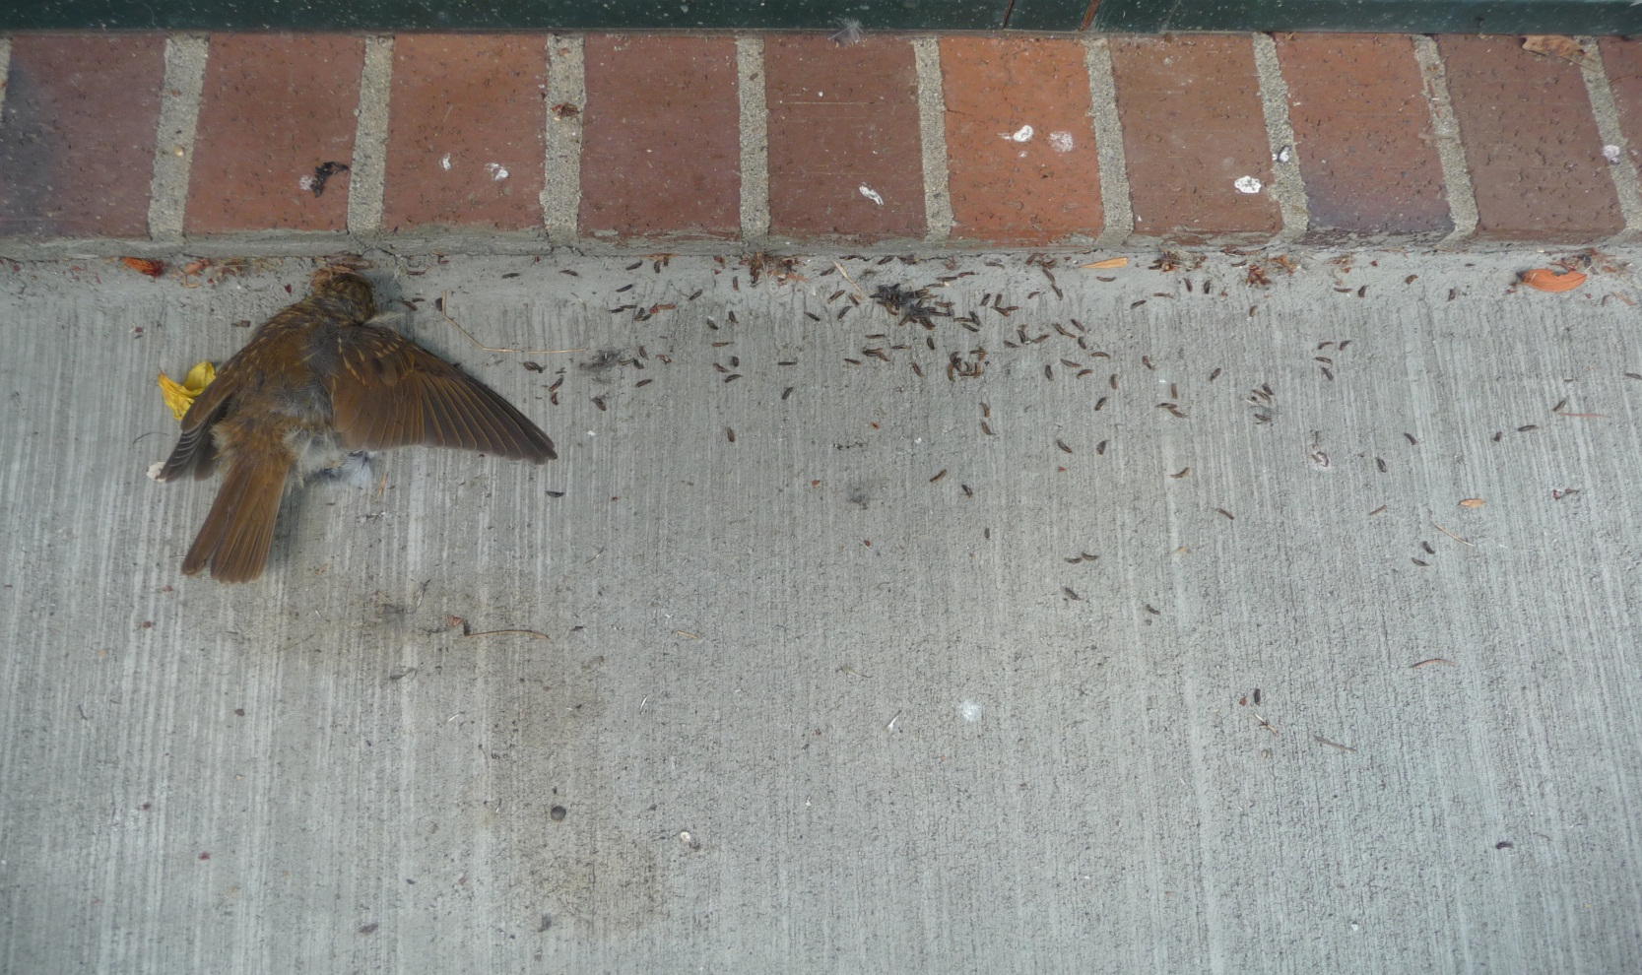
Third instars migrating away from a body when they are ready to pupate

Slide 12
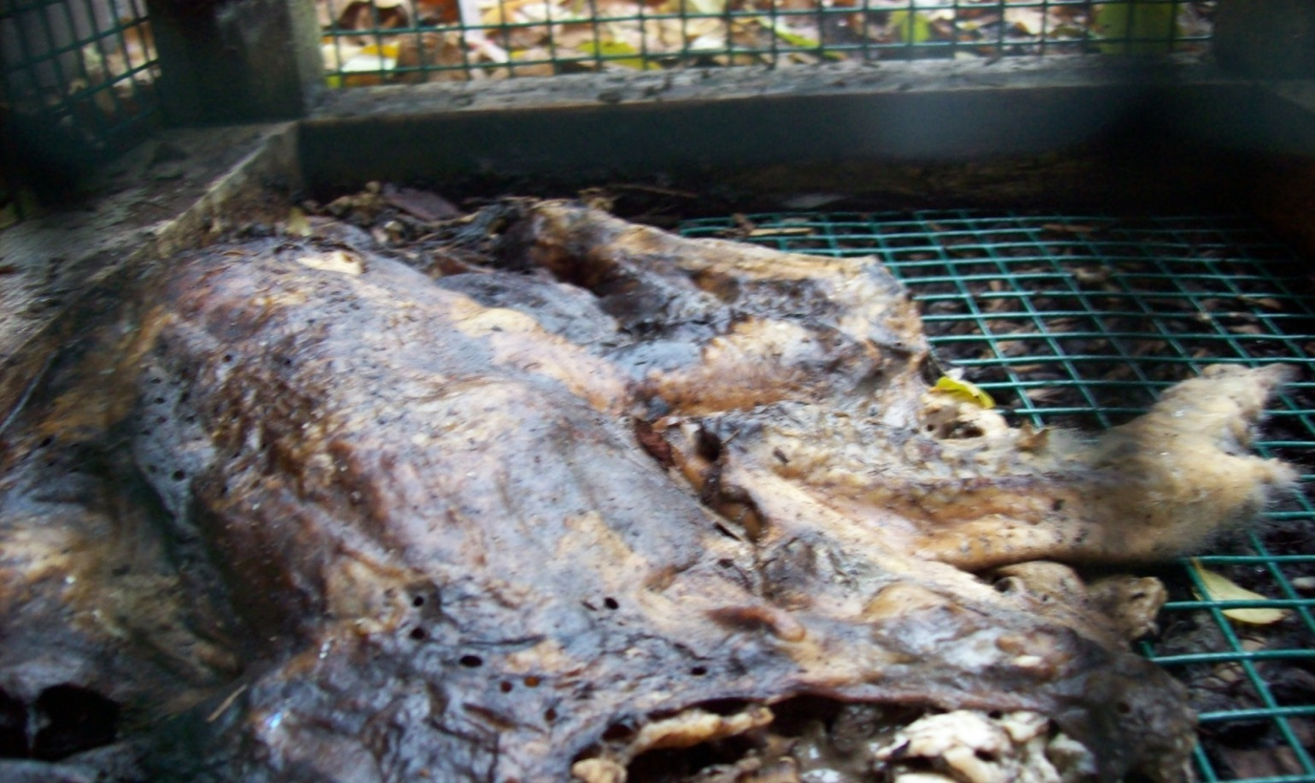
Skin holes made by insects to protect themselves from rain and cold

Slide 13
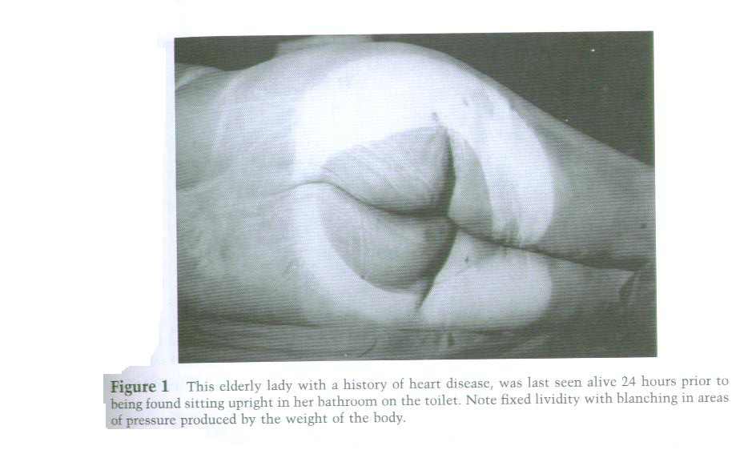
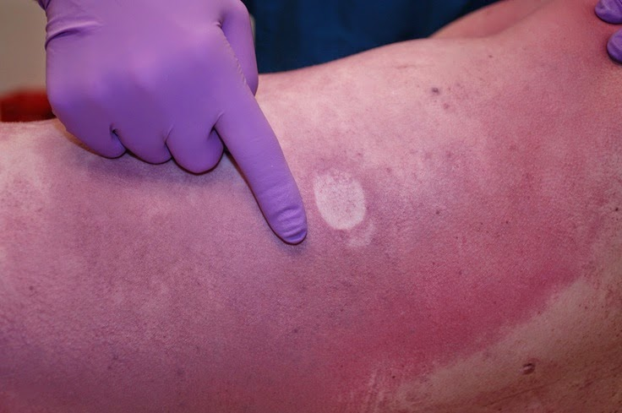
PMI calculation: Lividity or livor mortis on back, finger makes blanched area, lividity is not fixed—this person has been dead for less than 8 hours

Slide 14
Rigor mortis—stiffening of muscles
Complete 10-24 hours at 70 F and entire body will be rigid, disappears after 48 hours
Warm temps speed it up
Cool temps slow it down

Slide 15
Algor mortis
Cooling of the body to reach ambient temperature
Cools at a rate of 1.5 F per hour

Slide 16
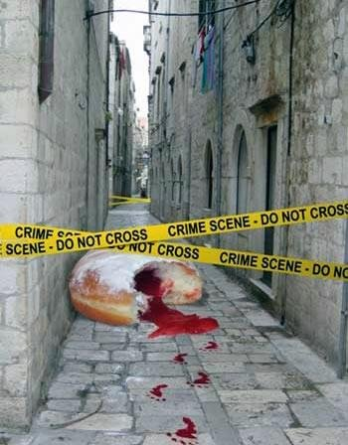
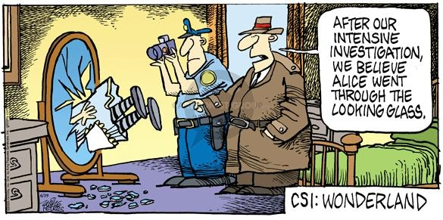
CSA—analyzing evidence at the scene

Slide 17
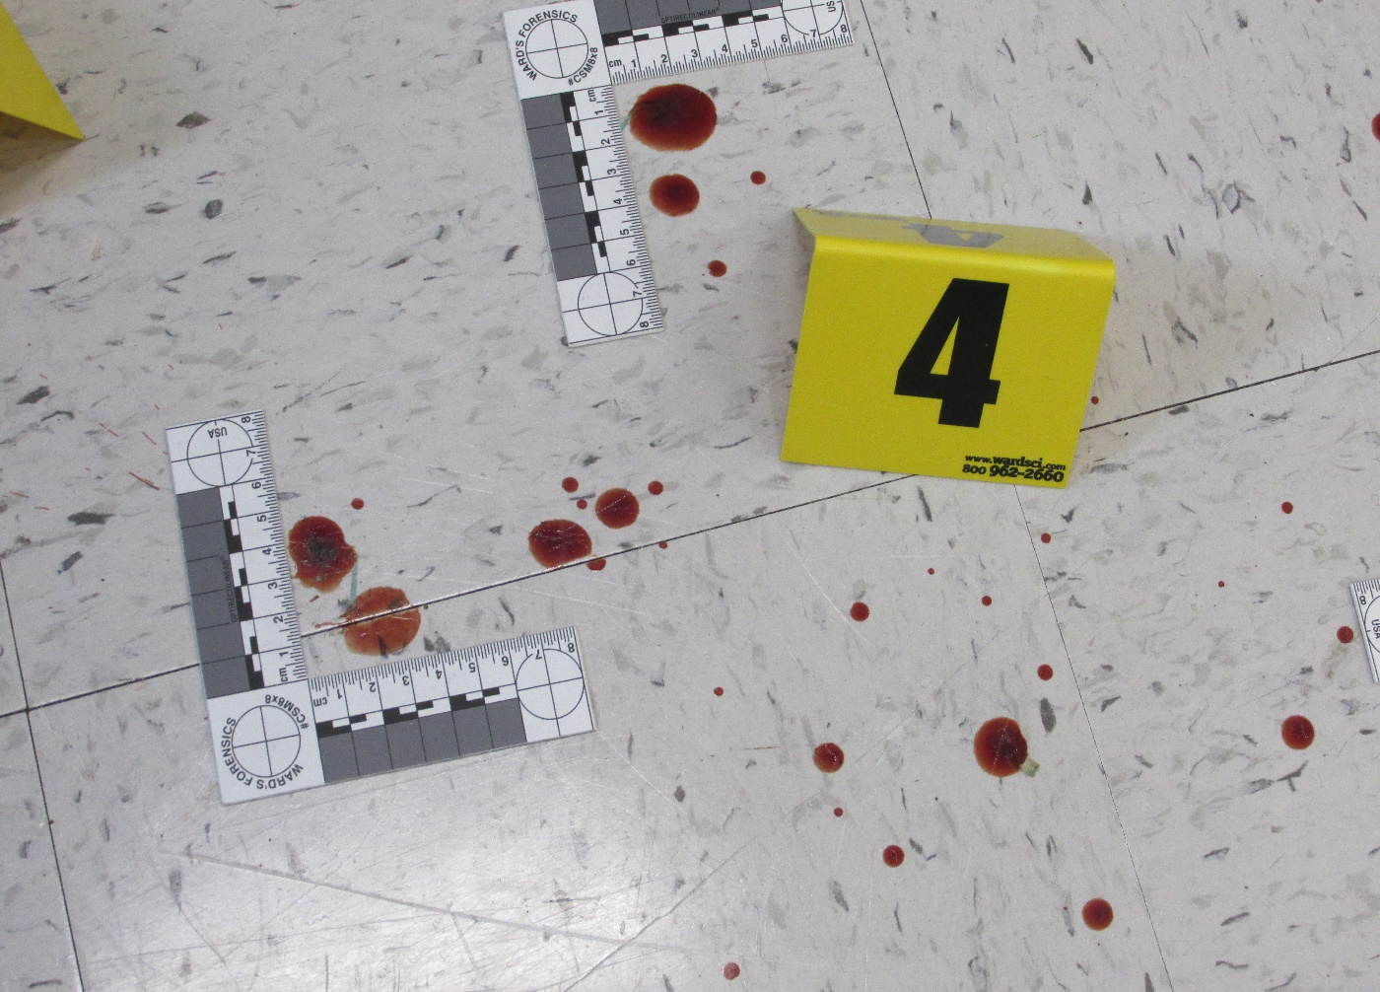
Blood analysis
Hemastix are the best ways of determining if that RED spot at the scene is really blood and not hair dye, food coloring, or paint
Bovine (cow’s) blood gives good positive tests and looks real

Slide 18
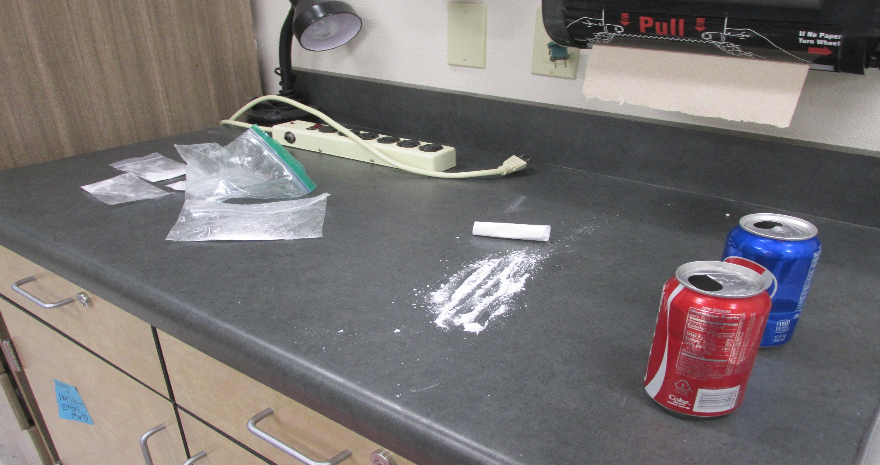
Unknown white powders at the scene—combines with toxicology for pathology

Slide 19
Results from the unknown white powders and the drugs they relate to
Unknown white powders results:
Aspirin + phenol red = orange
Calcium carbonate + ferric nitrate = orange
corn starch + iodine = blue
Aspirin + Ferric nitrate= light purple
Key
Color of test result Drug it simulates
orange Methamphetamine
blue Cocaine
purple Morphine, heroin

Slide 20
Washington State Patrol
Forensic Laboratory Services Bureau
2203 Airport Way South, Suite 360
Seattle, Washington
USA 98134
Re: Toxicology sample from ______________
Dear Deputy Coroner:
Blood, vitreous humor, and urine samples from ___________________ were analyzed and the following results were obtained:
Blood ETOH level was 0.04mg/ml
Alprazolam 0.104 µg/ml
Zoloft 0.025 µg/ml
Wellbutrin 0.050 µg/ml
Temazepam 1.0 µg/ml
Hydrocodone 0.03 µg/ml
Cocaine 0.90 µg/ml
Methamphetamine 0.05 µg/ml
Diphenhydramine 0.05 µg/ml
Oxycodone 0.20 µg/ml
Morphine 0.04 µg/ml

Slide 21
Toxicology—can tell you more about the cause and/or manner of death--pathology

Slide 22
Toxicology with drug amounts and using Winek’s resource, 2nd column
Blood ETOH level was 0.08mg/ml p. 6 in Winek’s
methadone 0.32 µg/ml p. 9 in Winek’s
diazepam 0.20 µg/ml p. 5 in Winek’s
nordiazepam 0.05 µg/ml p. 11 in Winek’s
Hydrocodone 0.03 µg/ml p. 7 in Winek’s
Temazepam 0.01 µg/ml p. 15 in Winek’s
morphine 0.07 µg/ml p. 10 in Winek’s
Which have therapeutic, toxic, or lethal levels?

Slide 23
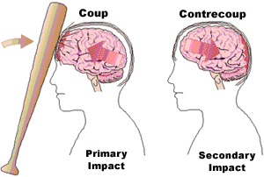
Blunt force trauma: Coup and Contrecoup Injuries—add another layer to the final
2nd impact is another injury at opposite ends
2 injuries here and here-----→
Single injury here

Slide 24
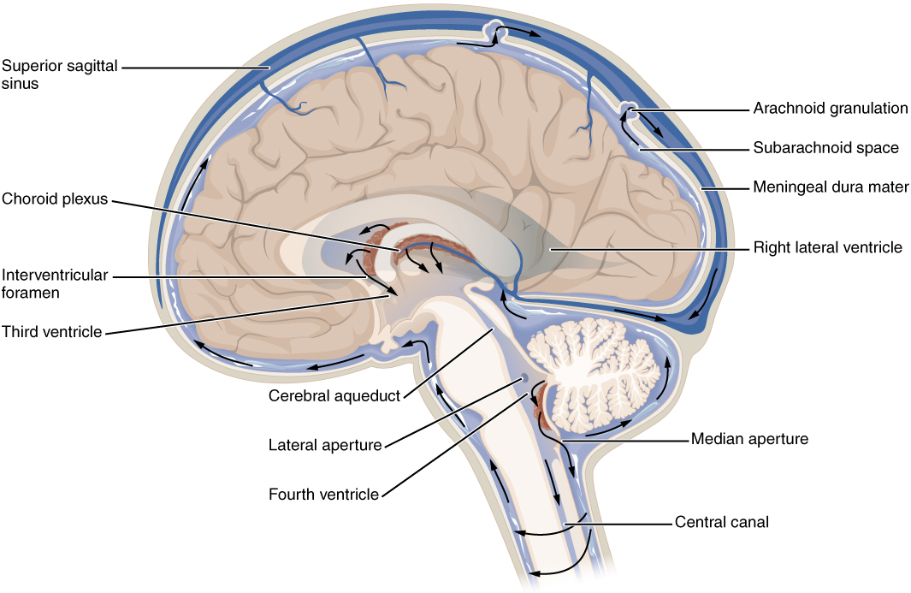
Cerebrospinal fluid—blue area

Slide 25
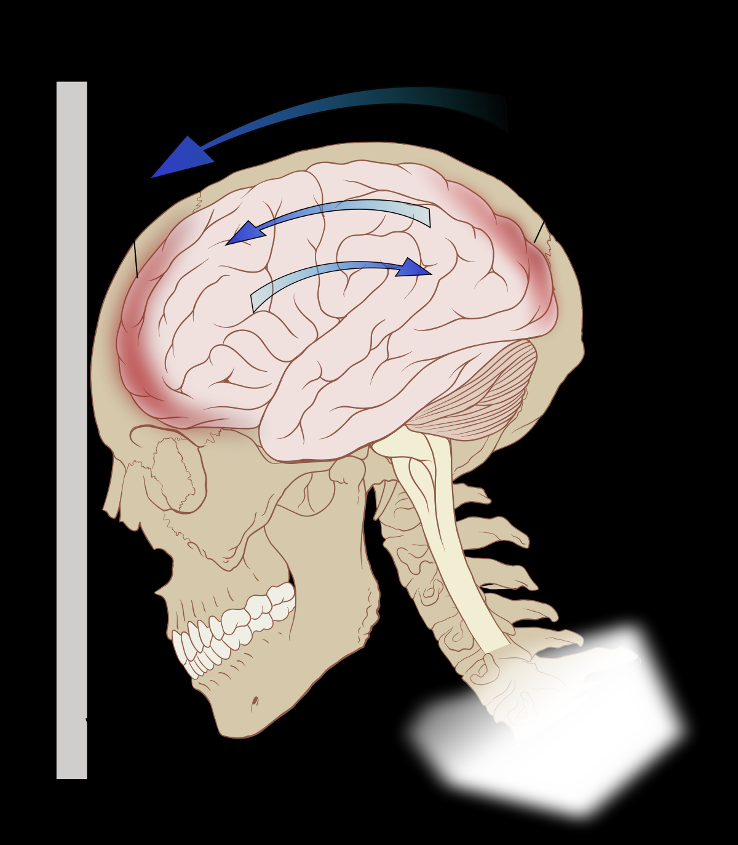
Contrecoup injuries and falling—Accidental manner of death
The cerebral fluid in the brain goes toward the front and then pushes the brain back so the brain hits the back and then the front.
That is why a person who falls hard enough can have a contrecoup injury to the brain WITHOUT hitting their head at all

Slide 26
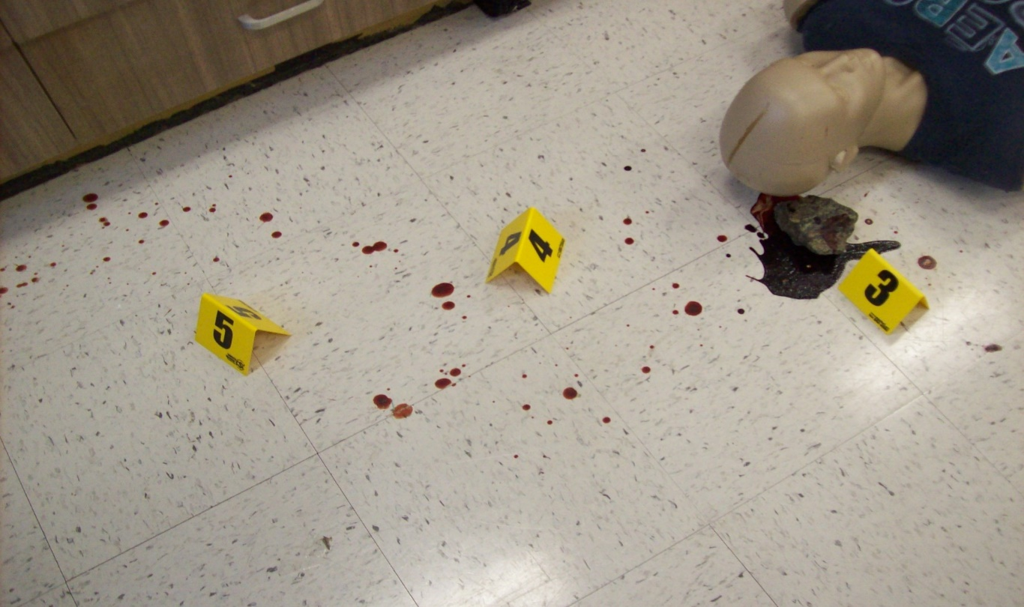
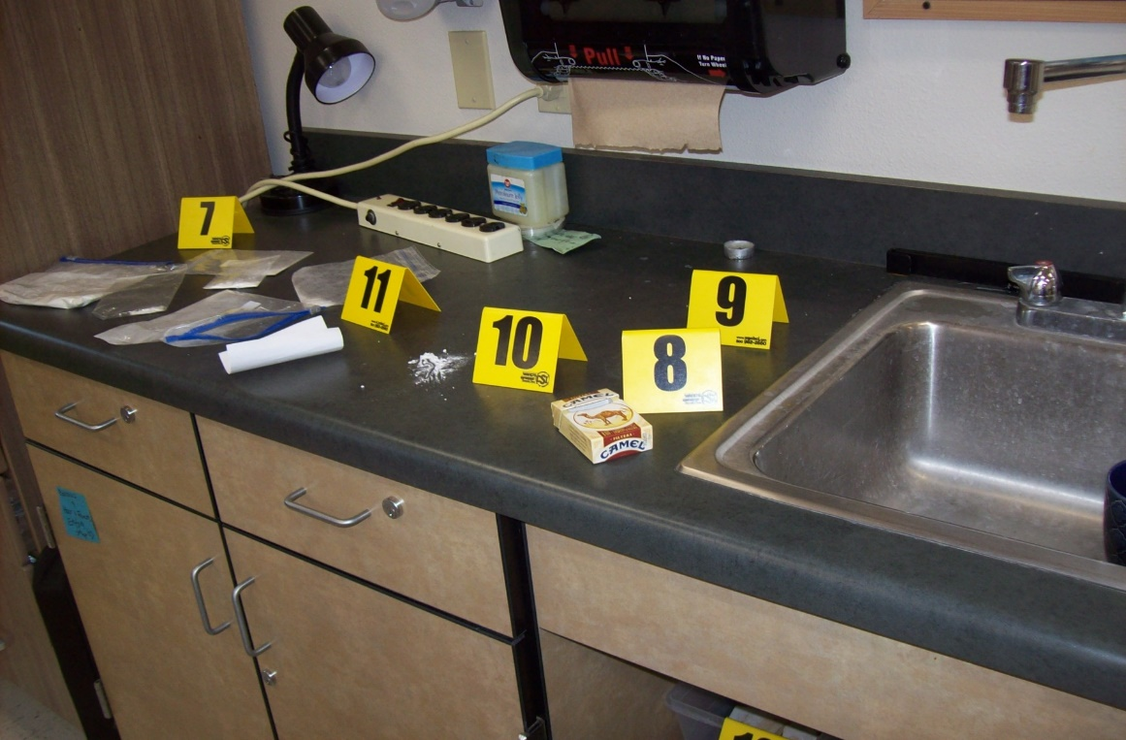
Final for Fresh Bodies
Case report
Set up your crime scene
Set up your groups so each
Job group works together like
All the pathologists look up the
Toxicology and take the injury
Information from the autopsy,
Work together to come up with
a cause and manner of death

Slide 27
Thank you!
What are your questions?
Please email me if you need anything in regards to resources and have questions later.

Slide 28
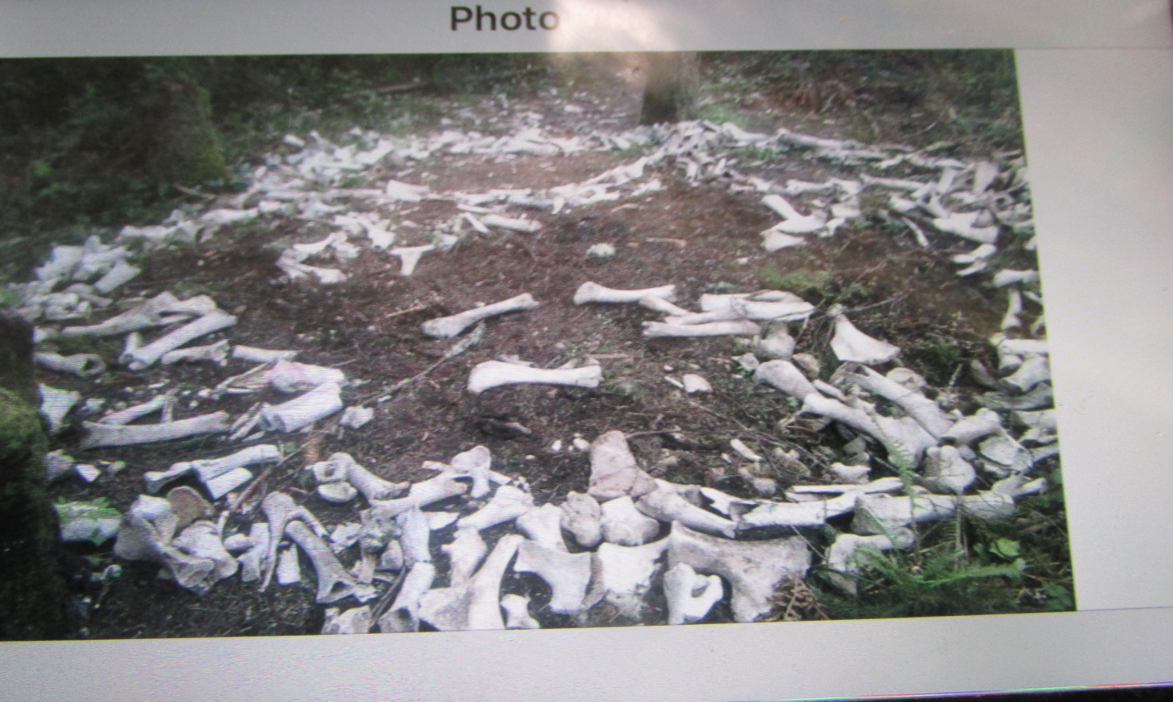
Are the bones human or animal?

Slide 29
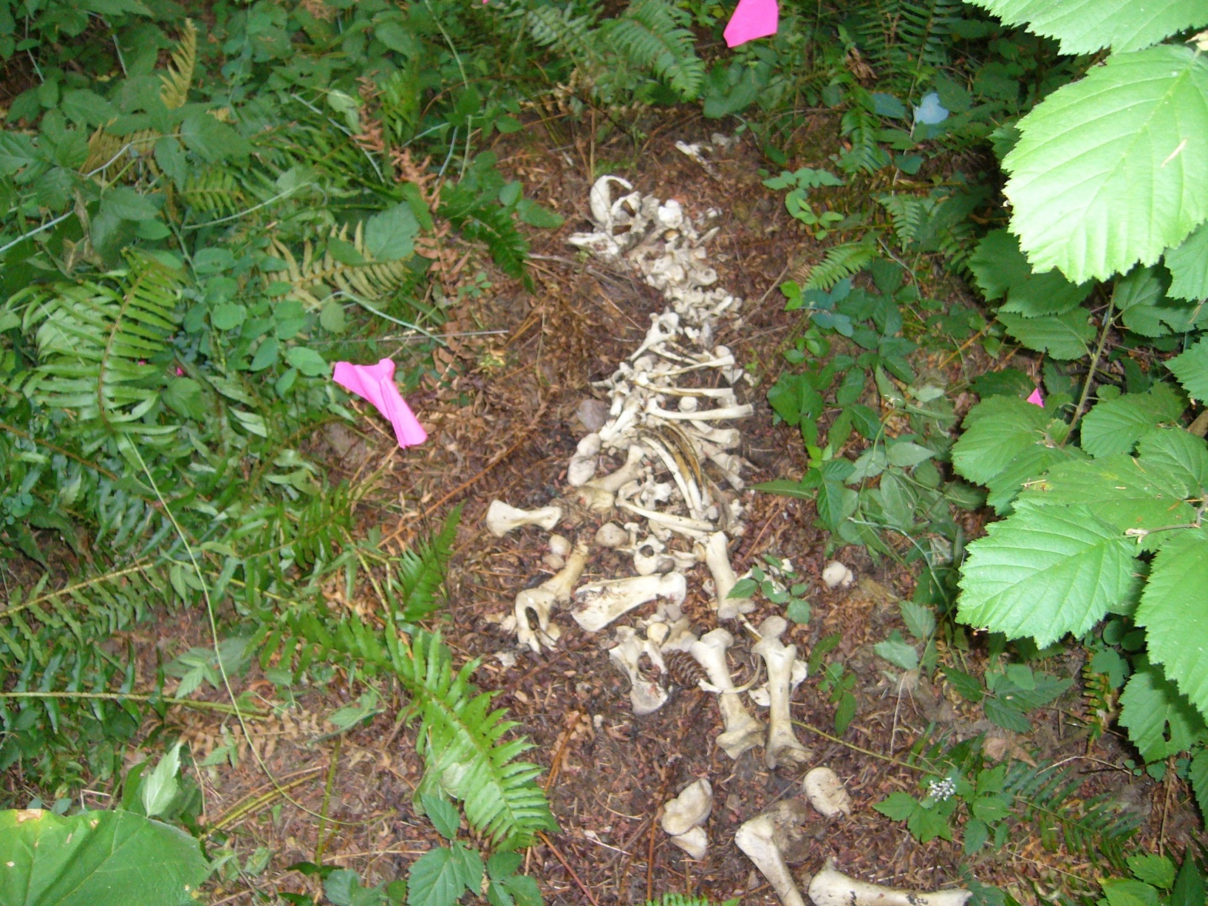
If you find animal bones, before gathering it for your class, take a picture of it

Slide 30
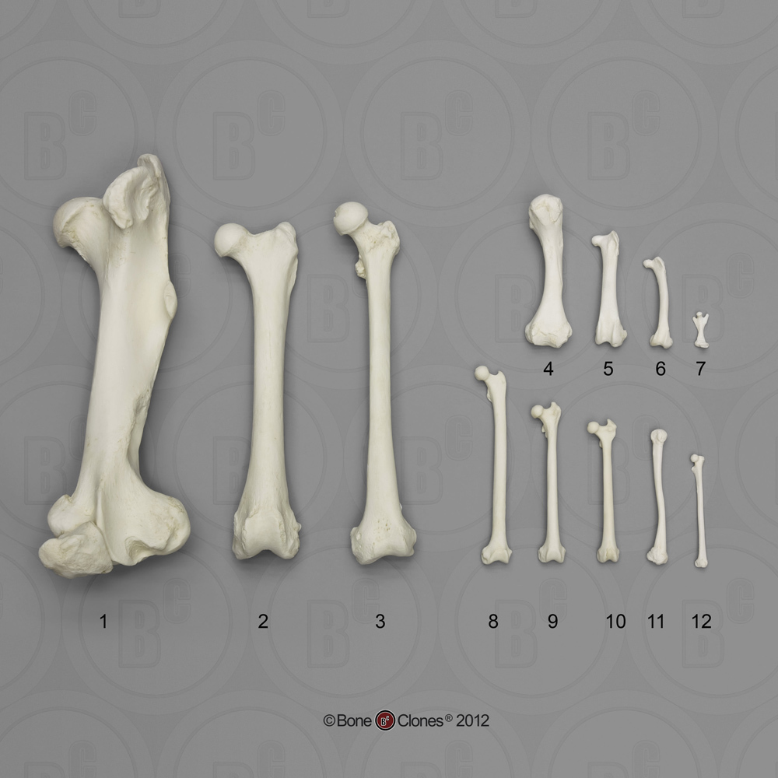
Skeletal material—are the bones human or animal? How can you tell?

Slide 31
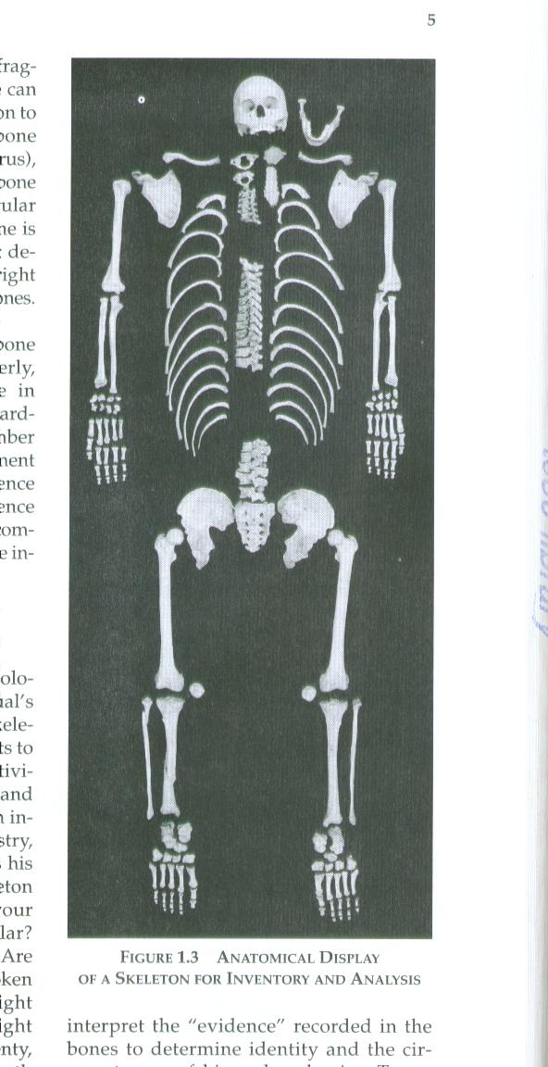
Bones are inventoried and put in the correct anatomical position

Slide 32
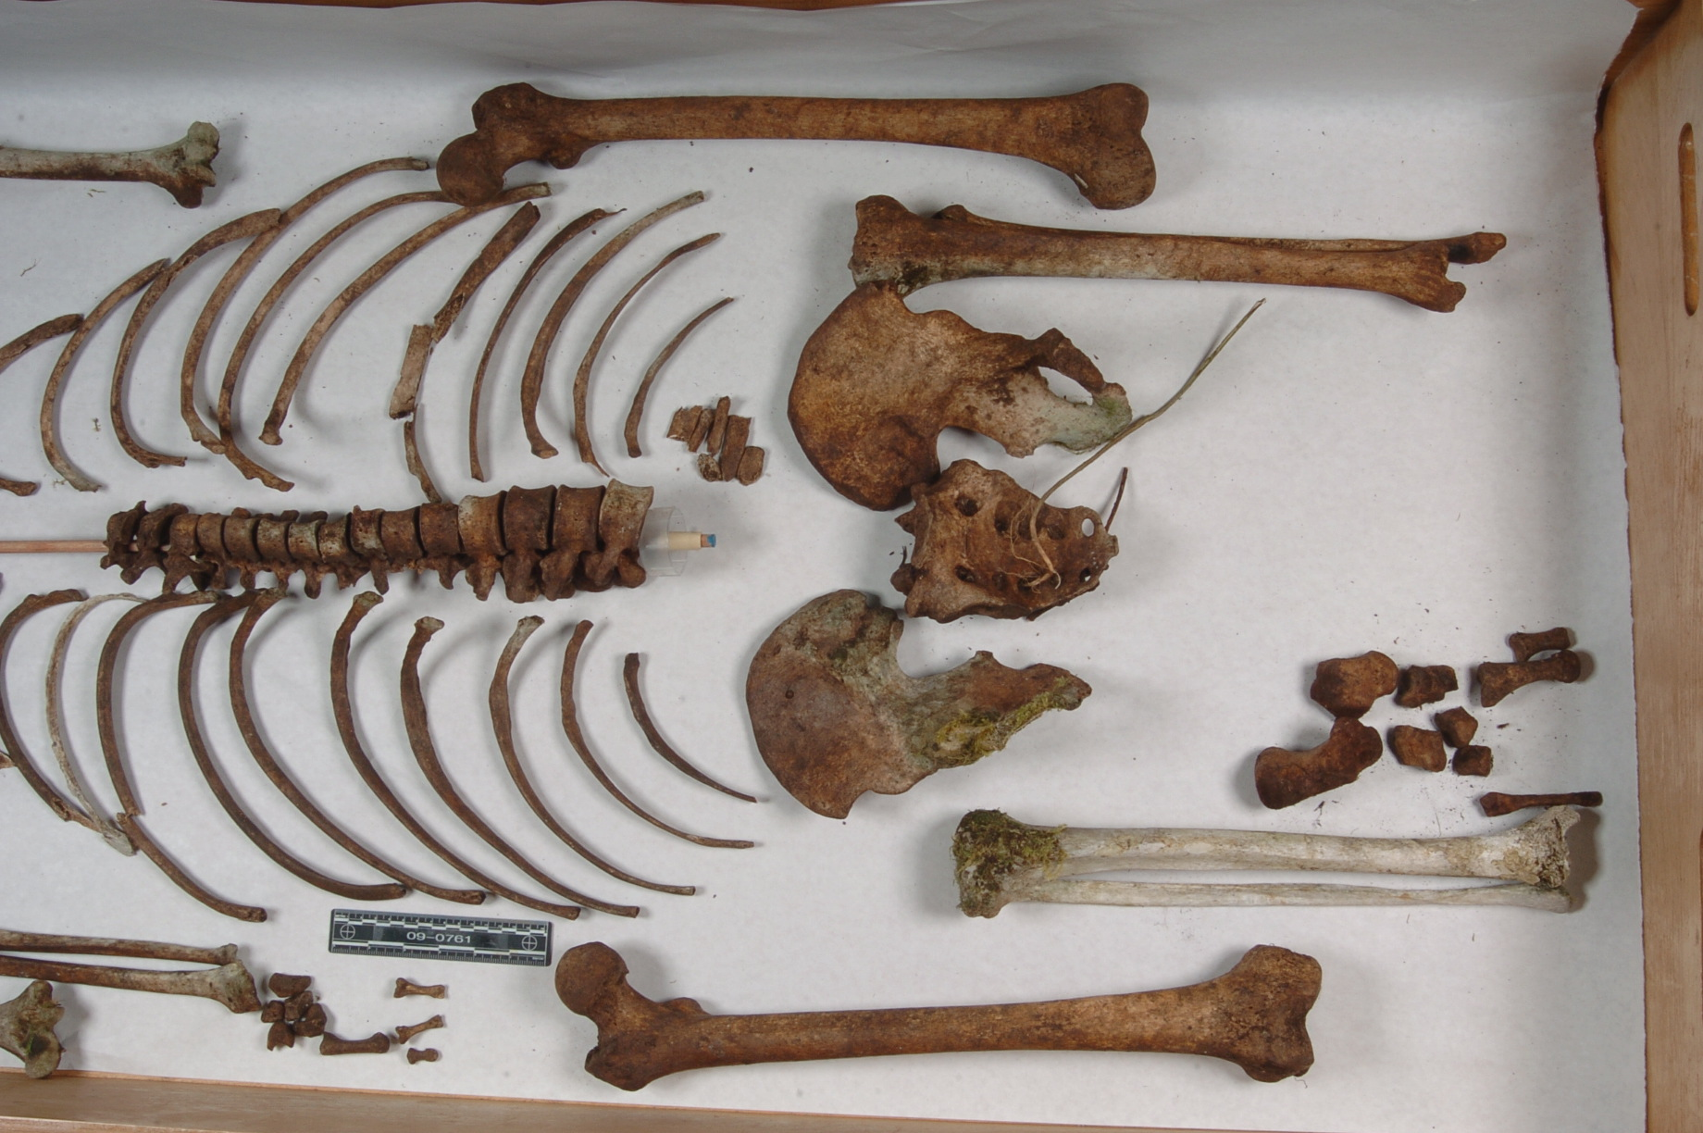
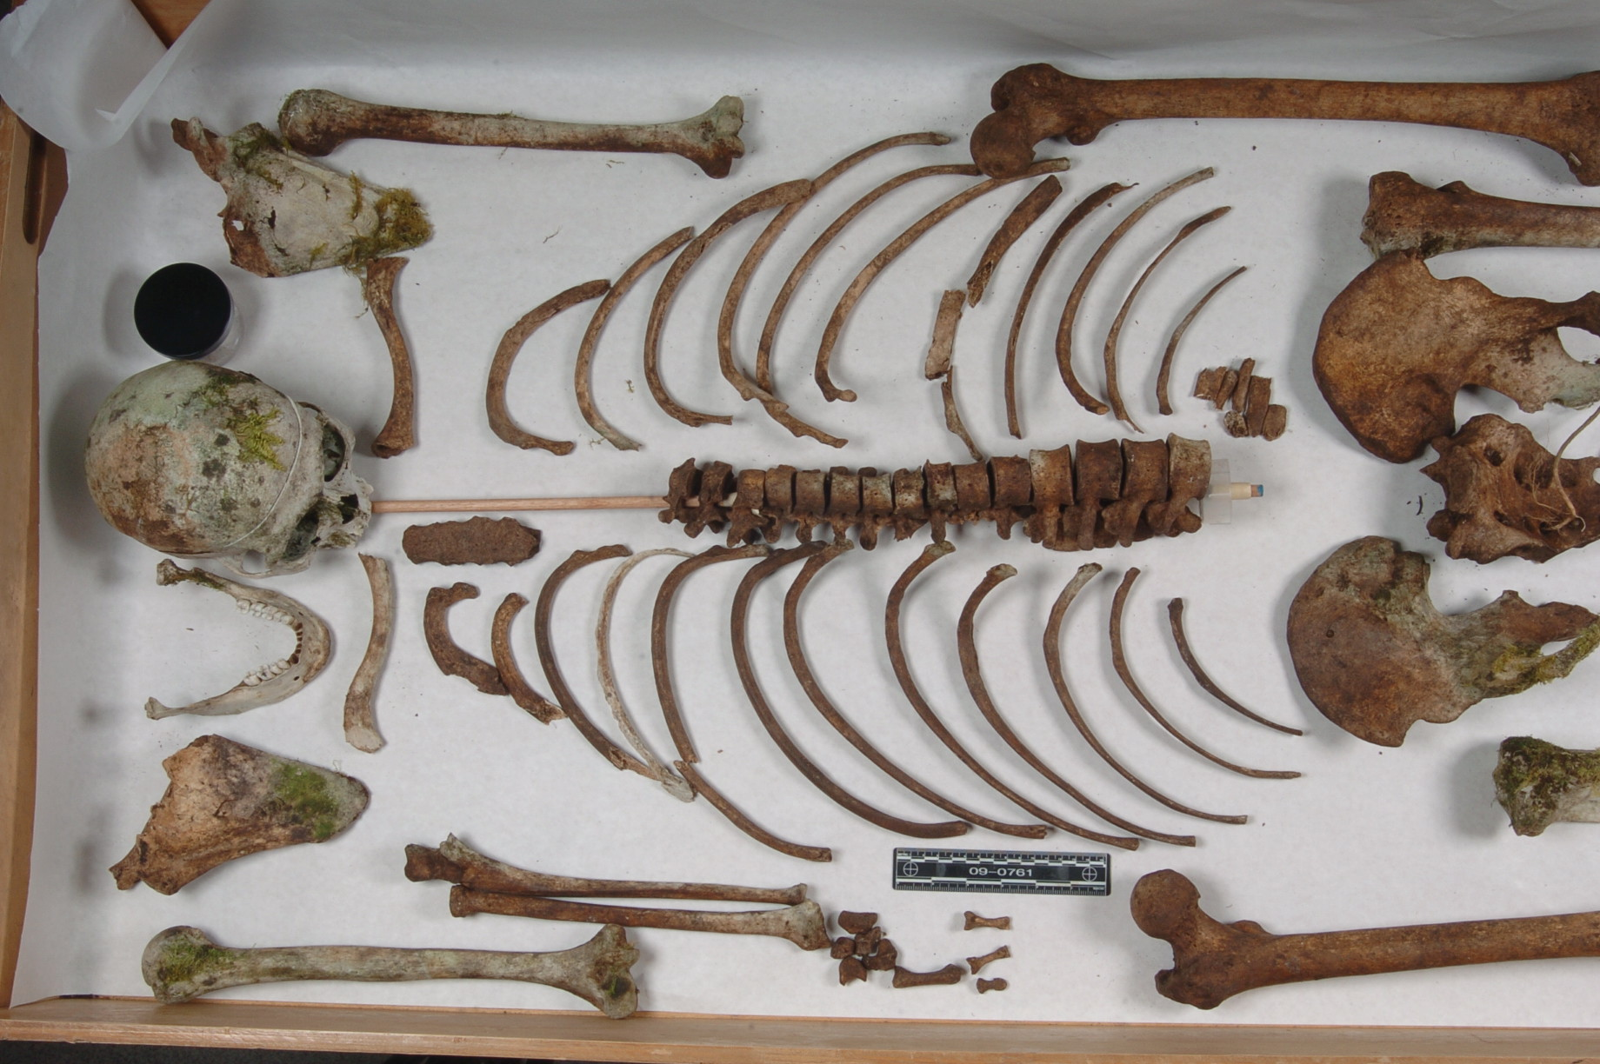
Case from Thurston County Coroner’s Office

Slide 33
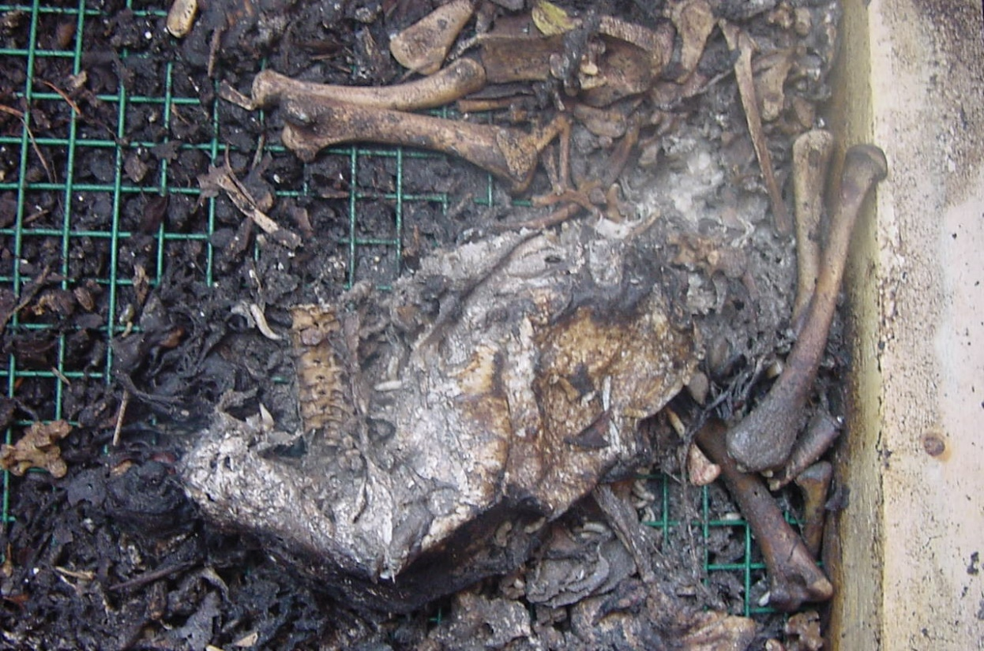
Now the chicken is nothing but bones in your body farm
Send an entomologist outside to gather part of the chicken to increase your inventory for labs
What ever he or she brings in, put it under a dissecting microscope and have the students draw what they see
What stage of decomposition is the chicken in?

Slide 34
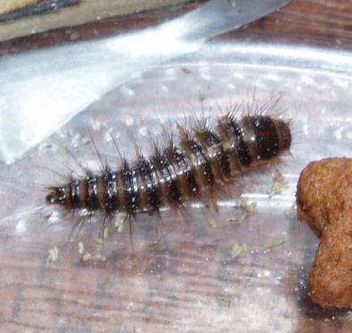
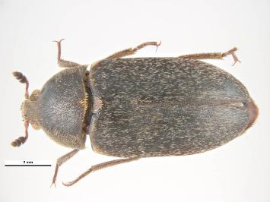
Forensic Entomology—skeletal
Last succession of insects—beetles, some flies
  body is dry, skeletonized, with no fluids
  Dermestes beetle, larvae left, adult right

Slide 35
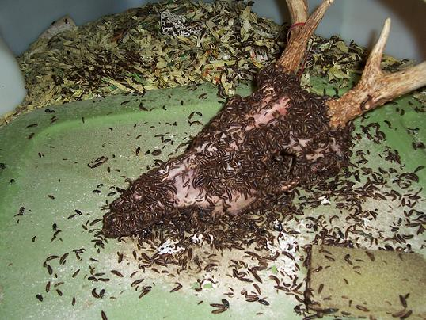
Dermestid beetles cleaning an animal skull

Slide 36
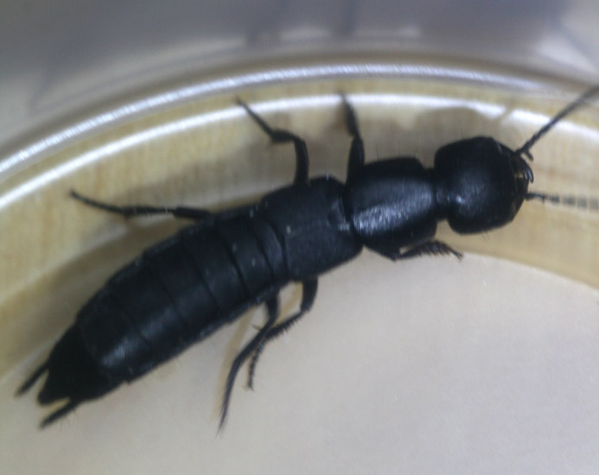
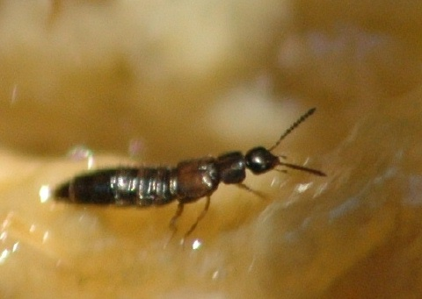
Rove beetles
Very small to very large, ranging from 1-35 mm
Associated with carrion

Slide 37
Skeletal Taphonomy—calculating time interval since death
You can use the bones from your chicken farm for a lab
Calculations for time interval since death are determined using the formula derived by Arpad Vass
Days it takes for a body to decompose completely to skeletal remains is determined by Y=1285/X, where X is the temperature in Celcius
  So if a body was found in early August, and the average temperature of July is 28 C, then the number of days it took the body to decompose is
    Y= 1285/28 C = 46 days.

Slide 38
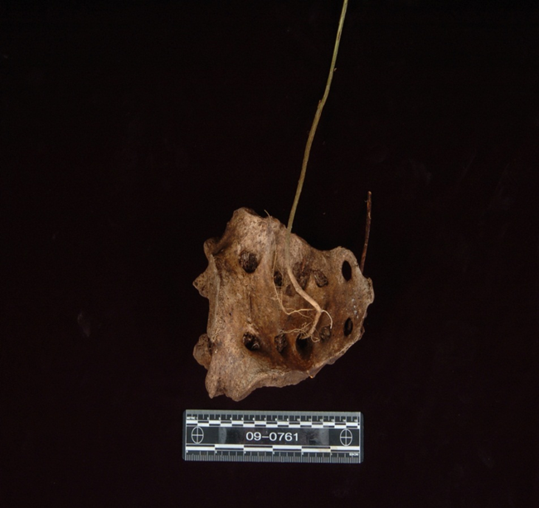
Forensic taphonomy: How long was the body there?
Are there leaves covering body?
What do the bones look like?
  Are they greasy?
  Partially decomposed?
  Skin dry?

Slide 39
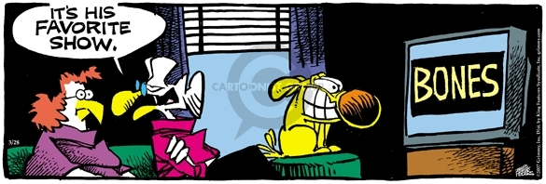
Anthropology answers who was this person?

Slide 40
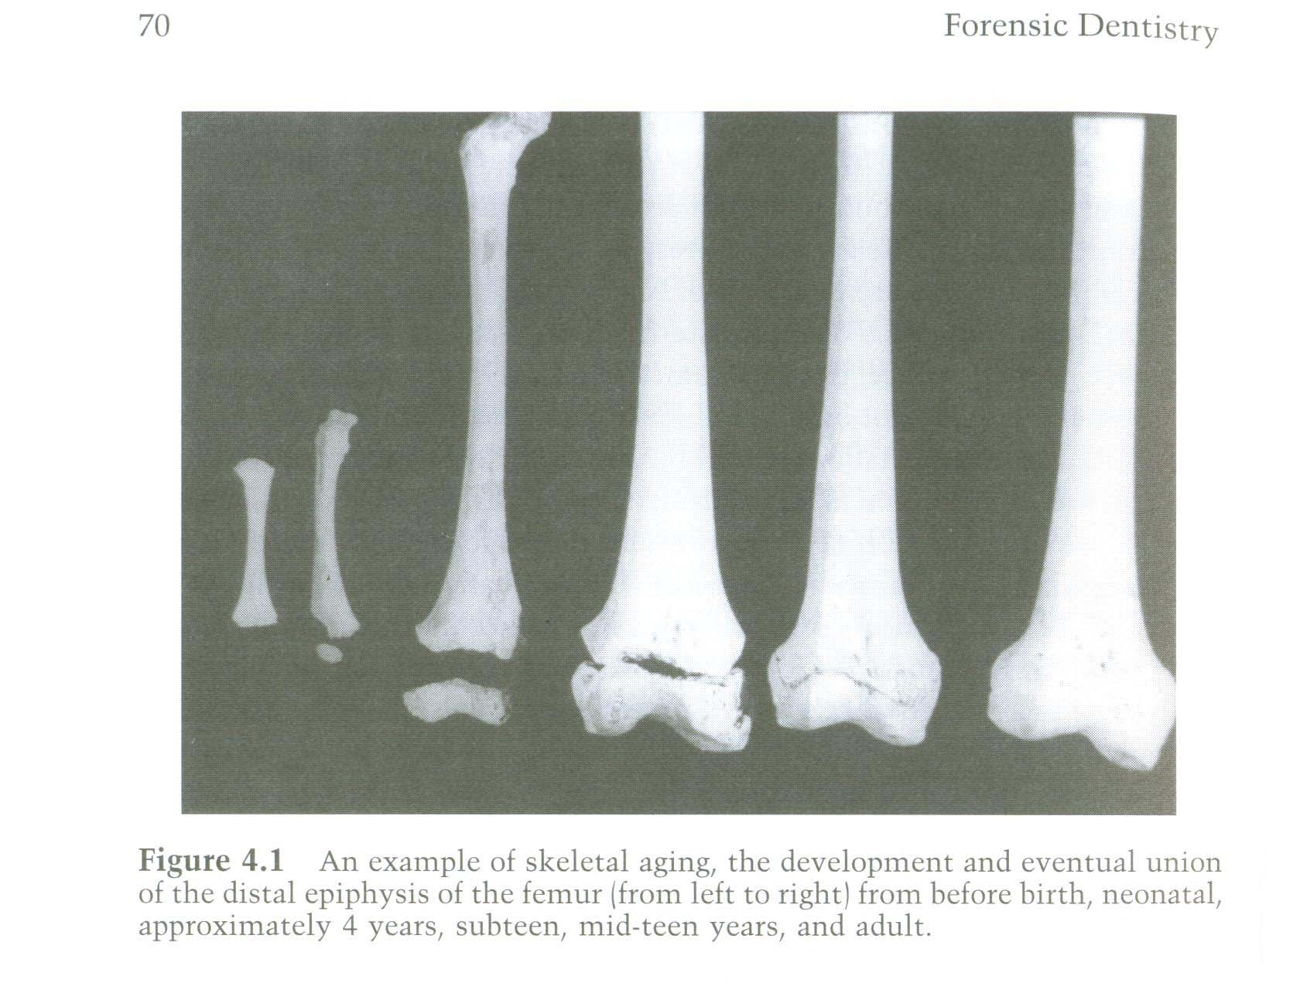
Aging bones using epiphyses

Slide 41
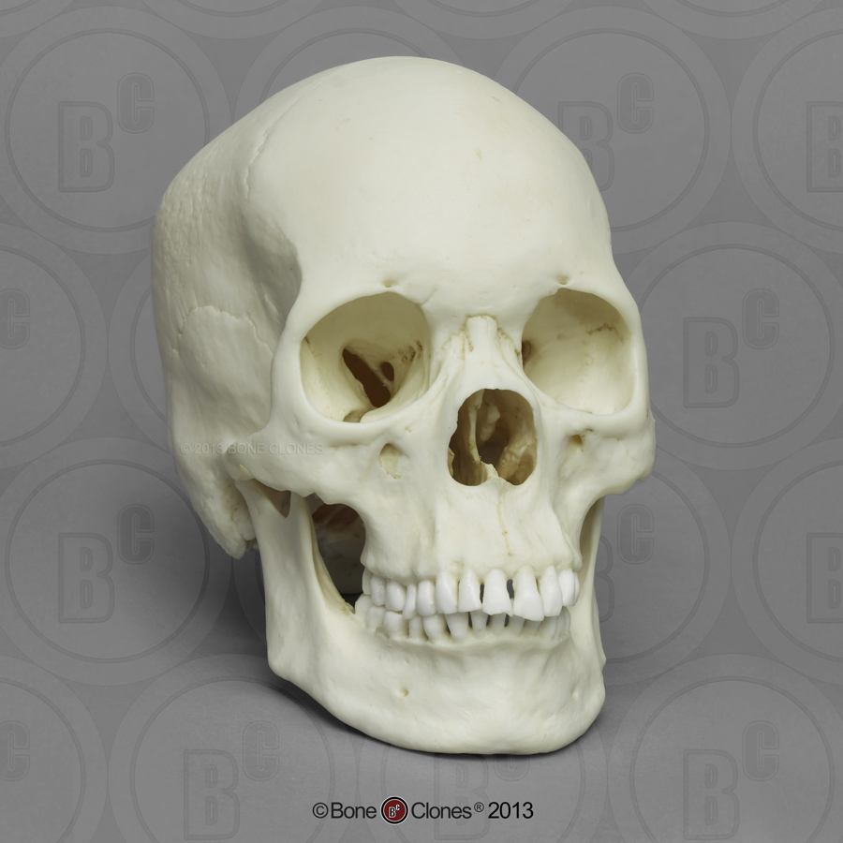
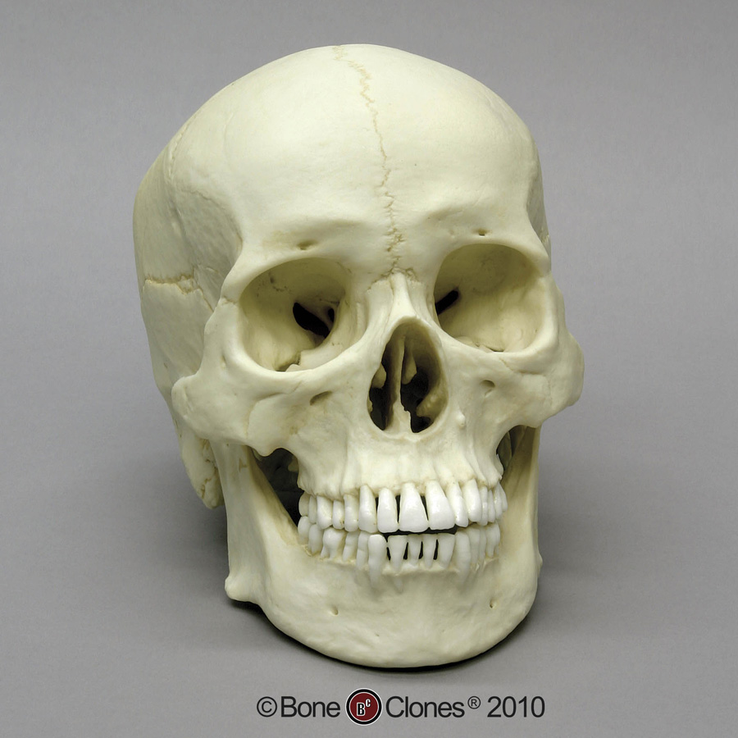
Supra-orbital margin—sharp in females
Supra-orbital ridges are large in males
Supra-orbit margin—rounded in males
Male
Pointed chin in females
Flared mandible in males
Female
Broad or squared chin in males
Male

Slide 42
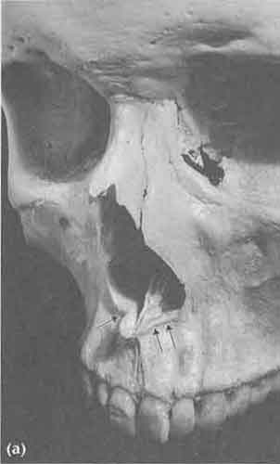
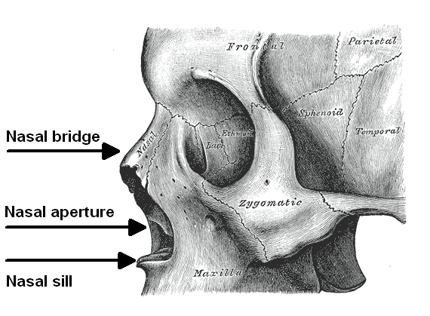
Determining ancestry or ethnicity
Check for a sharp nasal sill by taking your fingernail and going under the nasal sill. If there is a “lip” that stops your nail, the nasal sill is sharp.
large nasal spine with sharp sill found in white skulls

Slide 43
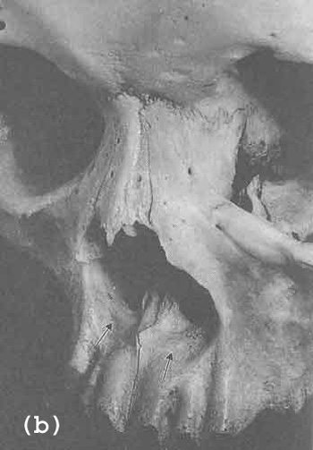
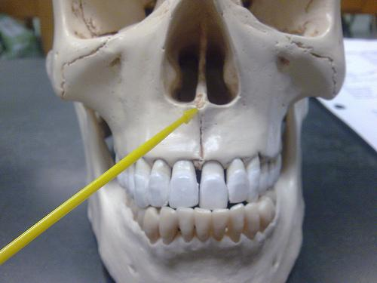
Determining ancestry or ethnicity
flat sill found in Asians
guttered lower border in black skulls

Slide 44
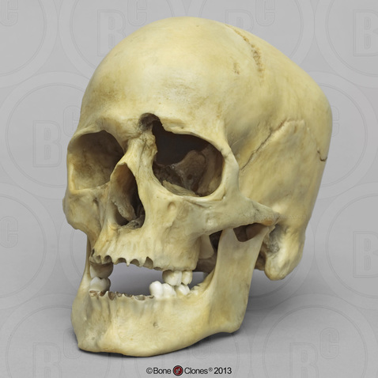
Forensic pathology—what is the cause and manner of death of the person?
Unfortunately with just one bullet wound it is difficult to determine MANNER of death
What could it be?
This CAUSE of death is easy to determine but many skeletal cases are UNDETERMINED for both CAUSE and MANNER OF DEATH

Slide 45
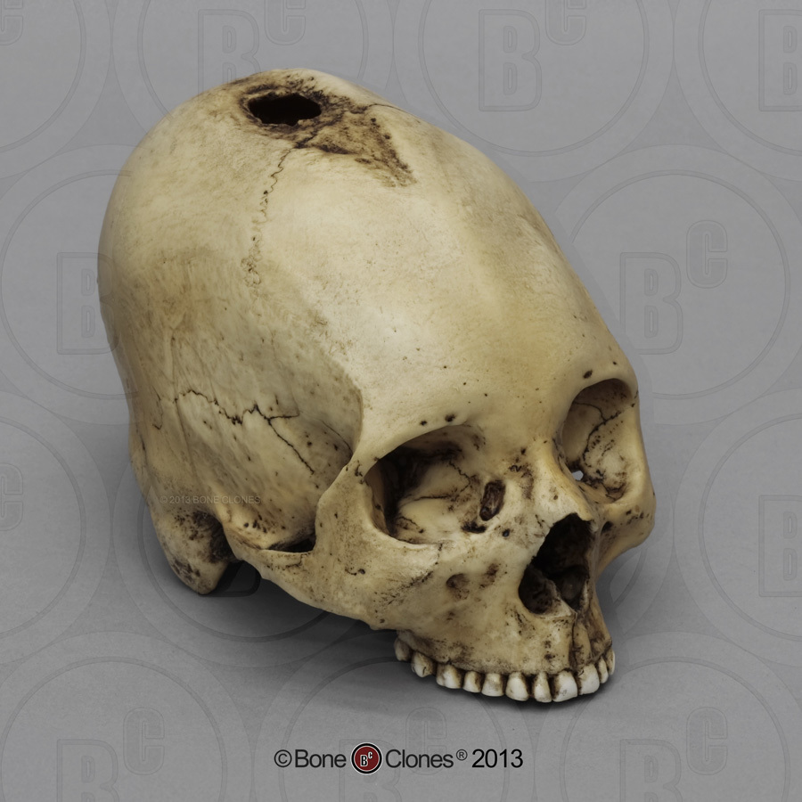
When did the trauma to the bone happen? Antemortem—before death
Antemortem wounds show smoothed edges from HEALING

Slide 46
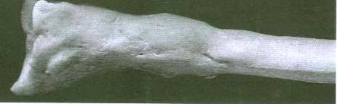
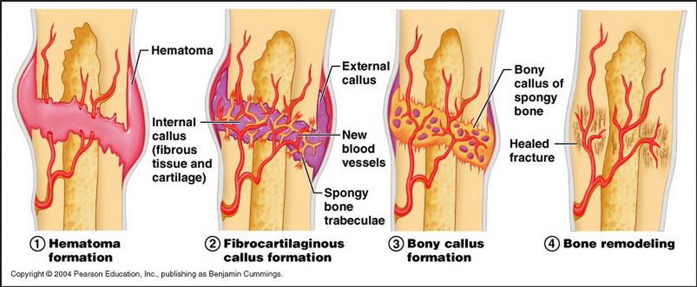
Antemortem trauma on bones show smooth, raised areas called calluses

Slide 47
Antemortem vs perimortem wounds
A person has to be alive to heal!
If there is healing to the wound, the injury did not necessarily cause death and person lived—antemortem wound
If there is no healing, then person might have died from injury and it is an perimortem wound

Slide 48
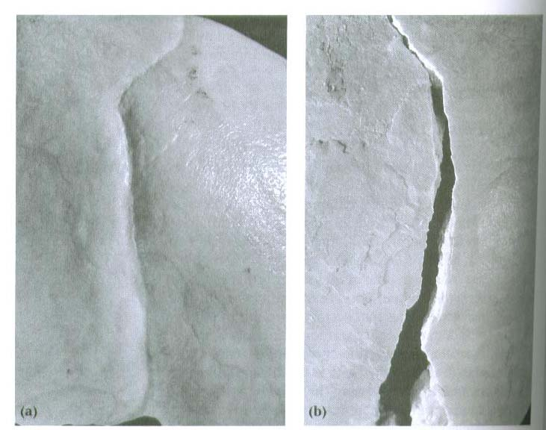
antemortem vs Perimortem
Slide on the left is from a antemortem trauma which did NOT cause death since there is healing
Slide on the right has sharp edges and from perimortem wound that probably caused death since there is NO healing shown

Slide 49
Be careful judging the wound that killed….
You cannot know absolutely that the perimortem wound you see was the wound that killed the person despite the lack of healing
Remember with skeletal material, you only have part of the picture since you do not have fresh tissue in which to discern more injuries
A person could die from a massive heart attack while driving, crash their car, sustain multiple fractures and look like they died from blunt force trauma

Slide 50
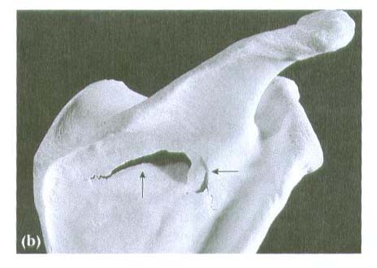
Perimortem wounds vs Postmortem wounds
B) Wounds to fresh bones can result in hinged fractures where part of the bone is still attached
Distinguished from old bones because they are brittle and area would just break away (postmortem)
Hinge fracture

Slide 51
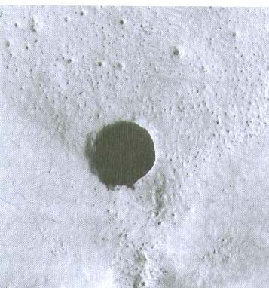
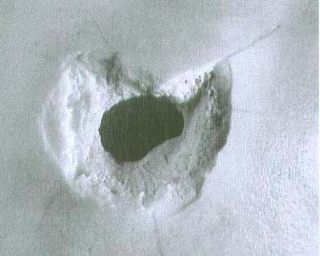
Gunshot wounds
The entrance wound of a cranial gunshot is beveled internally, while the exit wound is beveled externally.
entrance
Exit

Slide 52
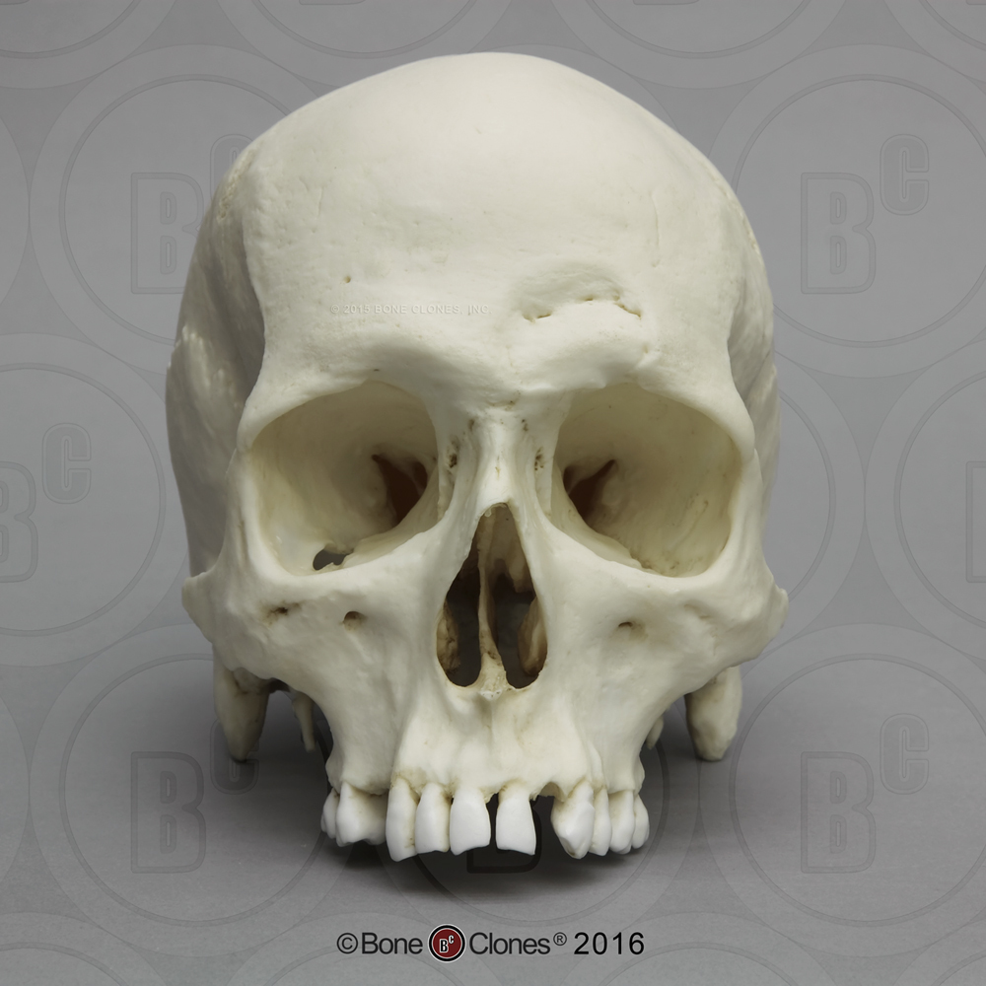
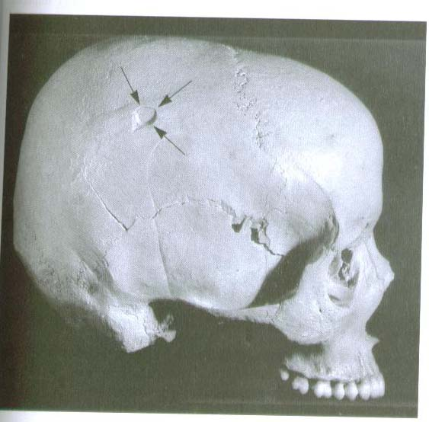
Hammer head wounds: antemortem versus perimortem
Antemortem: shows healing
Perimortem: No healing

Slide 53
Warnings
Be aware, bone does not accurately tell you the caliber of the projectile.
The diameter of the wound may be larger due to the angle of entry, chipping of the bone edges.
It could be smaller due to the shrinkage of the bone during drying.

Slide 54
Cavitation
This rapid expansion of air is known as cavitation. The shock wave from a bullet from a high-powered or high-velocity weapon like a rifle pushes a chamber of air in front of it which causes the massive holes. Usually the bullet doesn’t hit the bone at all but the cavitation does all the massive damage.

Slide 55


Slide 56

Cavitation from a shotgun blast creates a huge hole

Slide 57
Final for Skeletal Remains
Students are put in groups with a pathologist, photographer, taphonomist, entomologist, and anthropologist. The anthropologist gives everyone an anthropology job since they are numerous
Each group gets to collect a box of bones from outside after they have measured the scene and taking pictures
Case reports are required

Slide 58
Questions?

