Slide 1
Hands on Projects for Sports Medicine Classes
Presented by: Courtney Peart, MA, LAT, ATC & Stefanie Brophy MEd, ATC, AT/L

Slide 2
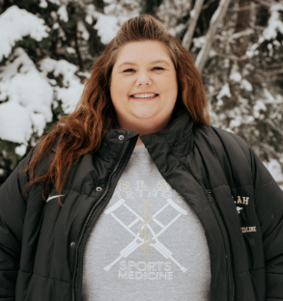
Bio
My name is Courtney Peart. I am a certified athletic trainer and CTE teacher at Selah High School. I currently teach PLTW's Principles of Biomedical Sciences, Medical Terminology, Intro to Medical Careers, Introduction to Sports Medicine & Advanced Sports Medicine. I have been with the Selah School District for 4 years and also serve as the high school's athletic trainer and the co-chair for the science department. I received my Bachelor's Degree in exercise physiology from Central Washington University and my Master's Degree in athletic training from University of Nebraska-Omaha. I currently serve as the Vice President for the HSCTE Board. In my spare time you can find me at a Sounders game or spending time with my family.

Slide 3
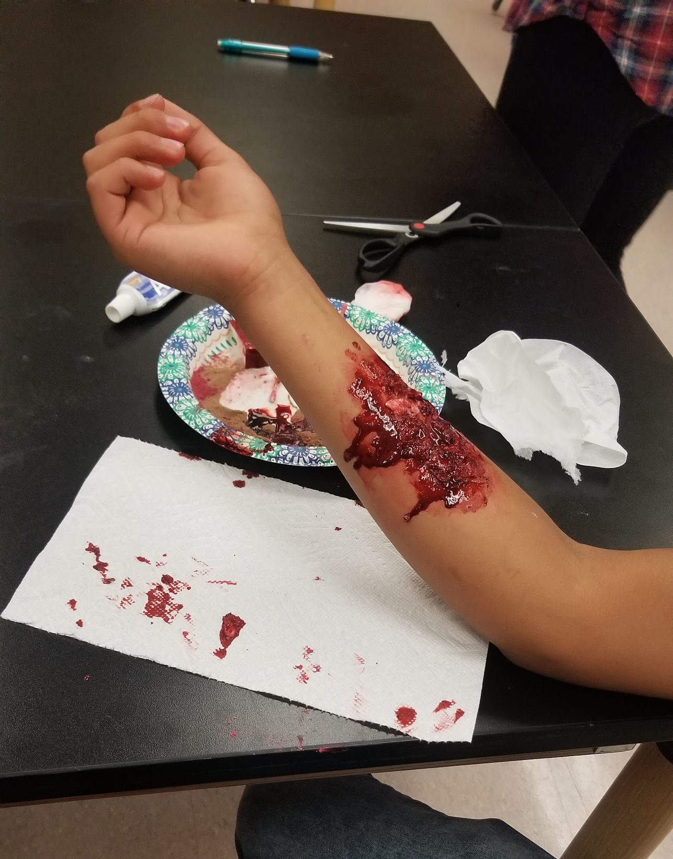
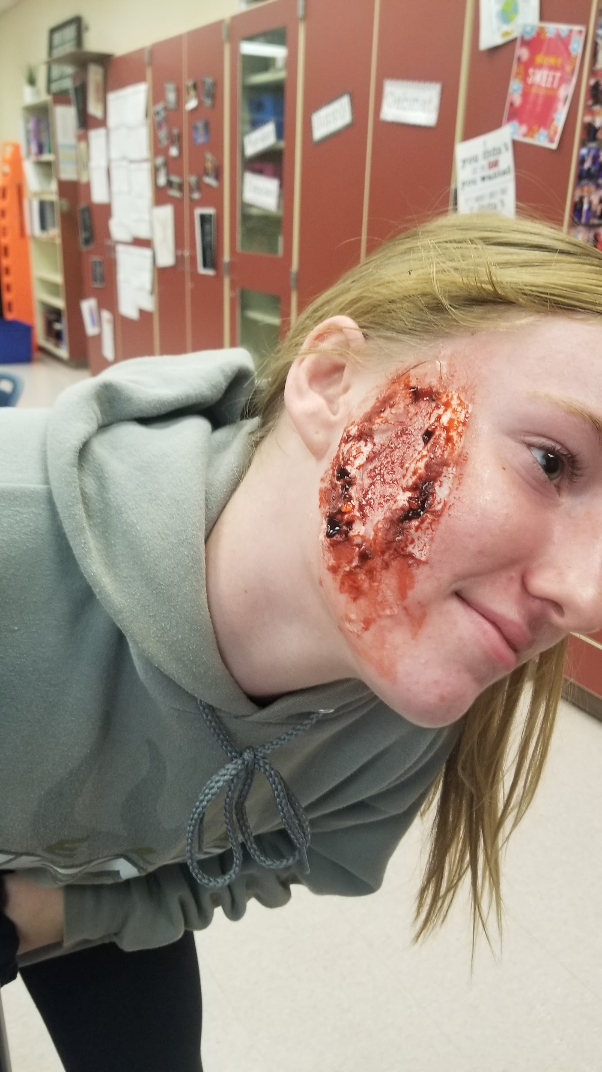
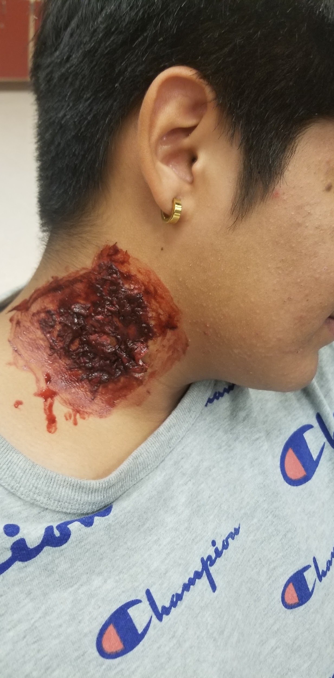
Grey’s Anatomy
Class Taught in: Intro to SM (could adapt to re-teach in Advanced SM)
When taught: I use it in my emergency care unit when teaching CPR & First Aid (due to lack of “practical” for first aid portion)
Time to complete: Two 55 minute class periods (in partners, each student has 1 day to complete their wound creation & the form that goes with it)

Slide 4
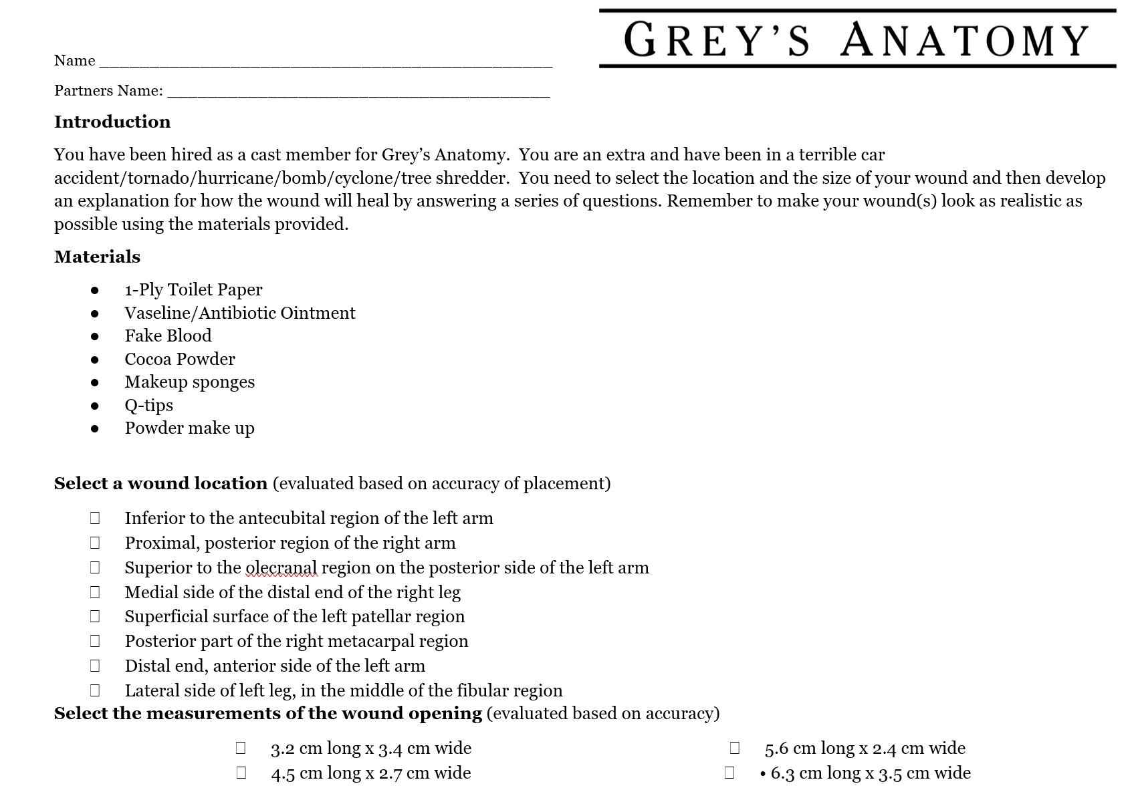
Grey’s Anatomy (cont).

Slide 6
Build A Spine
Class Taught in: Advanced Sports Med
When taught: I teach this after I teach spine anatomy
Time to complete: Three 55 minute class periods (could shorten). 1 day to plan/figure out materials needed, 2 days to build and label.
Walk-a-bout presentations at end of last day

Slide 7
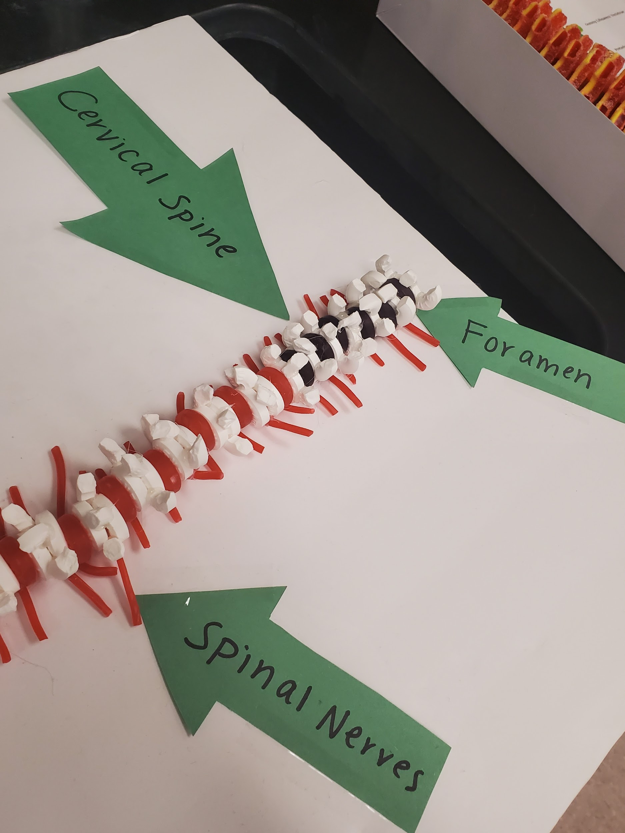
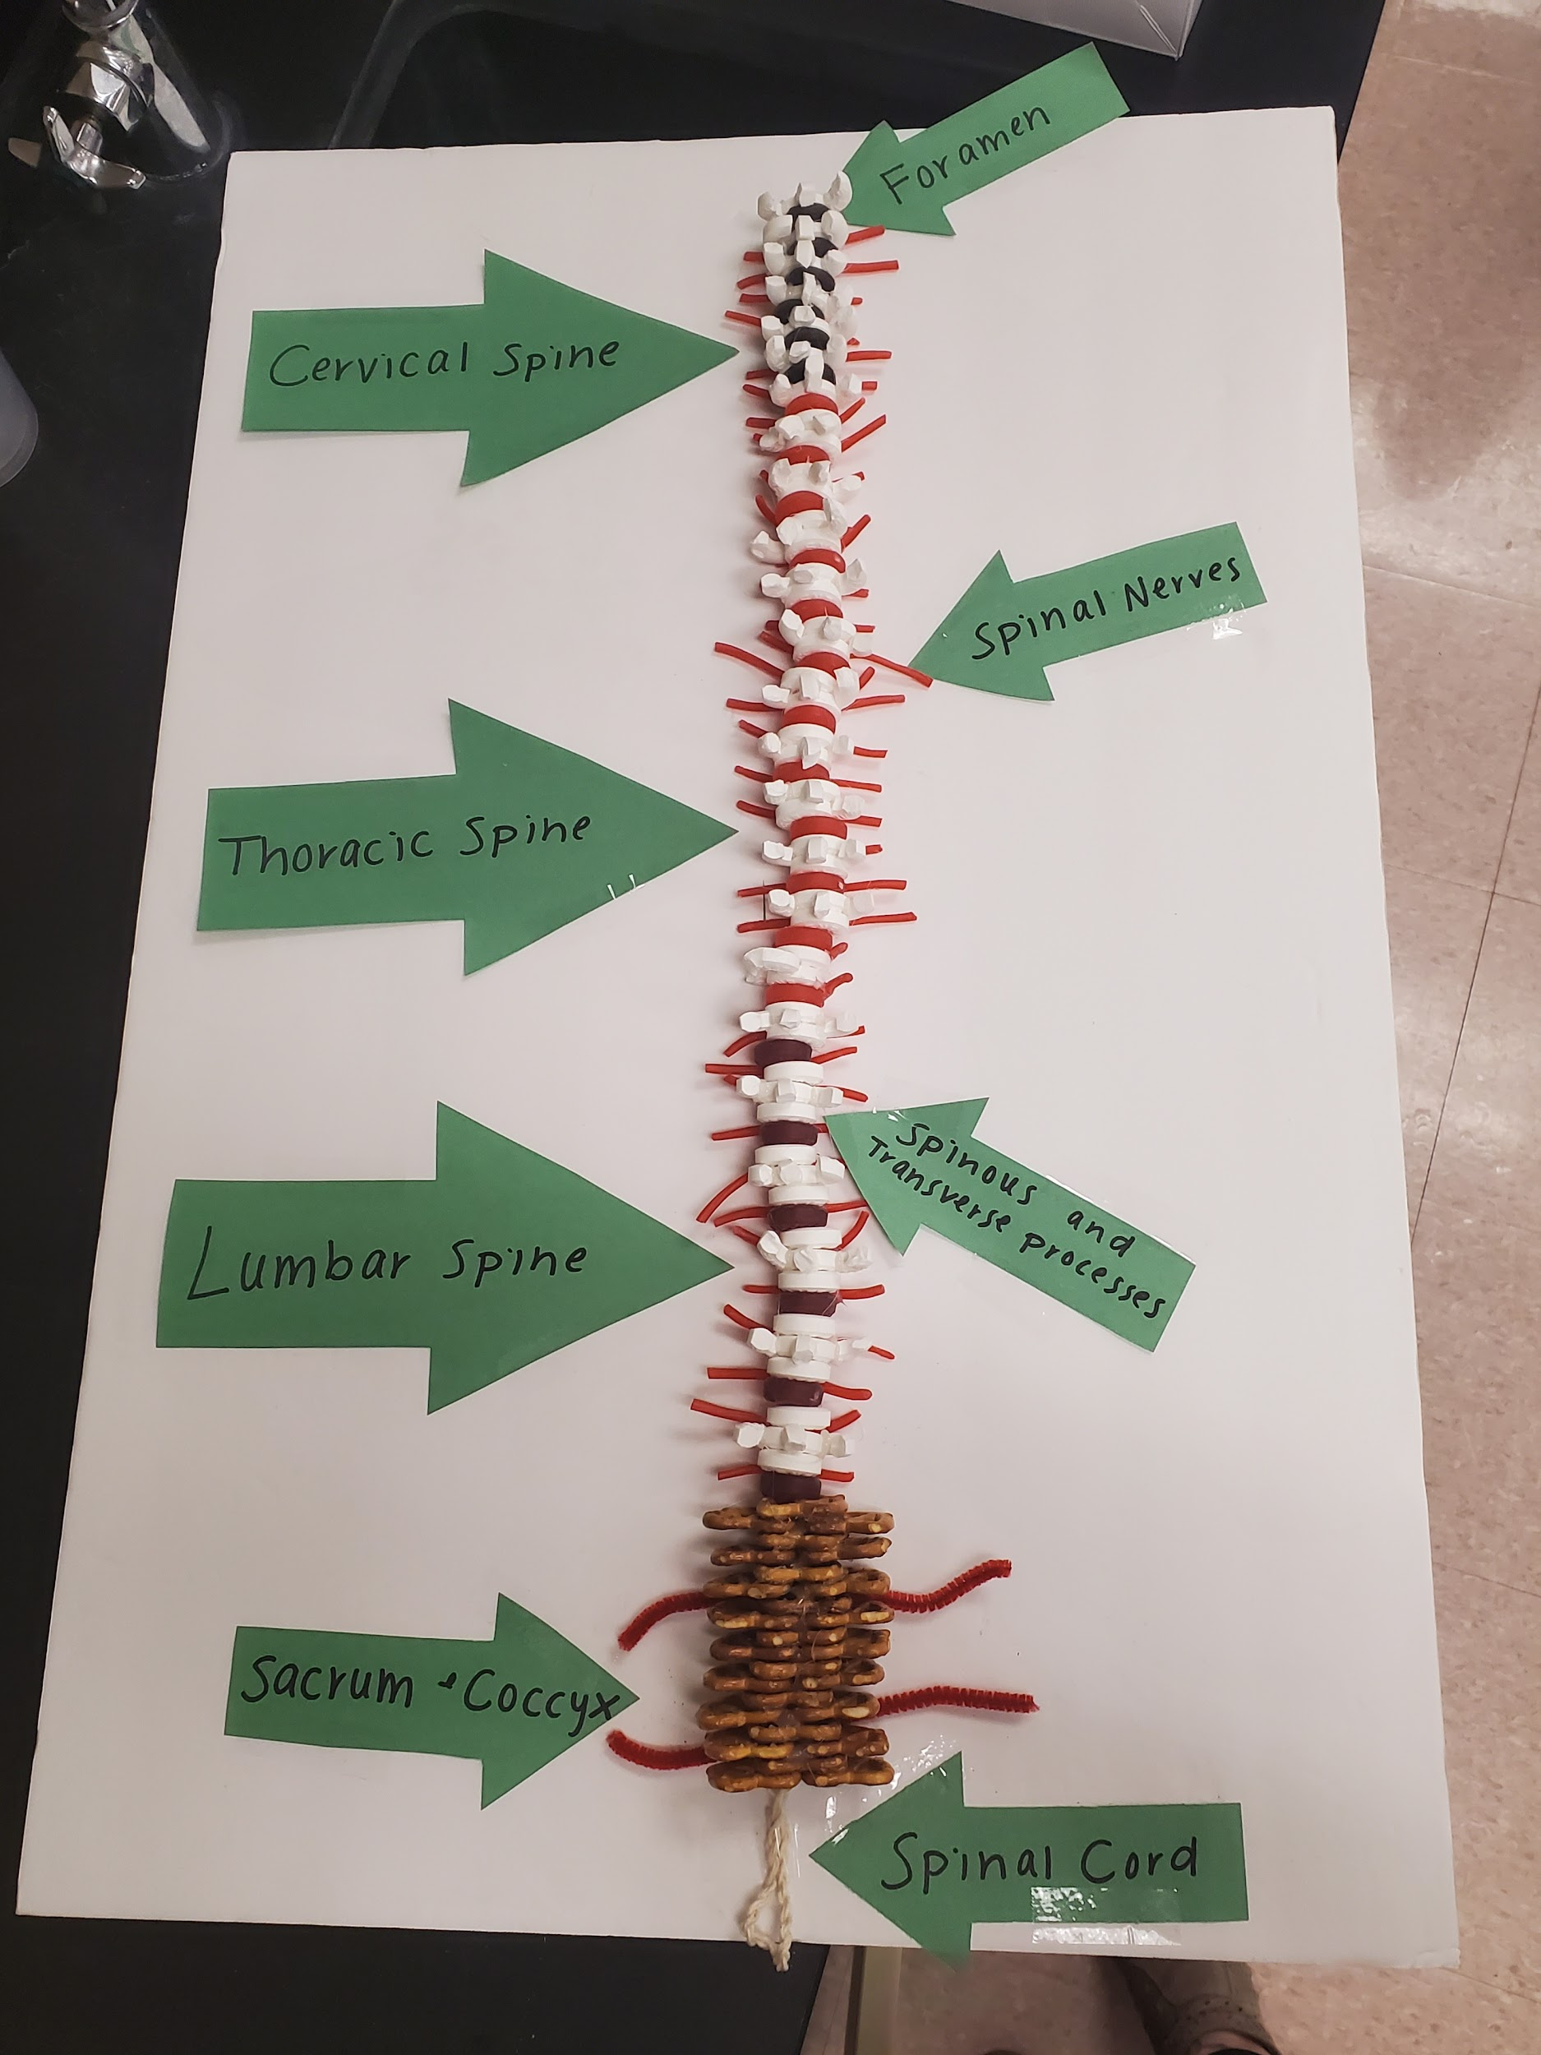
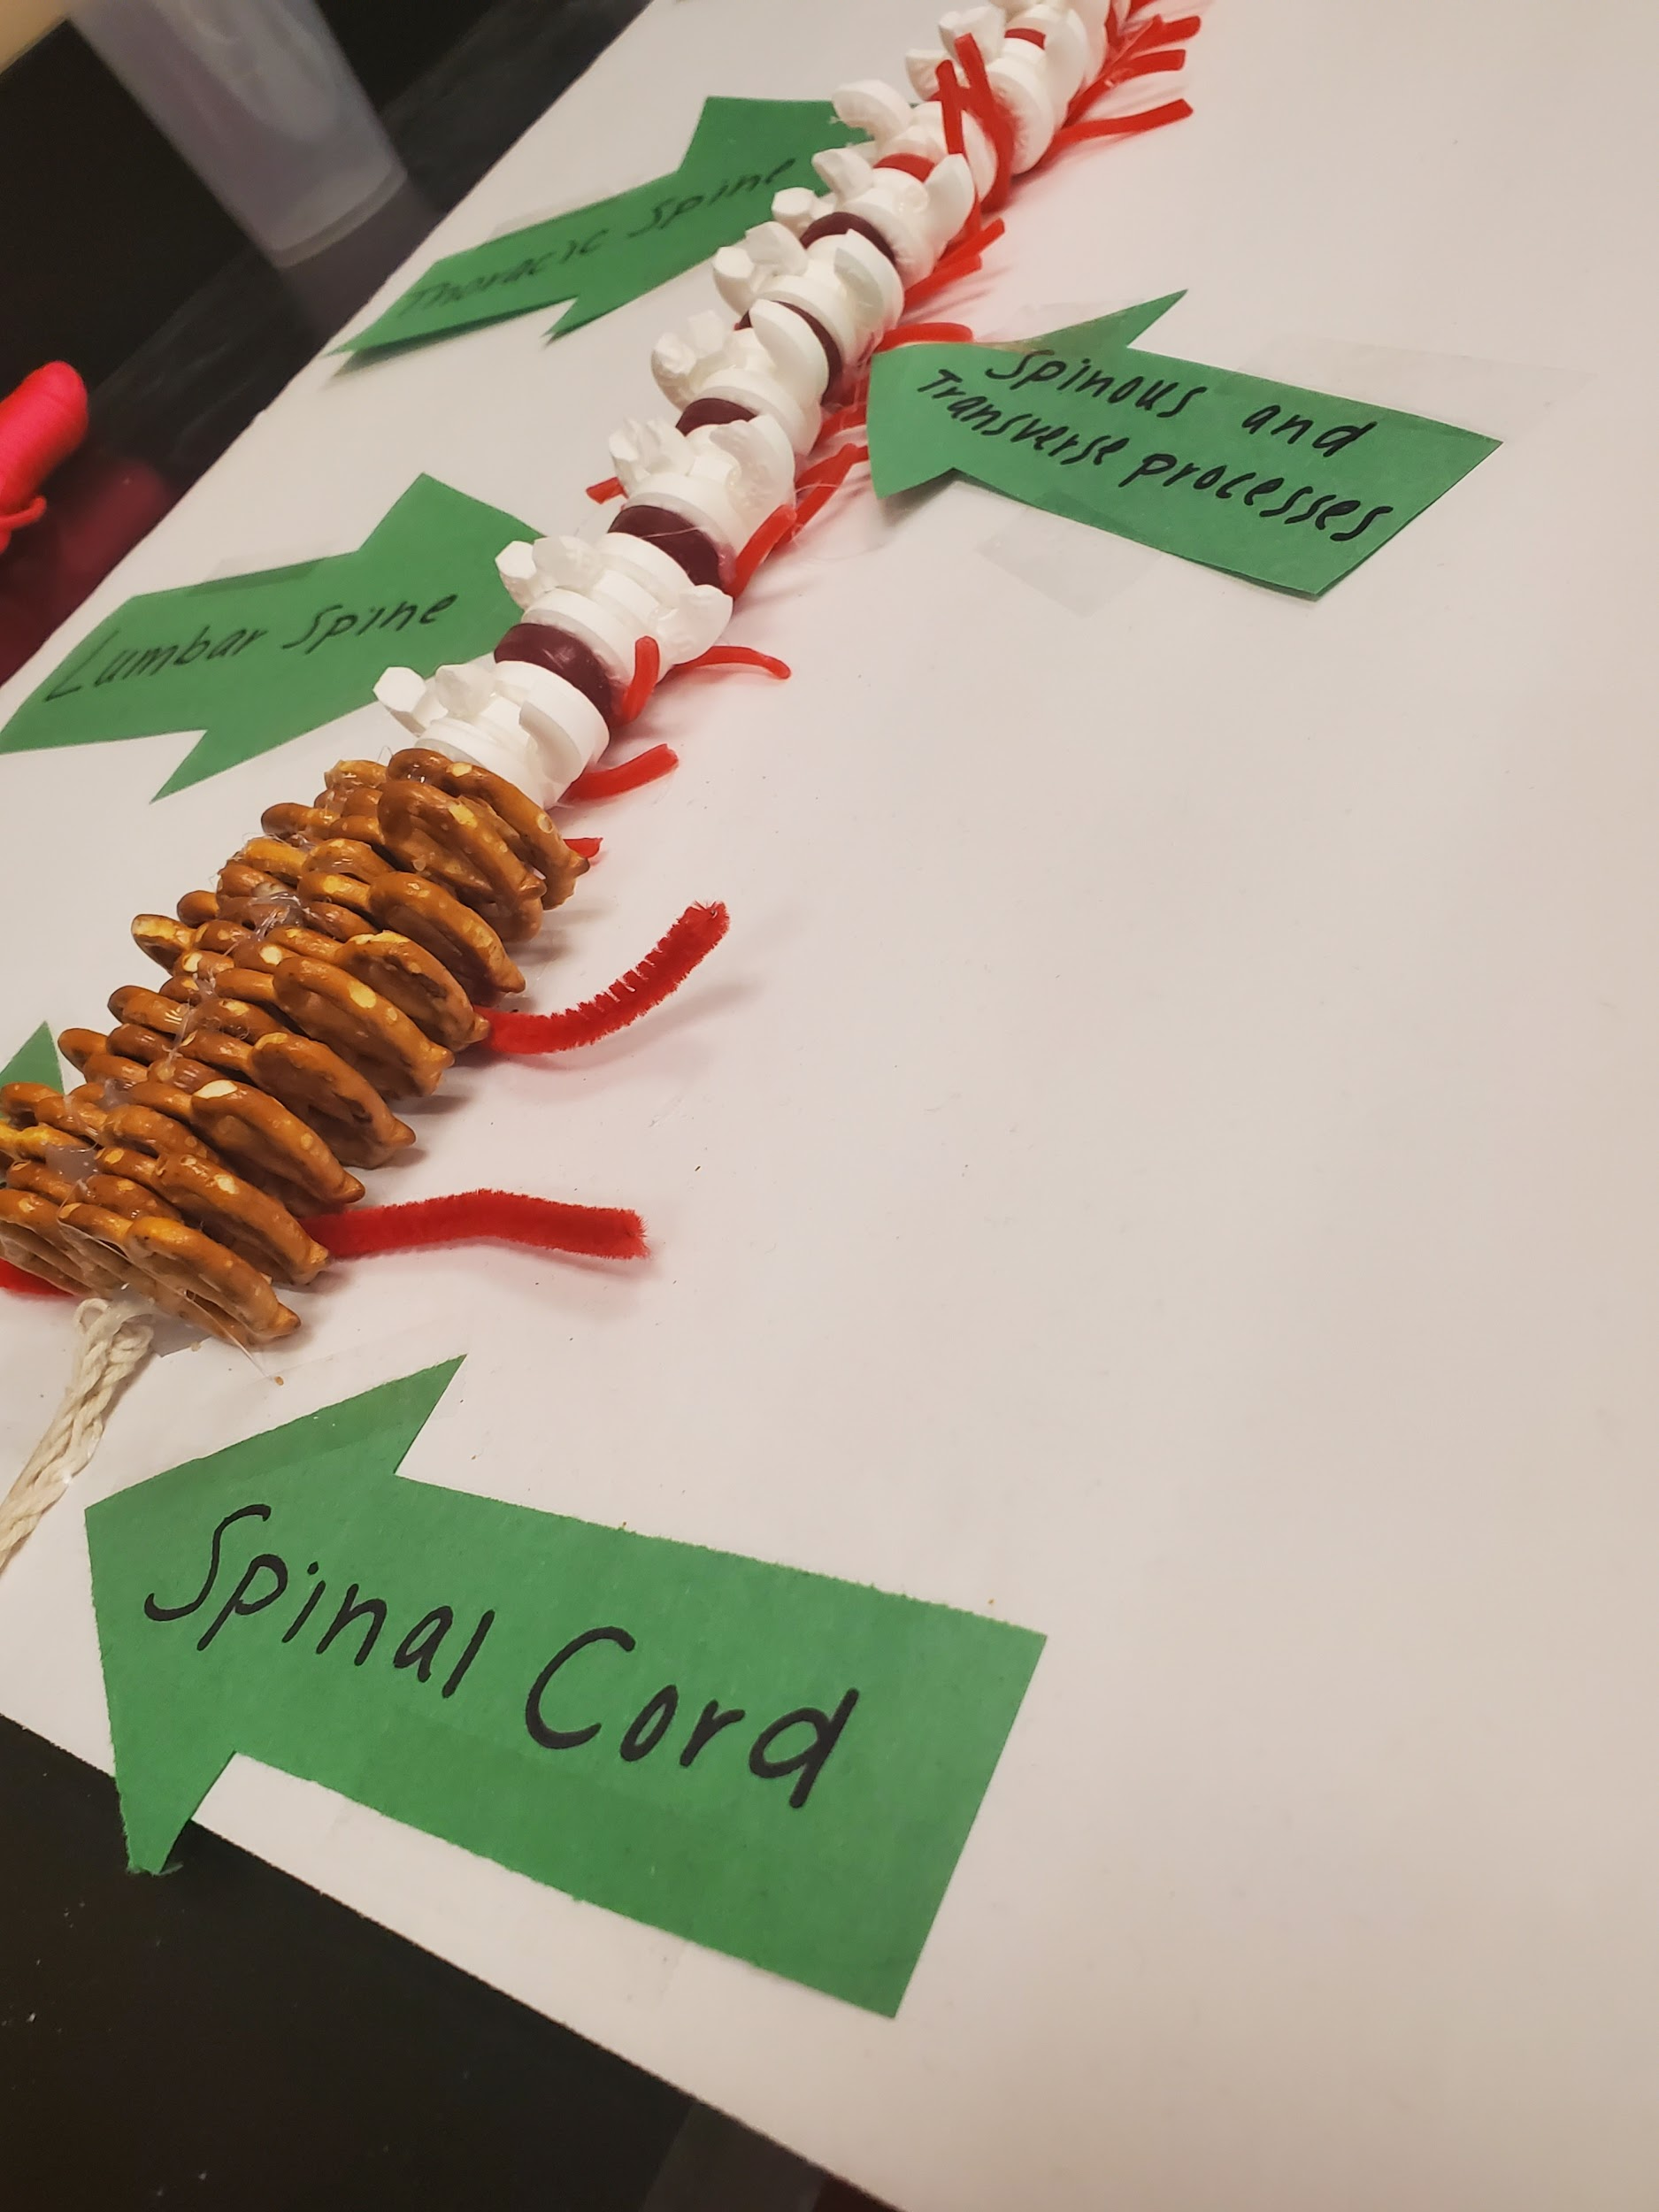

Slide 8
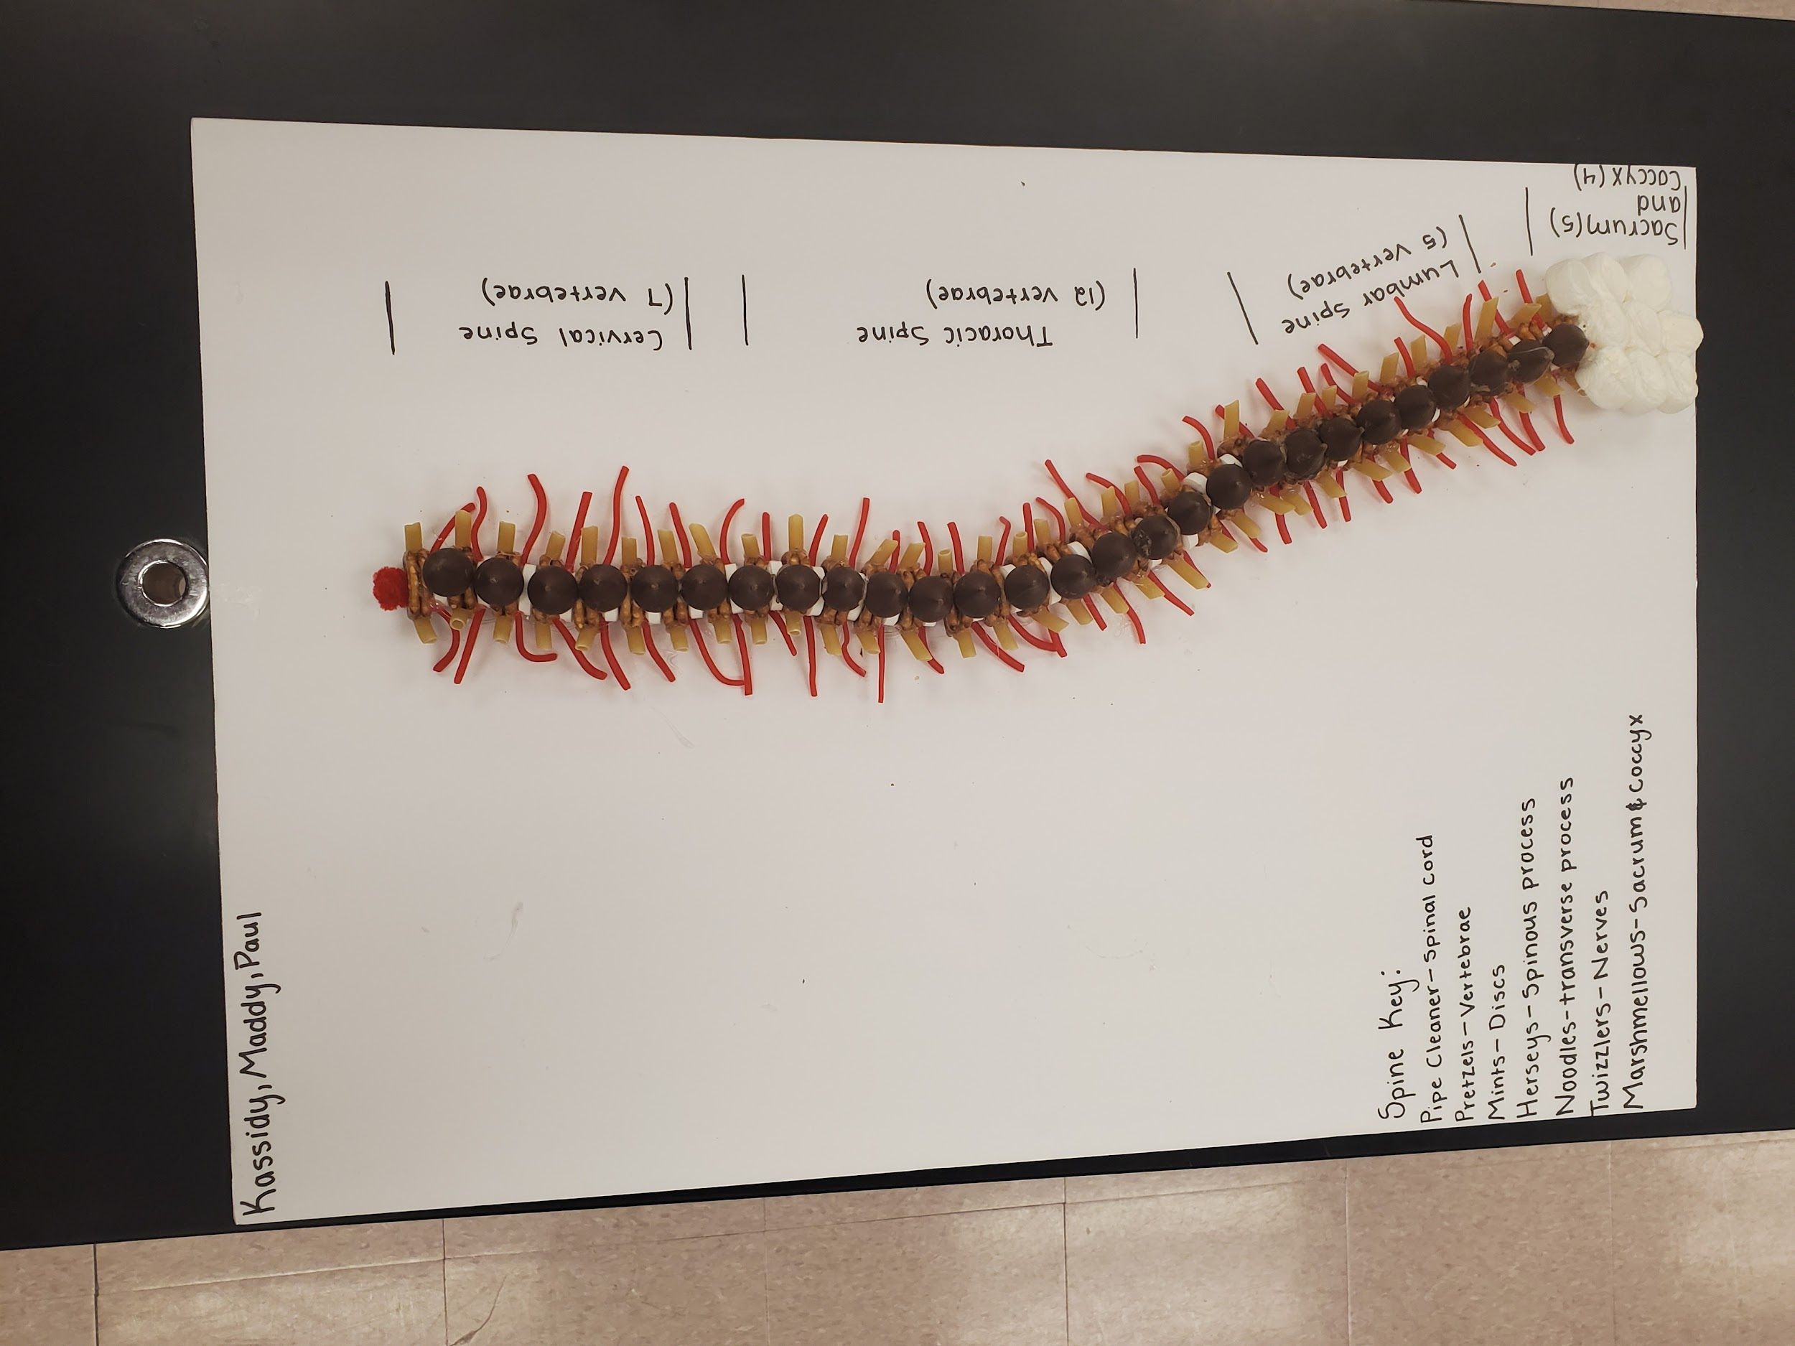
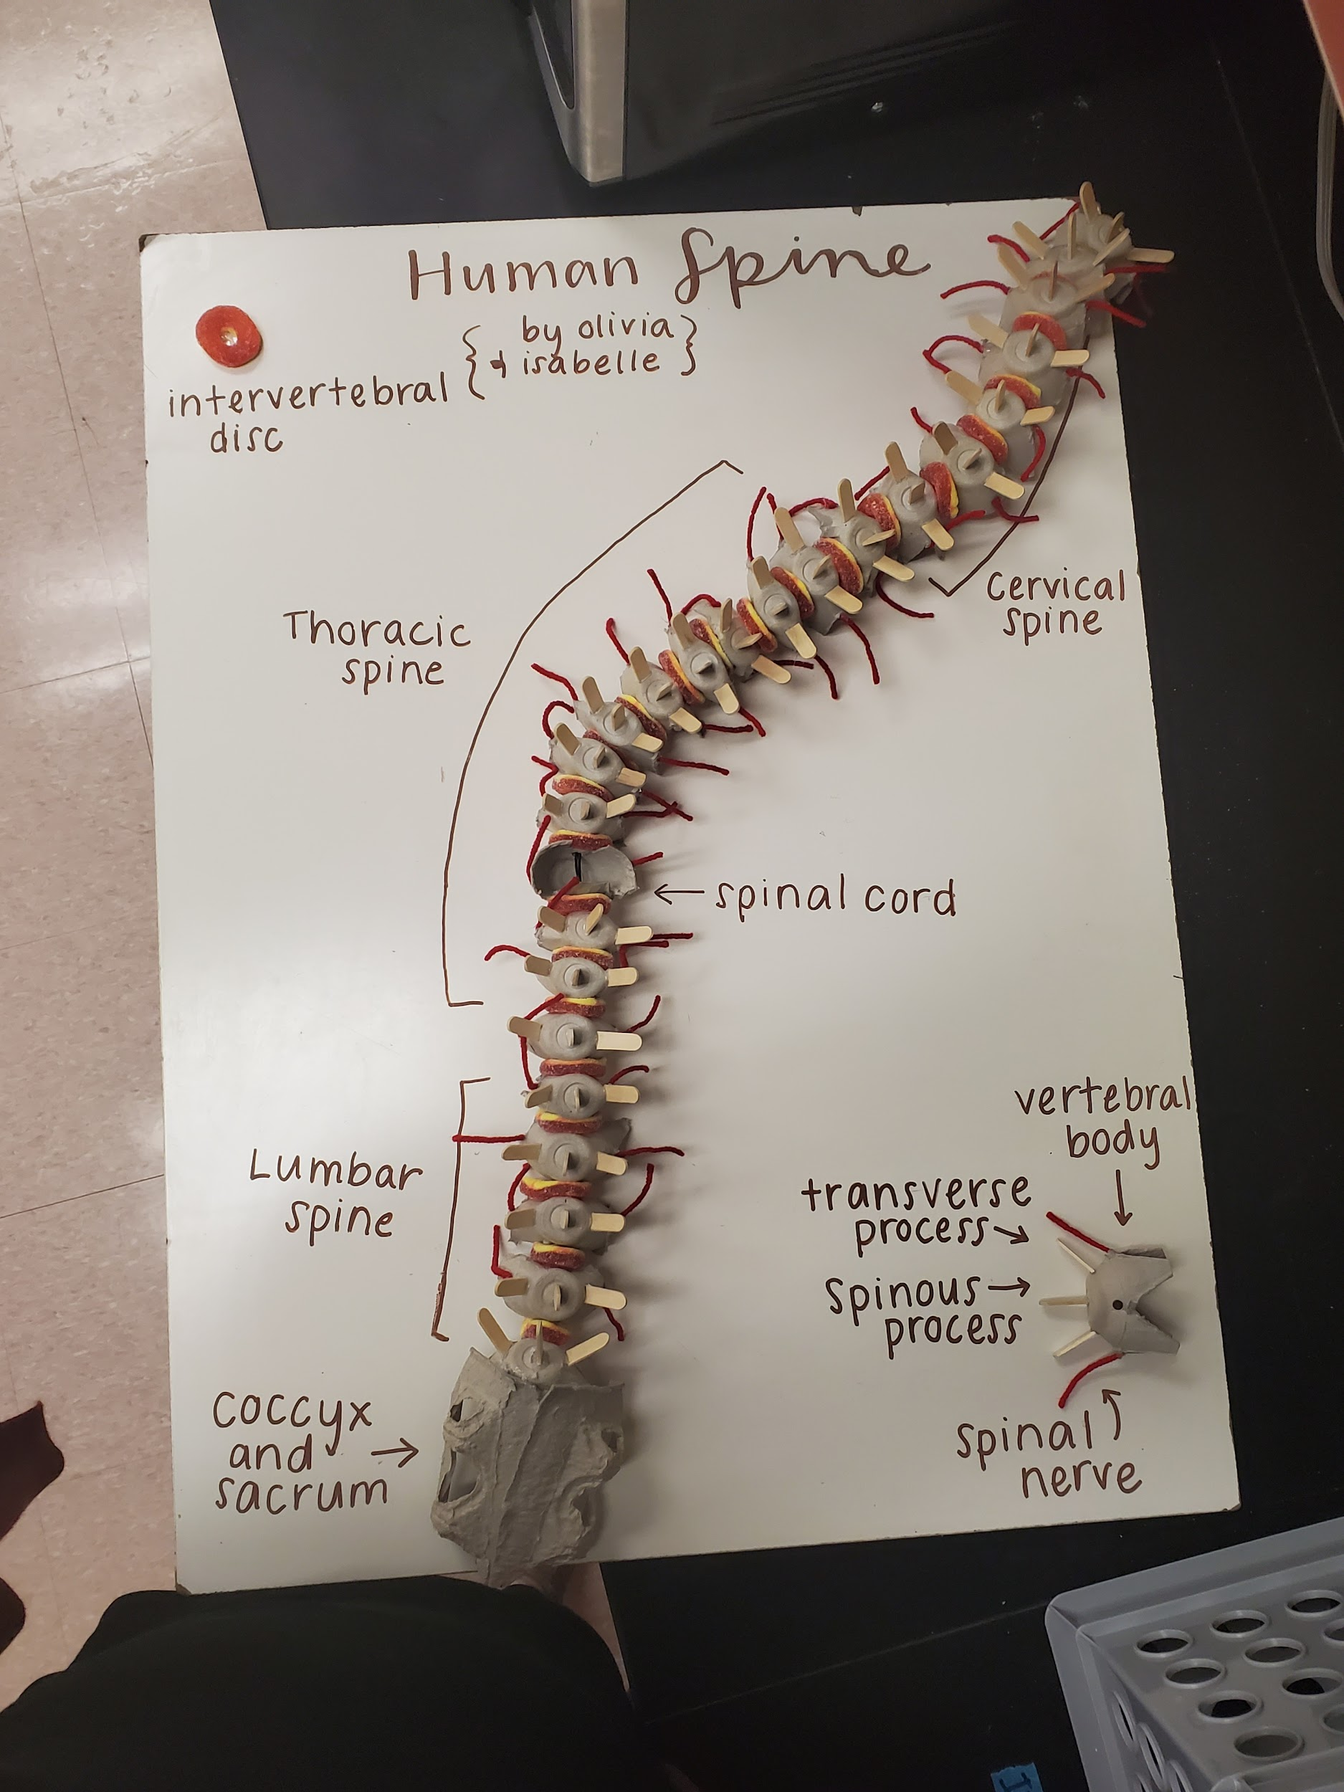
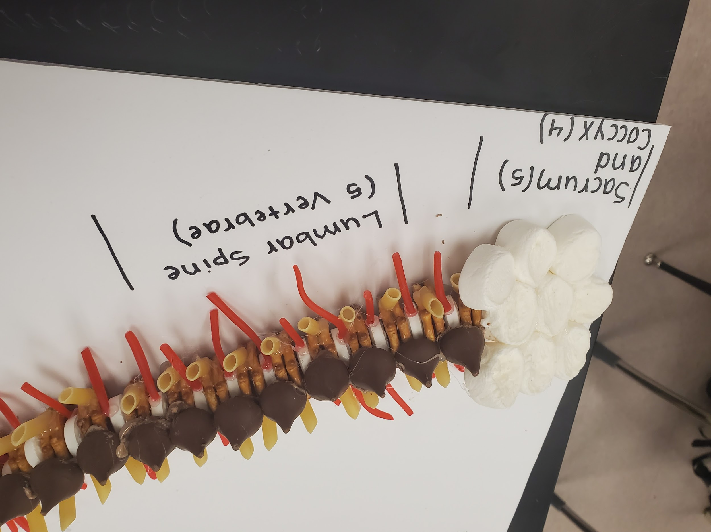

Slide 9
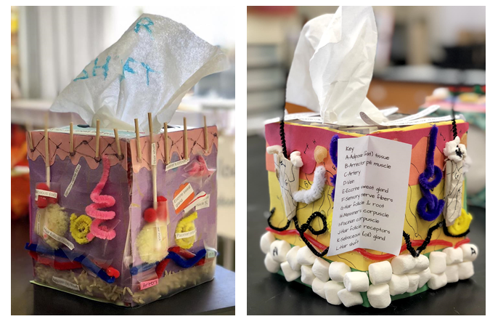
Skin Box
Class Taught in: Anatomy and/or Intro to Sports Medicine (body systems unit)
When taught: Integumentary system
Time to complete: Three 55 minute class periods (could shorten). 1 day to plan/figure out materials needed, 2 days to build and label.
Students also have to present their skin box to another teacher in the building & that teacher fills out a separate evaluation form.
Pictures courtesy of Audrey Ebert - Wilson HS, Tacoma, WA

Slide 10
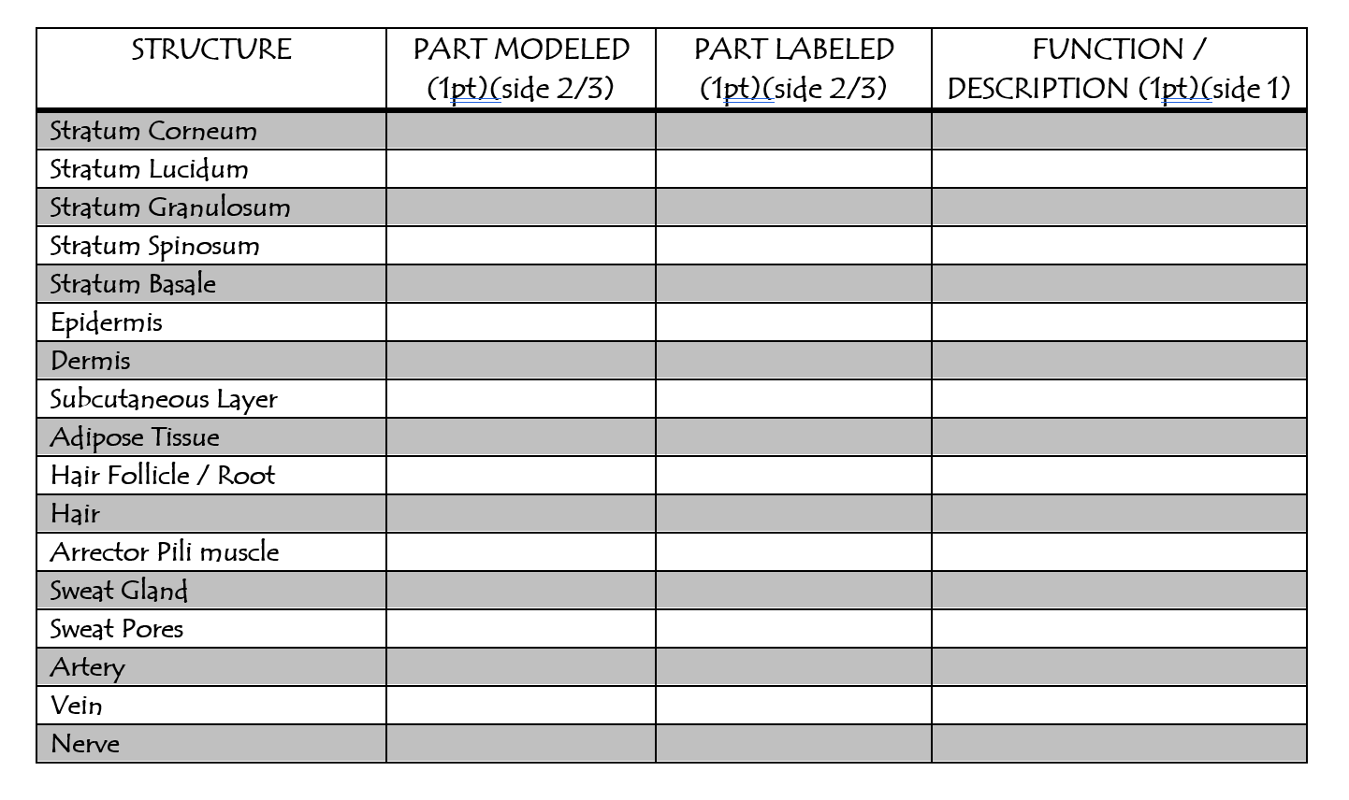

Slide 11
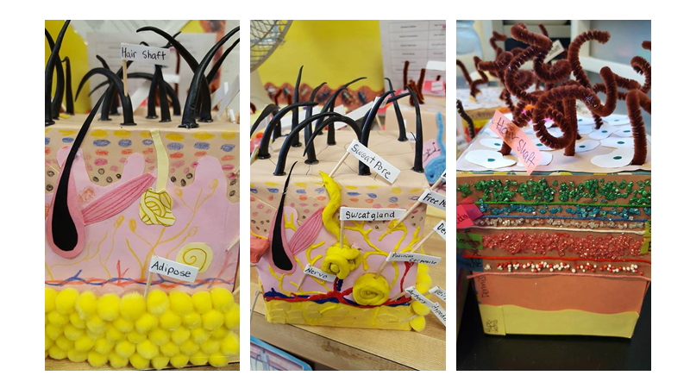
Pictures courtesy of Audrey Ebert - Wilson HS, Tacoma, WA

Slide 12
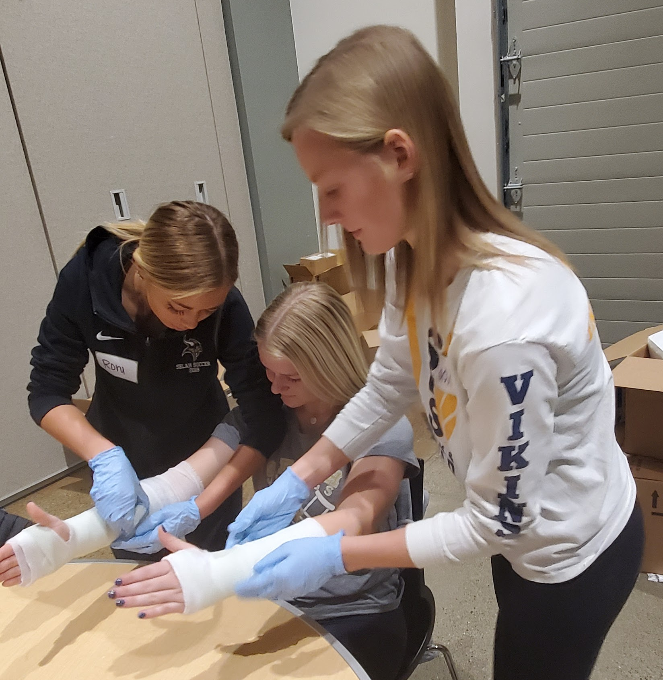
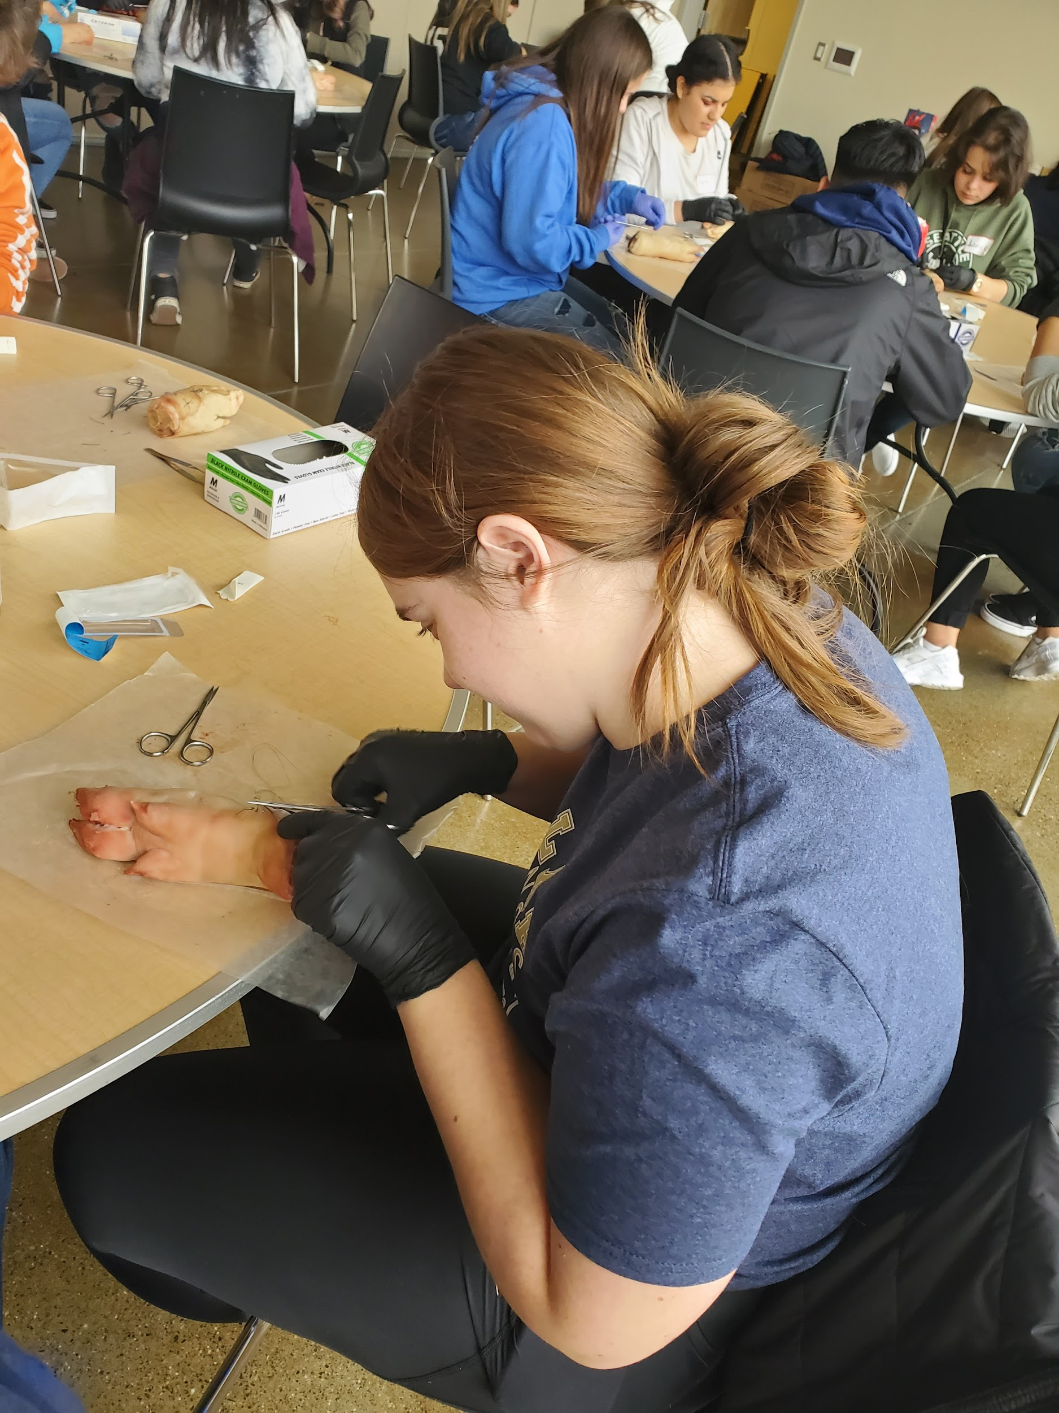
Other collaborations to consider:
Get with local sports med programs (if possible) and host a small hands on skills symposium
Yakima Valley does this every year where students learn suturing, casting, kinesio tape application, participate in a knowledge bowl and team building skills competitions
Pre-participation exams
Walk students through and teach them what a pre-participation exam looks like
Teach them how to do height, weight, eye chart, reflexes, blood pressure, respiration rate, etc

Slide 13
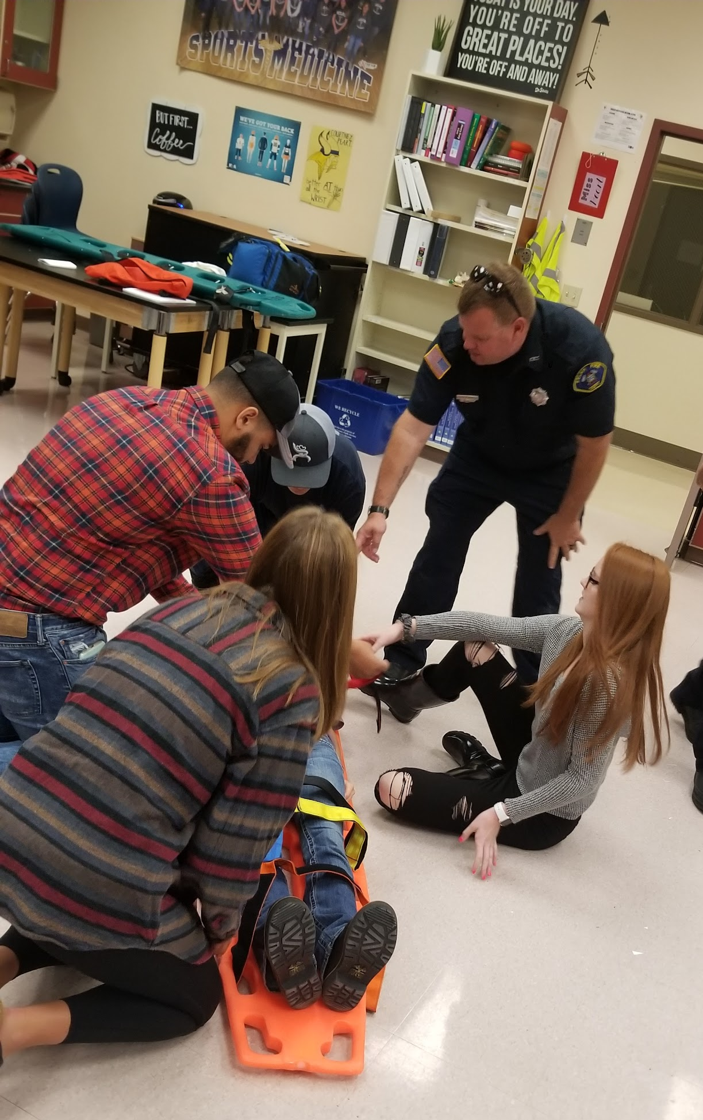
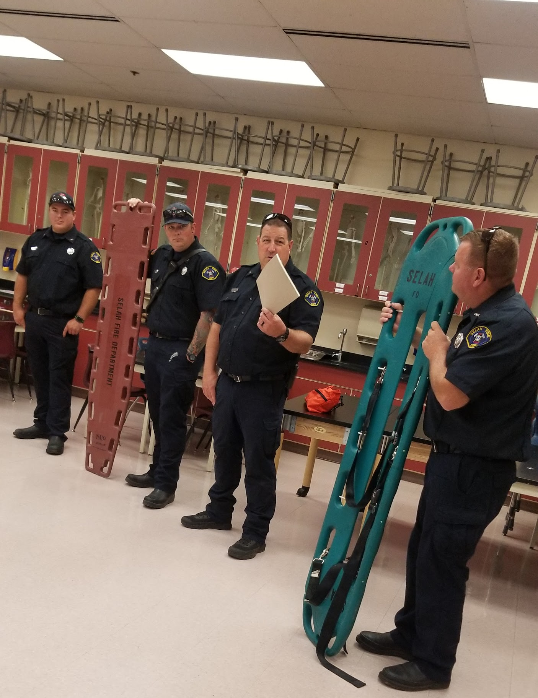
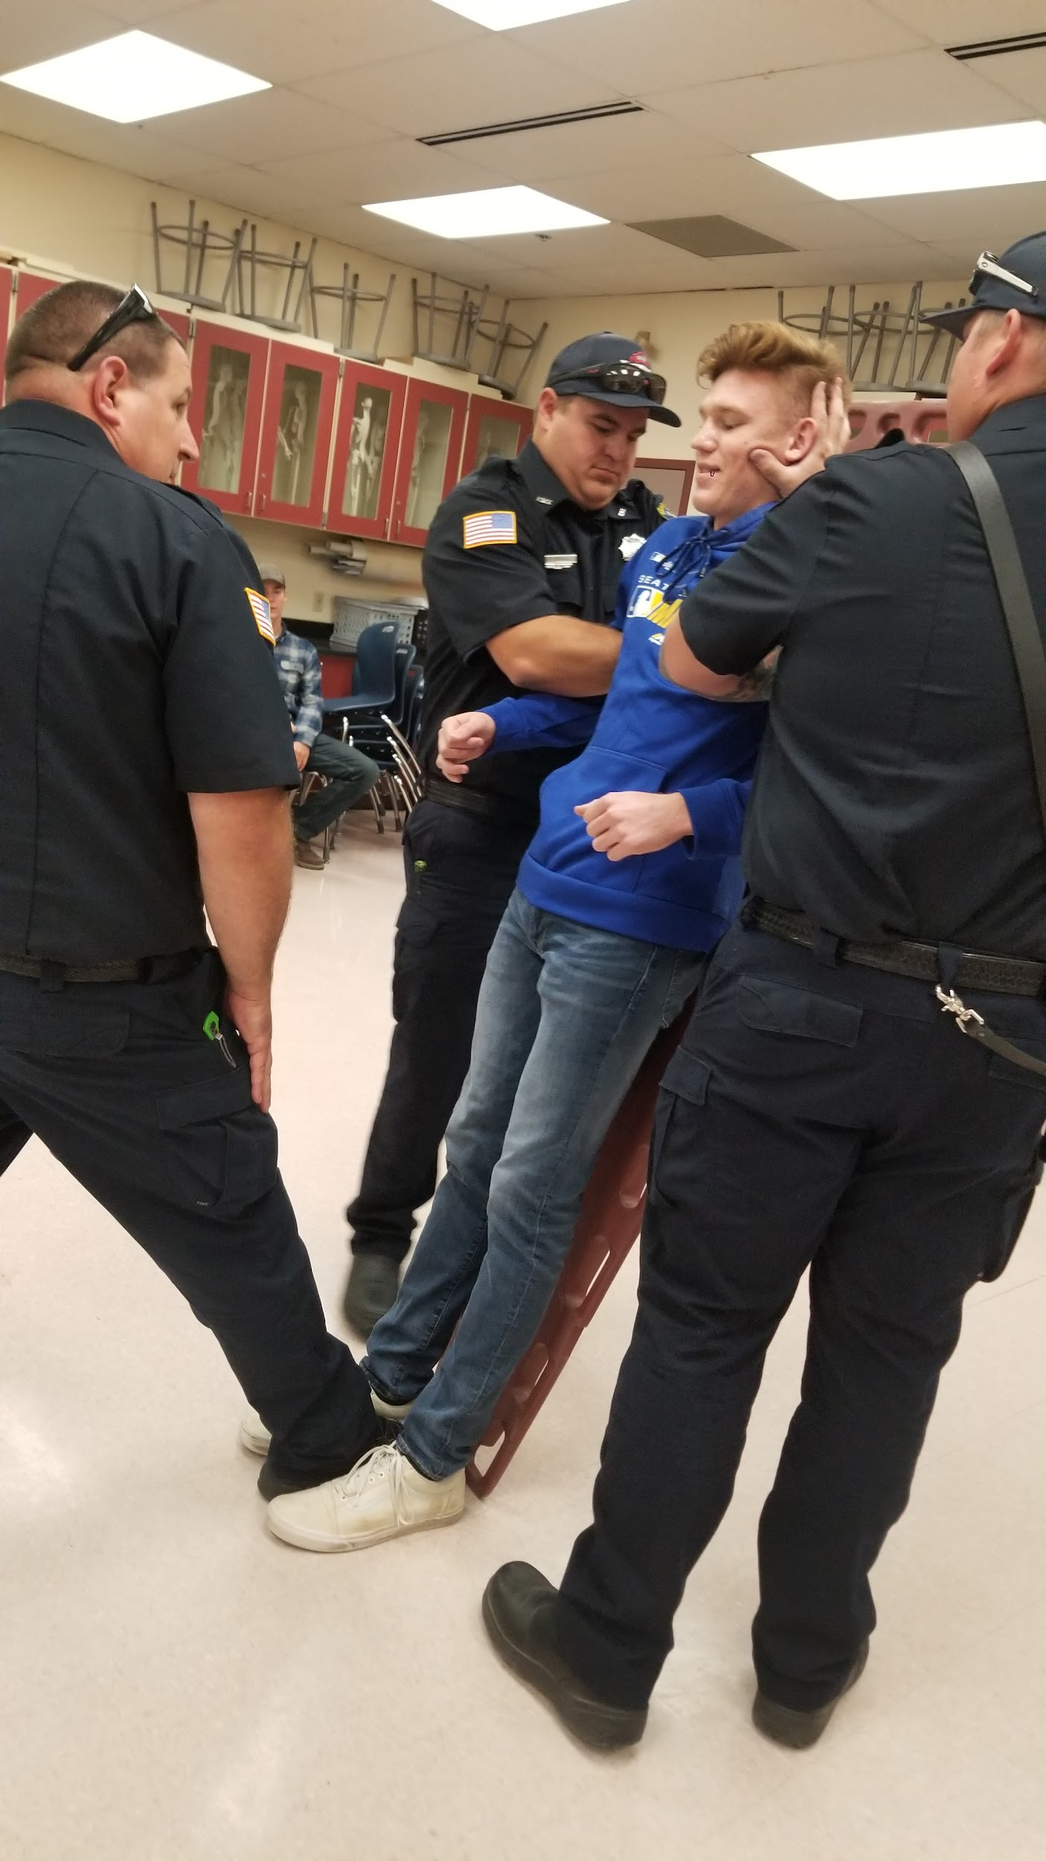
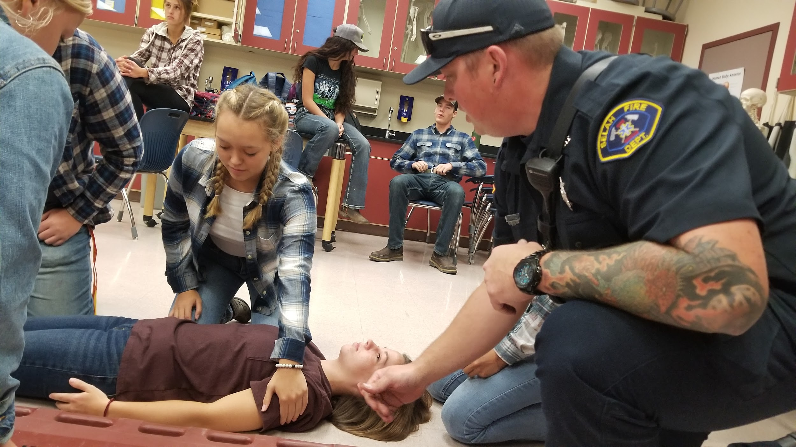
Other collaborations to consider:
Work with local fire department
Selah FD comes in to work with advanced sports med students on a spine boarding lab every year so students understand what teamwork looks like

Slide 14
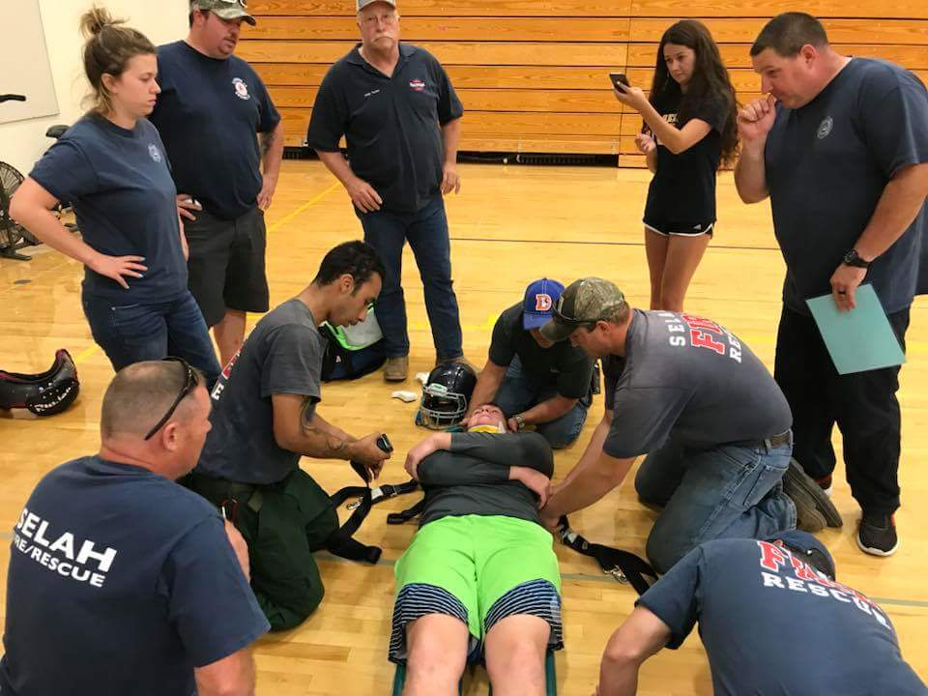
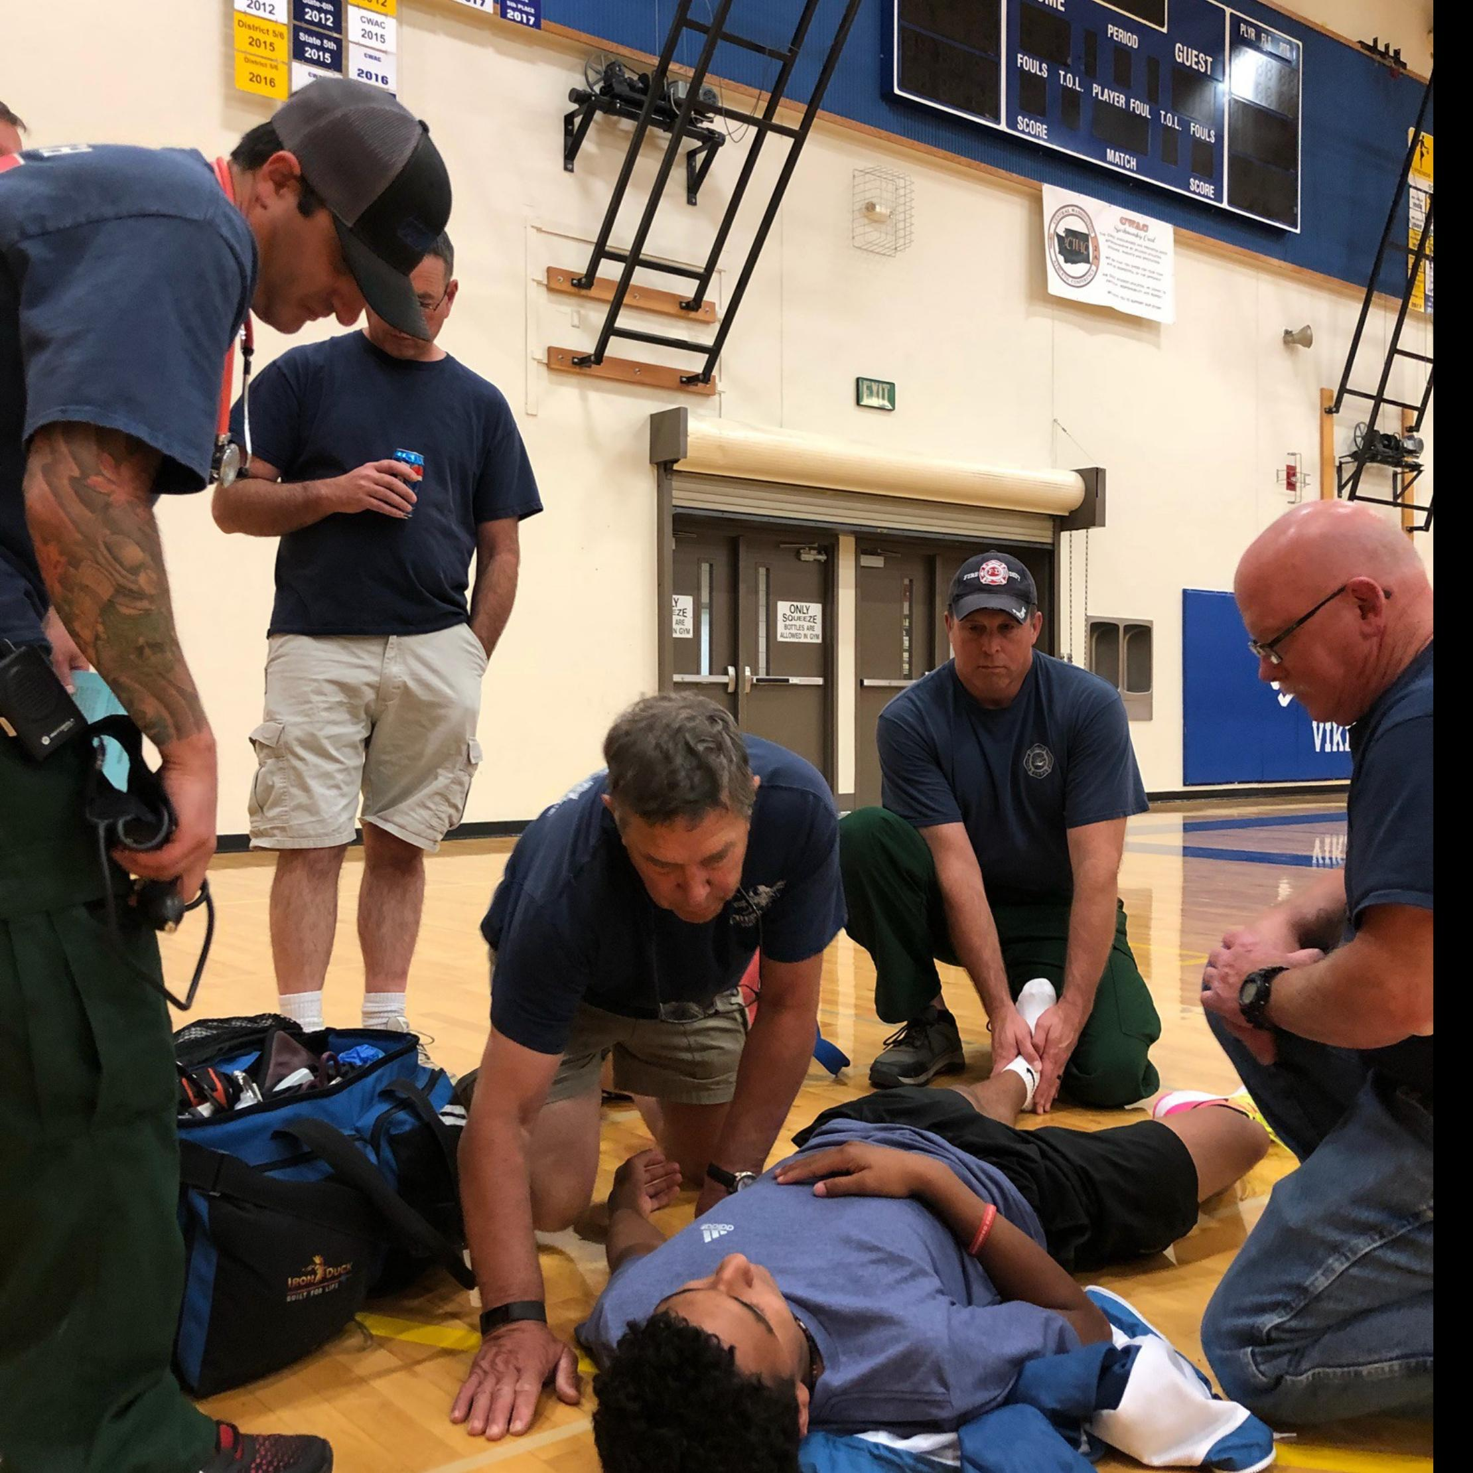
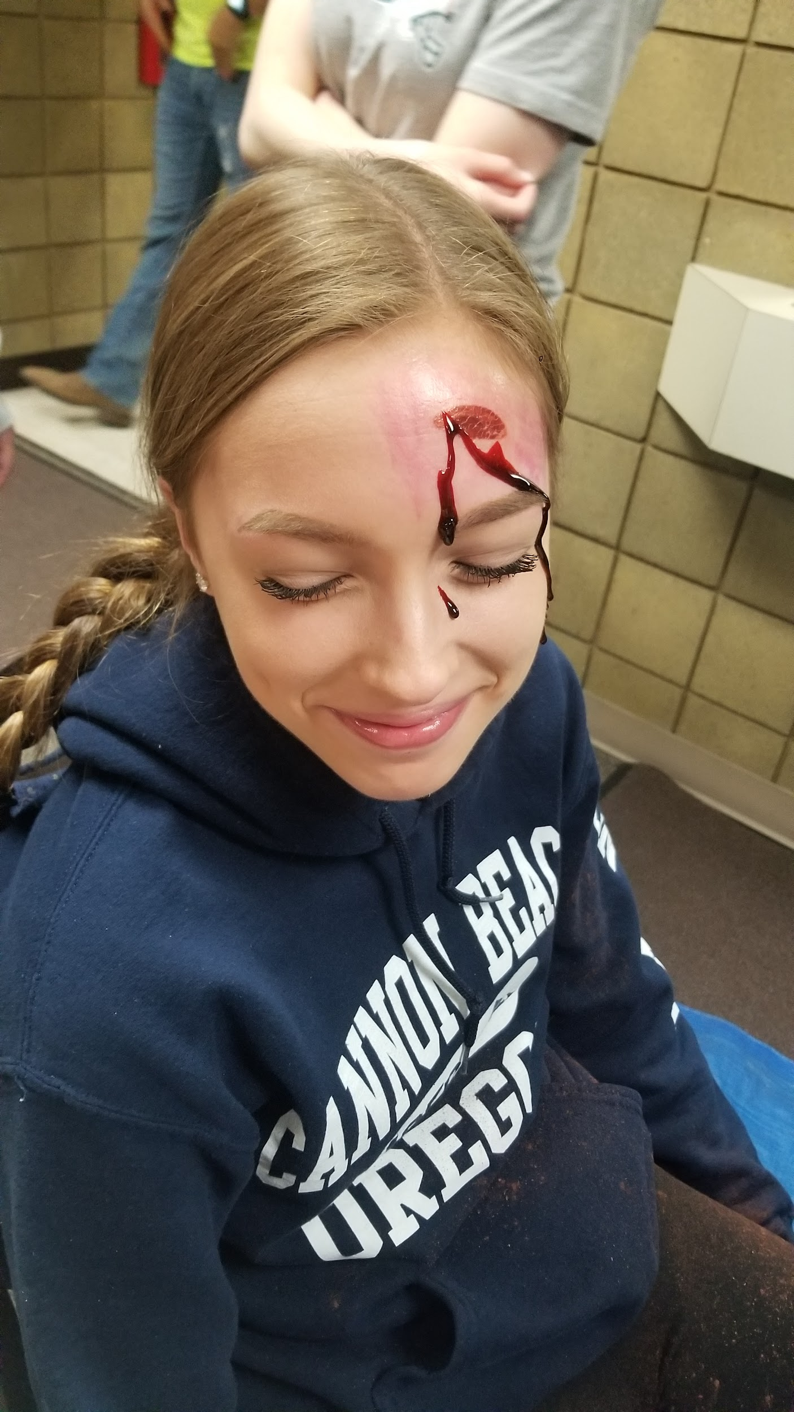
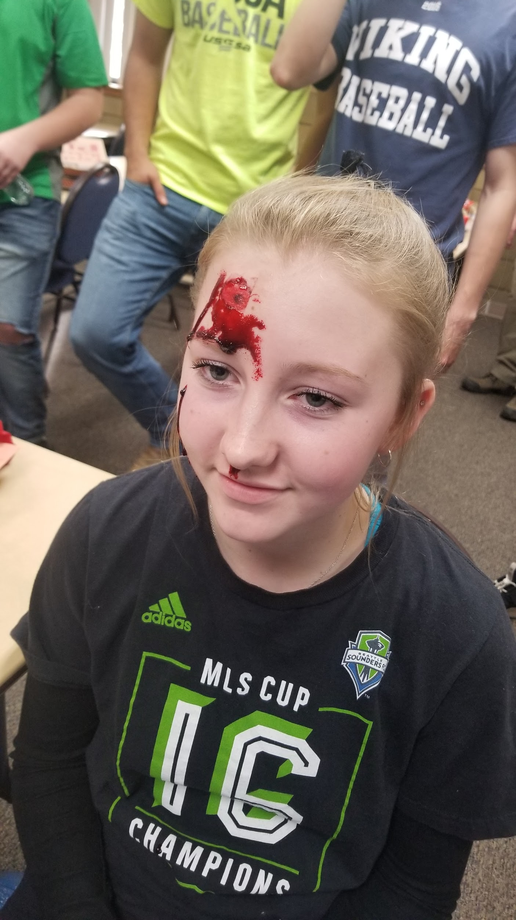
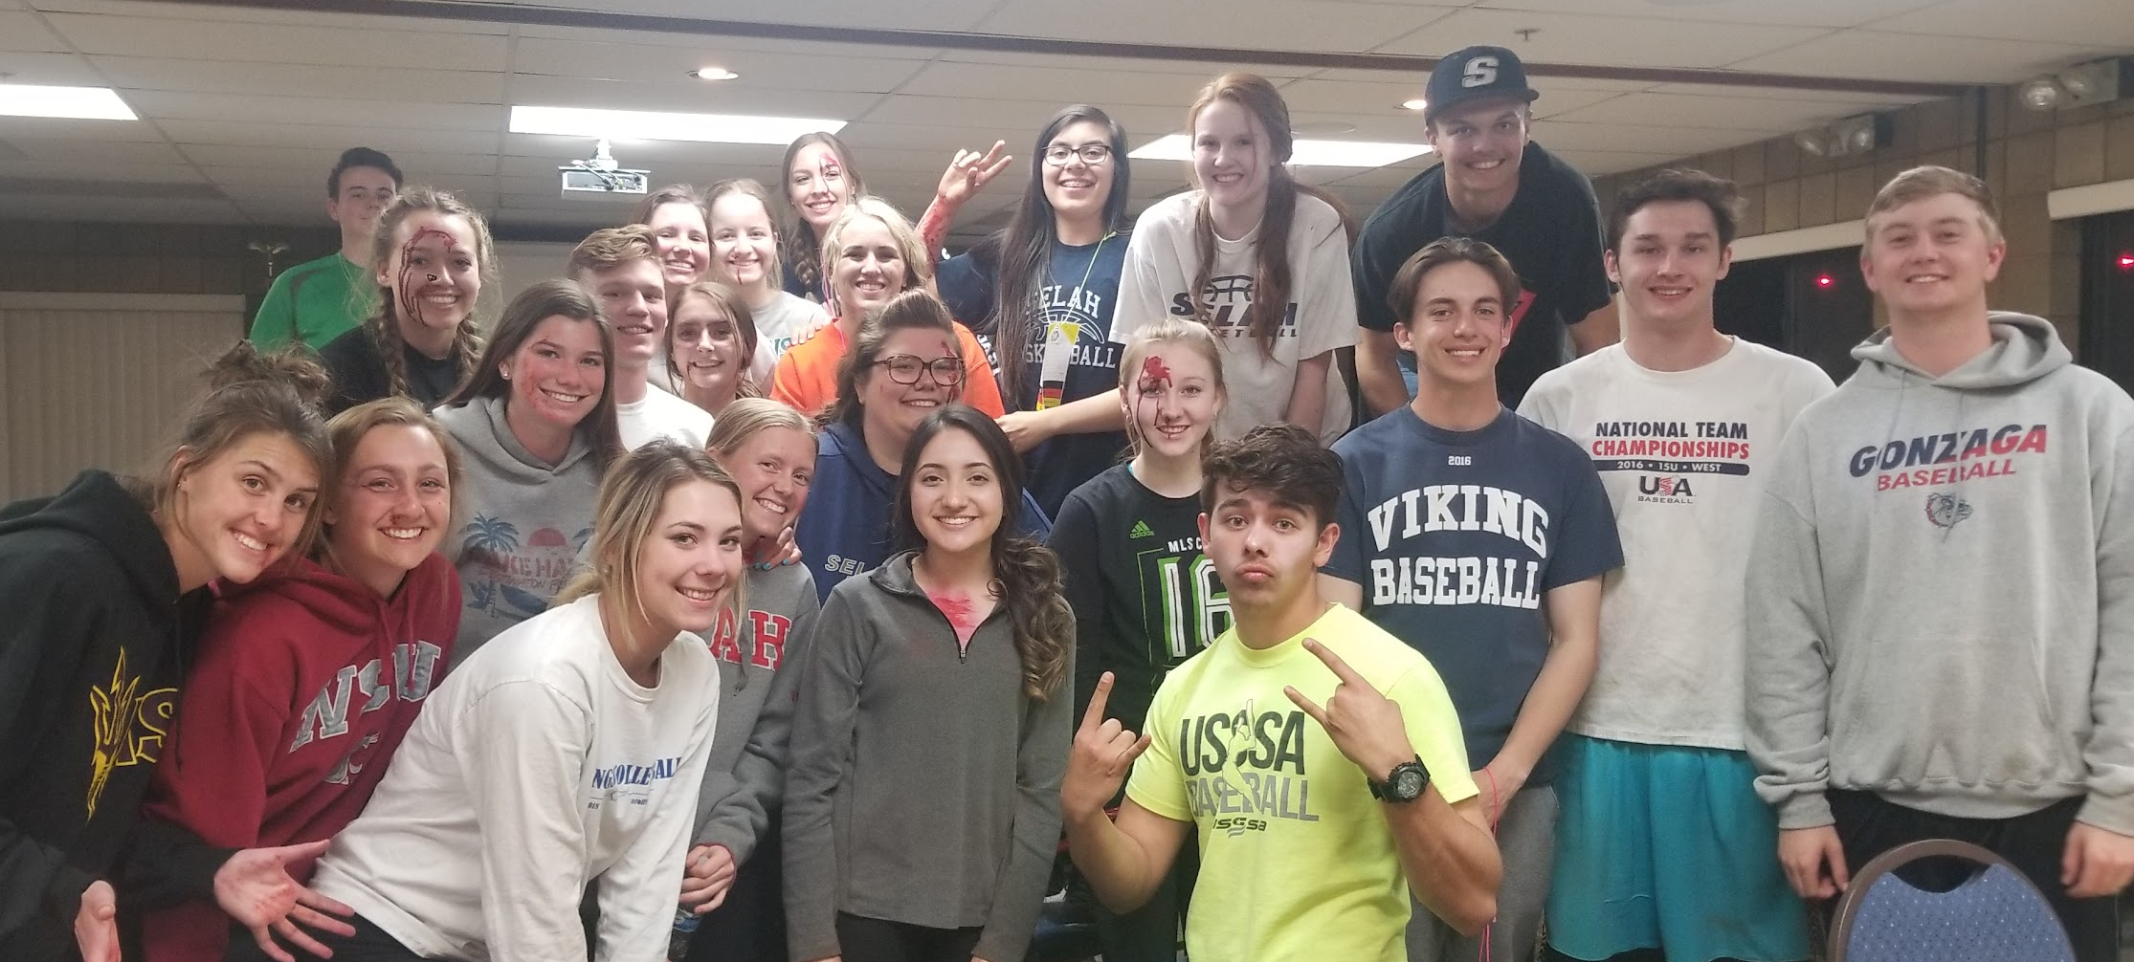
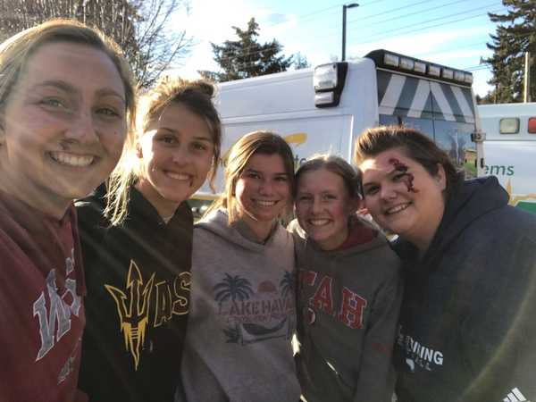

Slide 15
Next Presenter: Stefanie Brophy

Slide 16
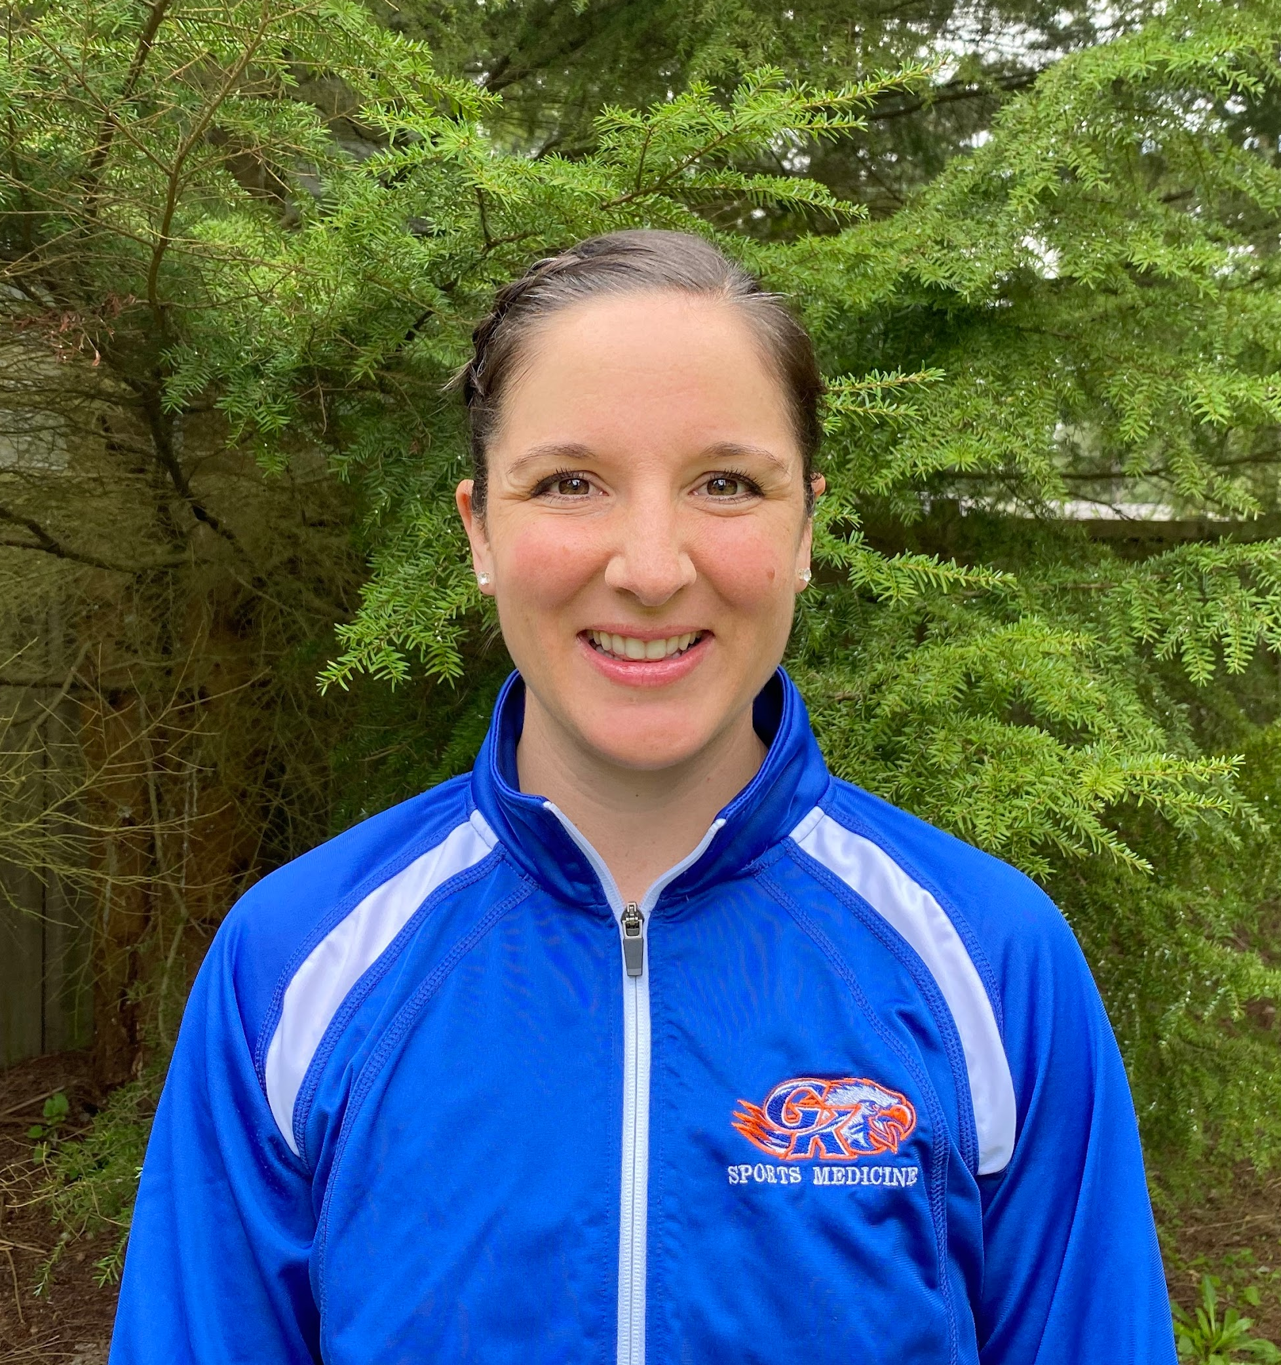
Bio
Stefanie Brophy has been in education for over 10 years and is currently teaching Sports Medicine, Medical Careers, Physical Fitness Technician and PE classes at Graham-Kapowsin high school in Bethel School District. Stefanie has been a Certified Athletic Trainer for 12 years mostly working at the secondary level. She holds a Bachelors of Science in Athletic Training Degree from Eastern Washington University, a Bachelors of Arts in Health and Fitness Education degree from Eastern Washington University and a Masters in Education degree from Antioch University in Seattle. Stefanie is also a board member of the HSCTE committee. Her passion is preparing students for any opportunity in the health sciences field after graduating from high school. She resides in Graham and with any free time she enjoys the outdoors with her husband and three children.

Slide 17
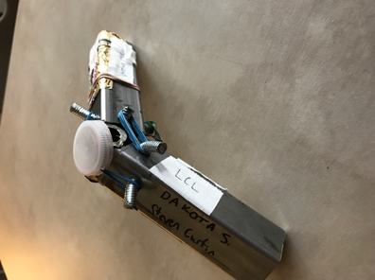
Knee model rubric and requirements

Slide 18
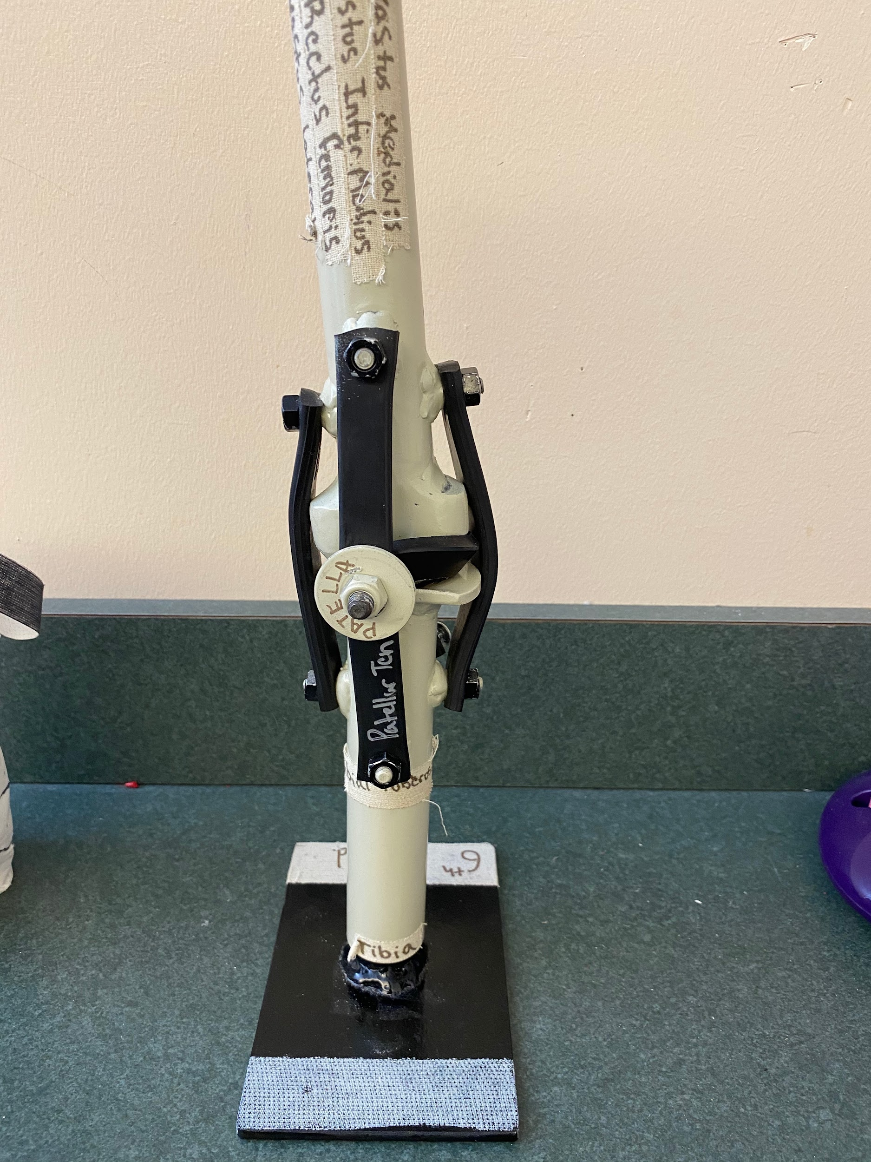
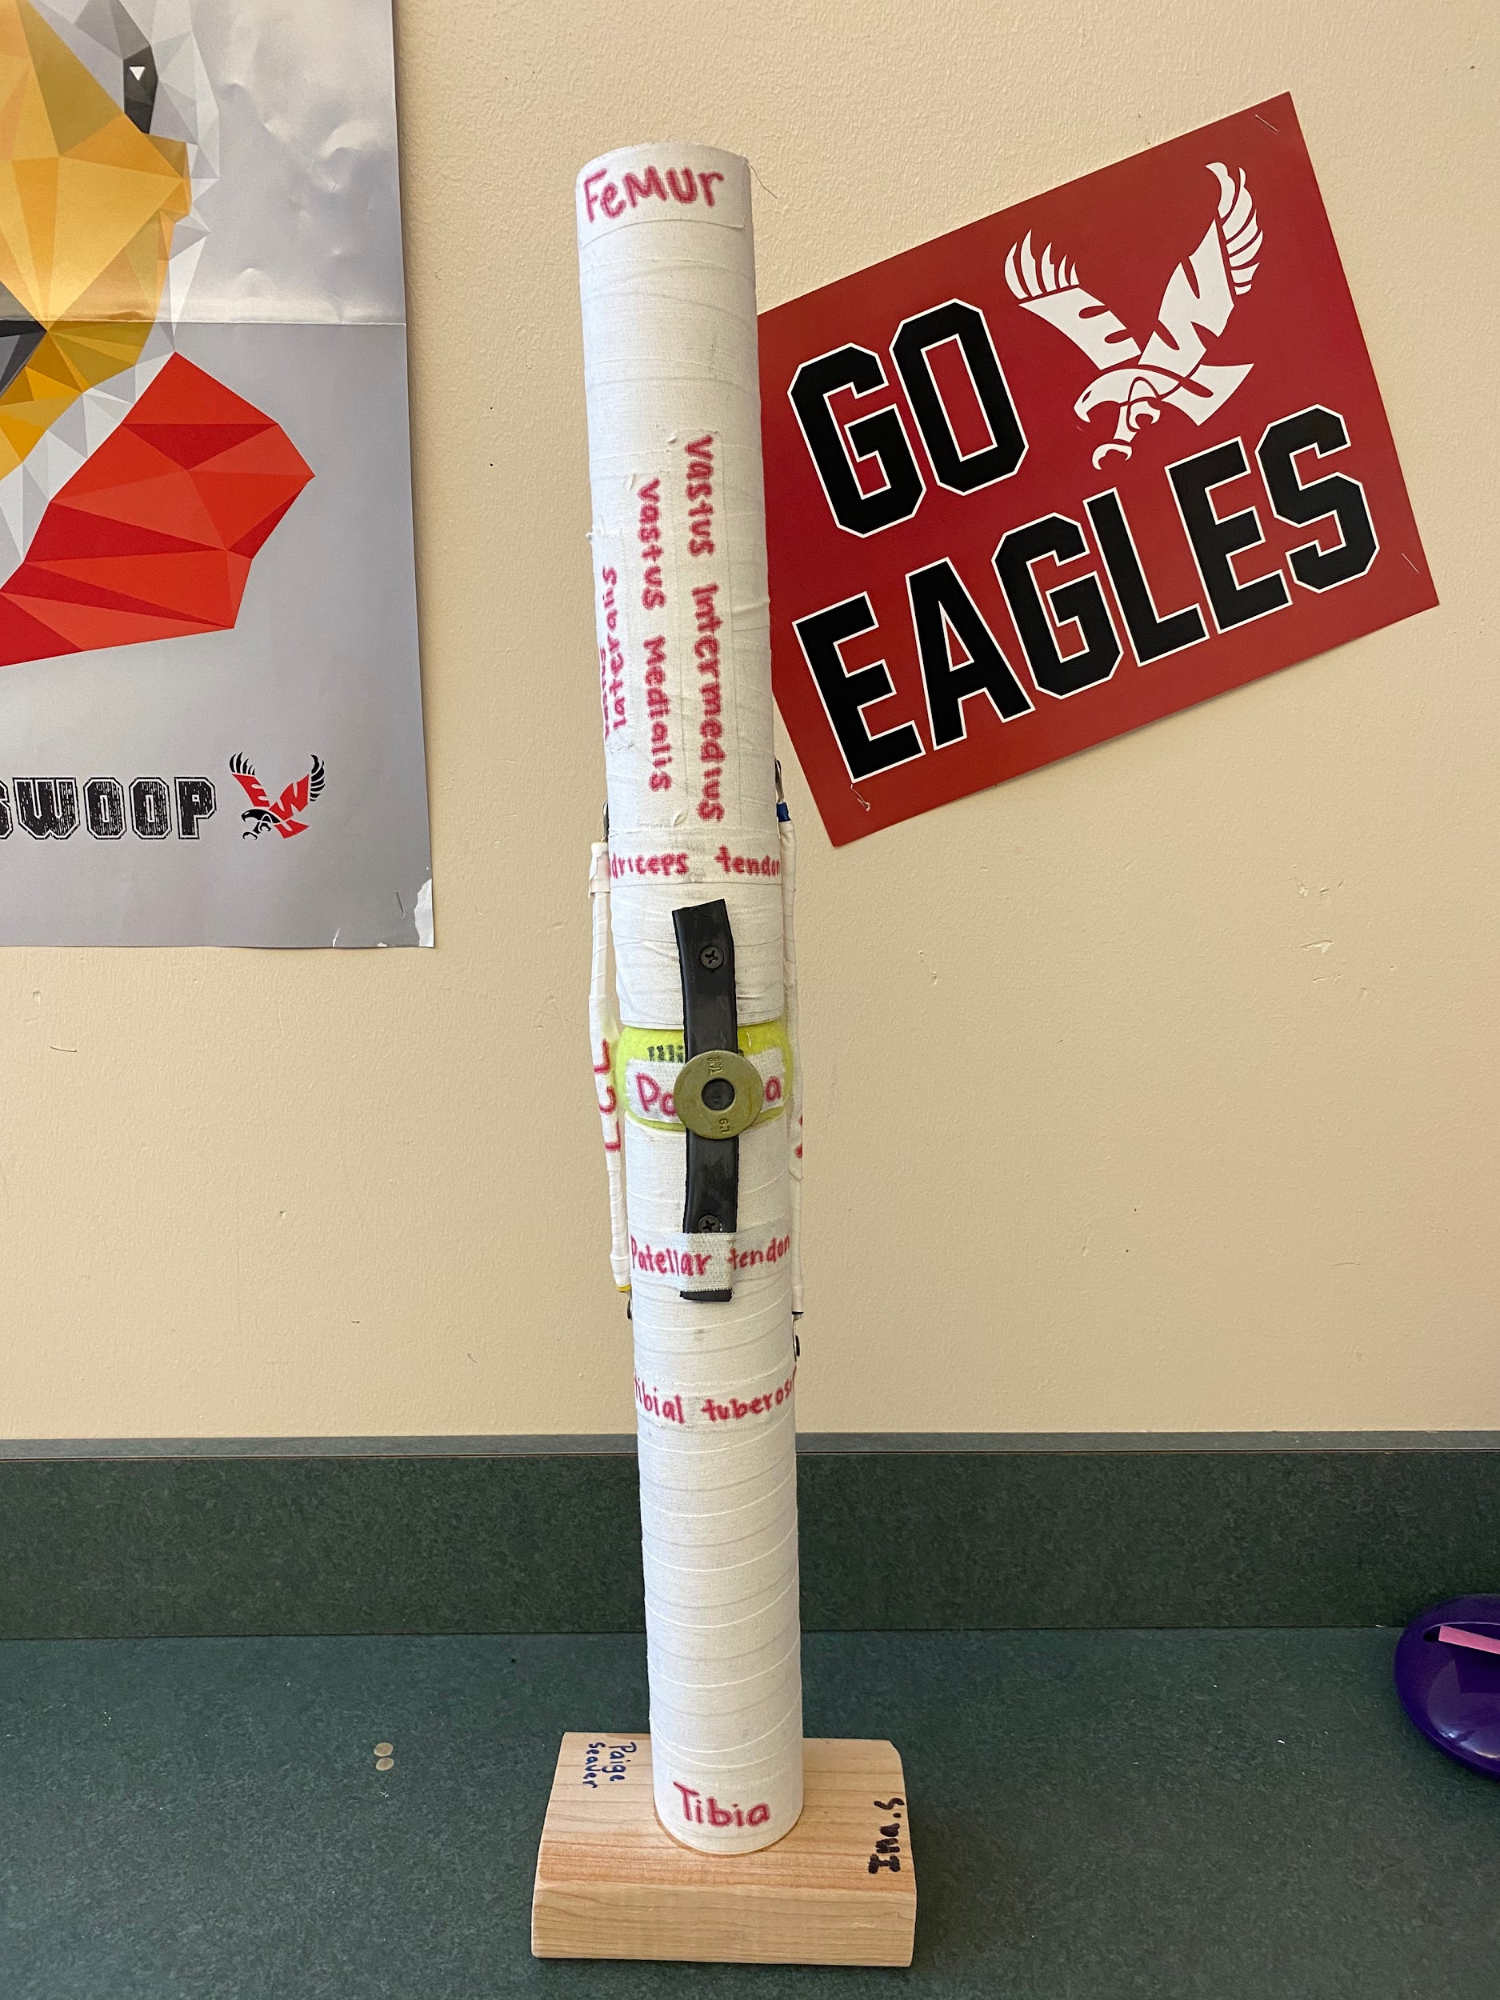
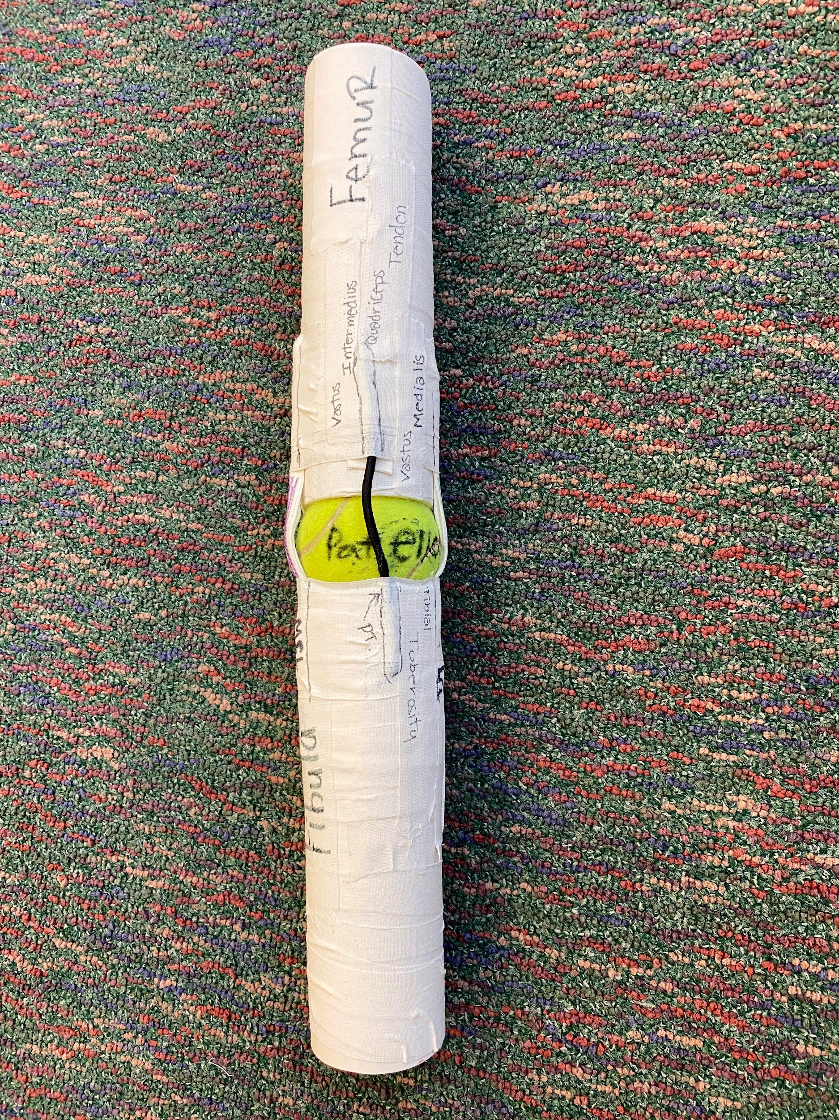
Knee Model Project (Sports Med 1)
Please reference the knee model rubric for requirements.

Slide 19
Shoulder Rap (Sports Med 1)
Shoulder Rap Example #1:
If you want to know the rotator muscles learn SITS
An easy word to stop all your fits
Beginning with supraspinatus to the infraspinatus to discuss
No time for confusion with abduction and rotation
Ain't nothing major with the teres minor
A simple motion of external rotation
This girdle ain't completis without the subscapularis
Get some medial rotatus with that humerus
Now you know all about SITS, now get the FOOSH out and stop the fits
Shoulder Rap Example # 2:
Supraspinatus helps you throw a ball
It's the first a the four we gonna go through em all
infraspinatus helps abduct your arm
Even when you're carryin hay at a farm
Teres minor lets you lift your hands in the air
Or reach into a tree to pick a pear subscapularis the last in sits
The acronym to remember
so your grade doesn't crumble to bits

Slide 20
Shoulder Rap requirements
The project requirements for this are vague for a reason. I want them to use their imagination. They are to include each rotator cuff muscle and their main action. The students perform this to appropriate music of their choice in front of the class.
I have students that come back years later and say they remembered these muscles because of this project.

Slide 21
Book Study (Advanced Sports Med)
A promising young athlete at the University of Pennsylvania who committed suicide in 2014. Fagan brings her experiences as a college athlete on a Division I team and her expertise as a sports journalist to explore why a young woman who excelled both academically and athletically would commit suicide. Over the course of the book, Fagan uncovers evidence of Madison’s depression and the numerous ways she sought help. She uses Madison’s story to explore bigger ideas about mental health, social media, perfectionism, and the challenges facing young people.
Notes:
Students will read 1-2 chapters a week with a discussion on Fridays
Final Project- In groups of 2-3 they will present a model to my sports medicine 1 students on how athletic trainers can create an open dialogue about mental health to their athletes (creating an awareness campaign in the training room, who to go to for help, etc.) and what resources athletes can utilize to benefit them

Slide 22
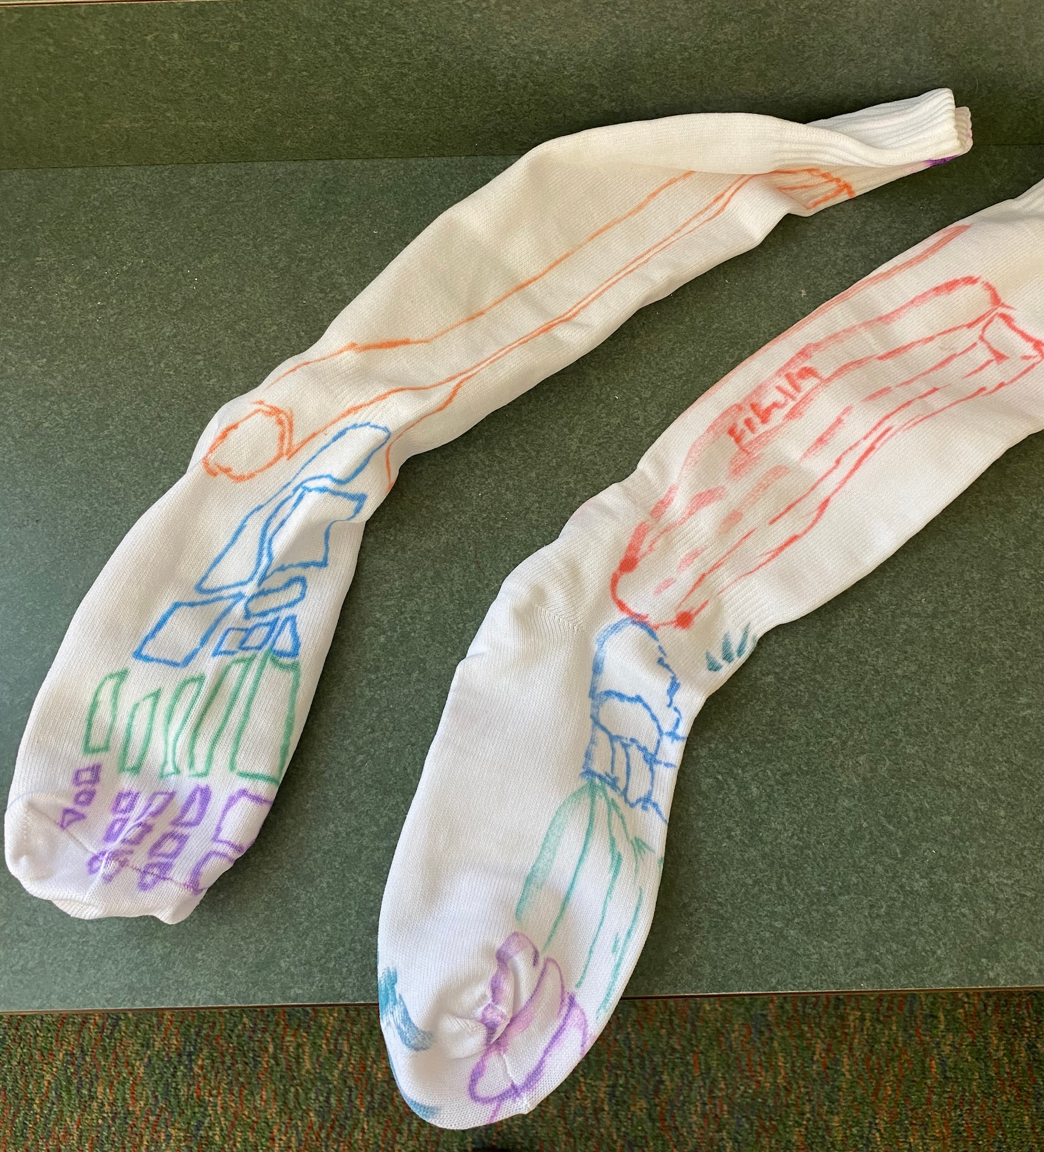
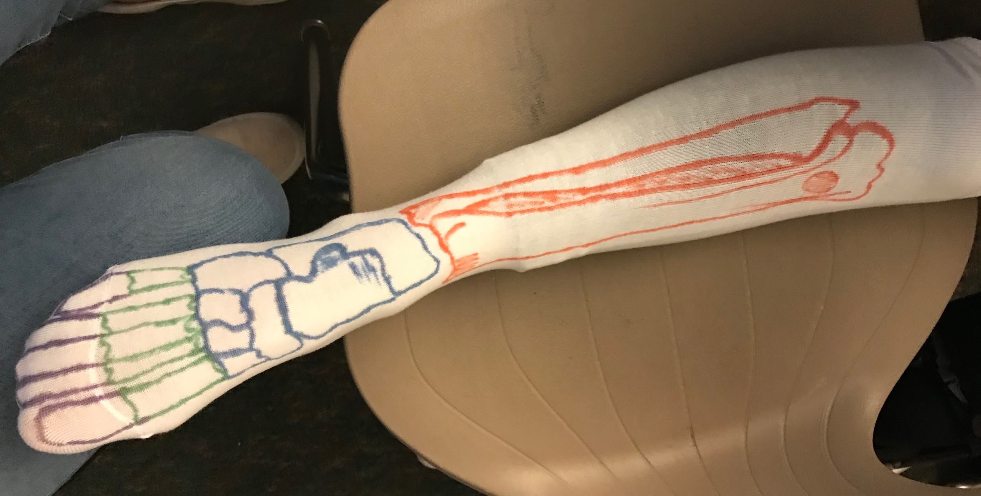
Small hands on projects
Great for practicing ripping tape!
Ankle, Foot, Lower leg anatomy
Tape project- Give each student one roll of athletic tape, they are required to make an object of their choice but they must use the whole roll of tape. (this is one students example of a hydroflask)

Slide 23
If you would like to see all materials that were used for this presentation the google drive link is:
https://drive.google.com/drive/folders/1DADzq_SEGmJ-x2lqg72qeMQ33MD7e_e2?usp=sharing
If you use something from this folder PLEASE MAKE A COPY and do NOT edit the original
We thought it would be a great idea to start a shared Google drive where we could add projects/ideas for everyone to access. This would be something where we could all add ideas and help support each other.
If you would like to be a part of this collaborative google drive, the link is:
https://drive.google.com/drive/folders/1uDzBlzr1vhzSYCcQ_vtrWFPmmMsgMVw-?usp=sharing
This link should automatically add you as an editor, but please email Courtney if you have questions or have problems accessing the drive.
The key here is to add projects or assignments (could even add tests) you have done in the past that you know your students really enjoy so other ATs in the area can utilize them.
If you could make a folder for each thing you add (to keep it organized that would be great!)

Slide 24
Contact Information
If you have any questions or need more information, our contact information is below:
Courtney Peart -- courtneypeart@selahschools.org or 253.219.7164
Stefanie Brophy -- sbrophy@bethelsd.org or 425-417-3438

