Slide 1
Patient Follow Through
This program will highlight the various SCC Allied Health Programs as they are involved in the care of the patient

Slide 2
Patient Care Team
The care of the patient is a team effort.
Everyone involved has a specific and important role to play in a patients ongoing care.
We, as Health Care Providers, serve the patient when they are at their weakest and most vulnerable, which means we always have to be at our best!

Slide 3
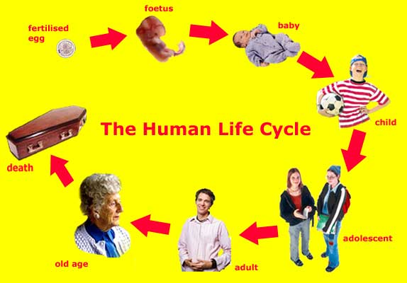
Meet Joe

Slide 4
About Joe
Our future patient, Joe Smith, has been experiencing dizziness, has been more forgetful than normal, has been experiencing abdominal pains as well as pains/cramps in his legs, he seems tired all the time, has had frequent headaches and occasional difficulty breathing.
He thinks it is due to age, maybe the flu, maybe allergies and he should really eat better.
So….like the majority of US citizens…….he downplays his problems…….doesn’t set regular check ups with his doctors (just doesn’t have the time)…………and moves on with everyday life.
That is….until “something happens”.

Slide 5
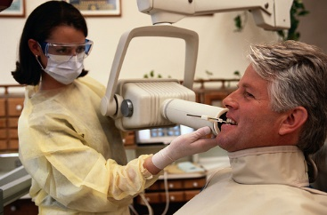
Dental (DA and EFDA)
A toothache finally drives Joe over the edge and he heads to the Dentist to have a check up and a cavity filled.
The Dental Assistant seats him in the room. Takes a brief history and gets his annual x-rays completed.

Slide 6
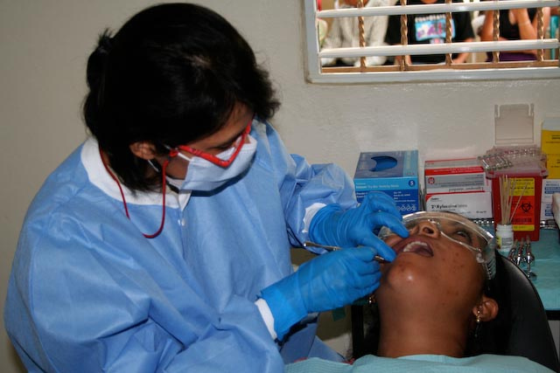
Dental
The EFDA then asks more questions about his history, takes his blood pressure and does head and neck exam. Seeing that his vitals are stable, the EFDA goes ahead and completes placing the filling.

Slide 7
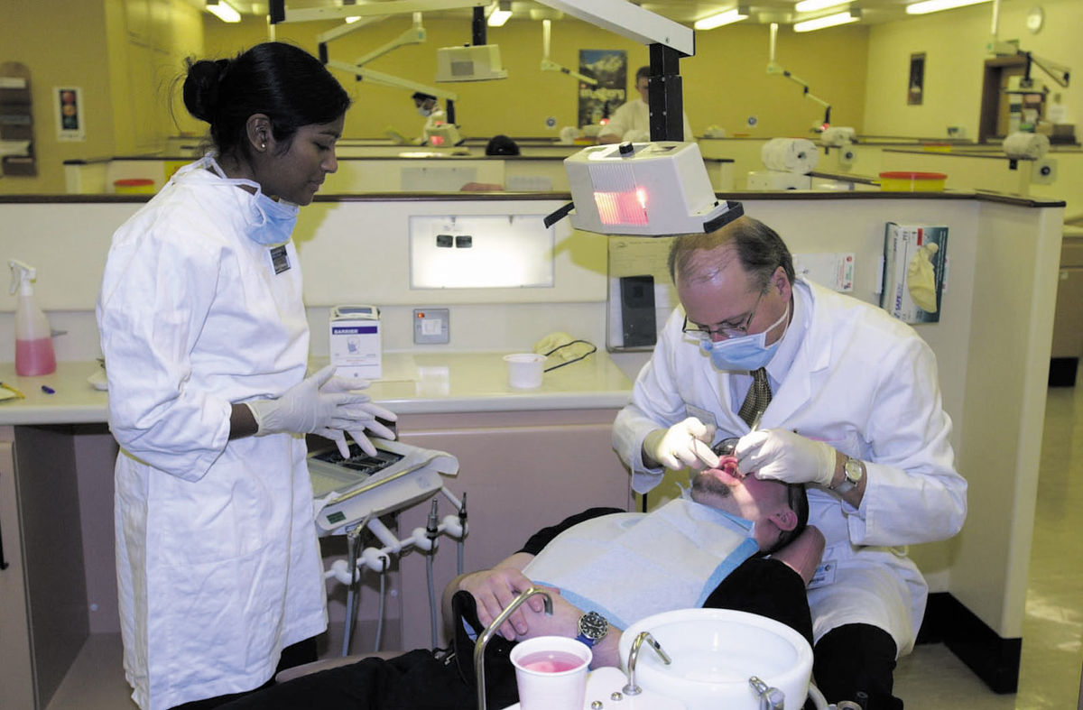
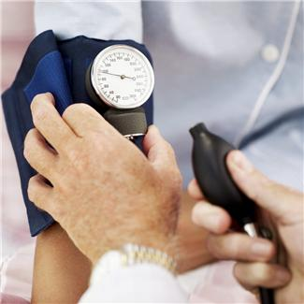
Dental
After the filling is placed, the dentist comes in to inspect Joe’s mouth. Joe is complaining of not feeling well. His vitals have changed a bit, but he is still stable, so the concerned Dentist sends him to visit his GP.

Slide 8
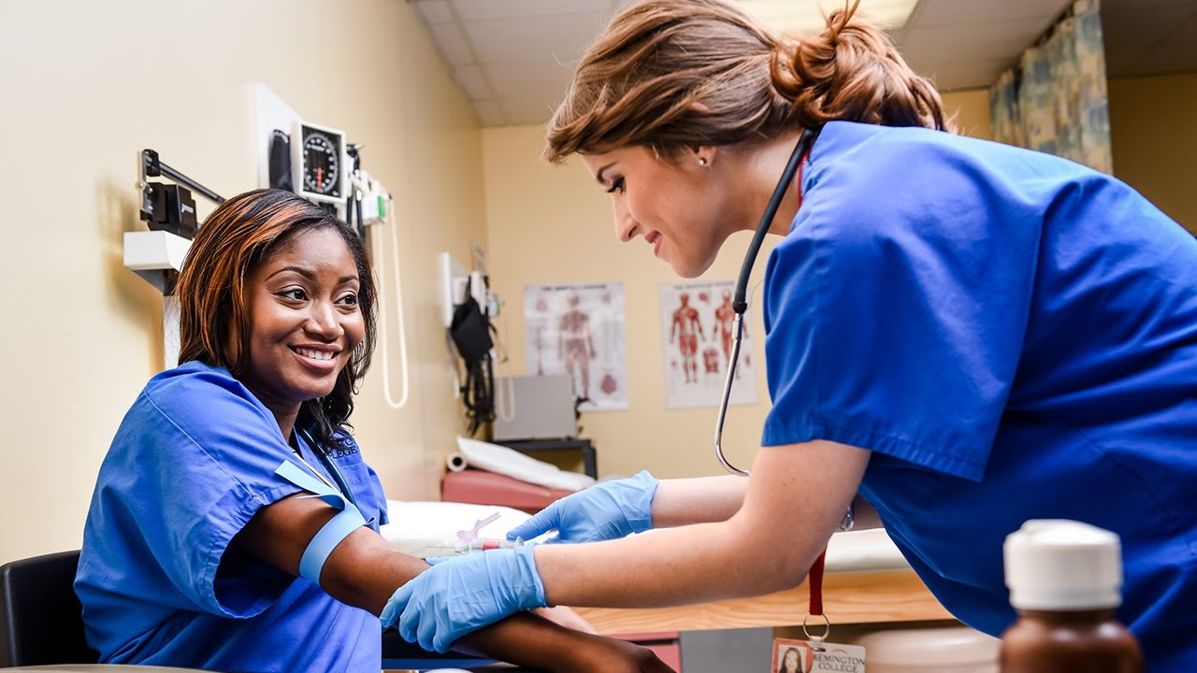
MA (Medical Assistant)
Joe makes an appointment and heads in to see his General Physician/Family Physician.
The Medical Assistant escorts Joe back to the exam room. Once in the room, the MA prepares Joe for his exam by: taking a brief history of his current “illness” and charts his vitals…… height, weight, BP, pulse, respirations, physical appearance and responses.

Slide 9
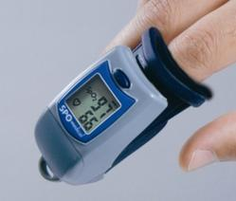
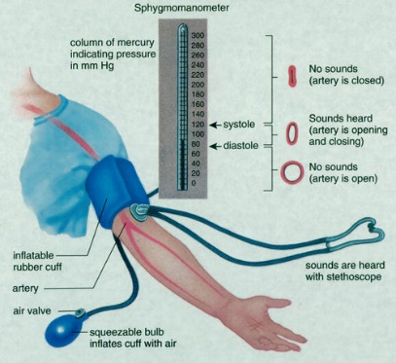
Vitals

Slide 10
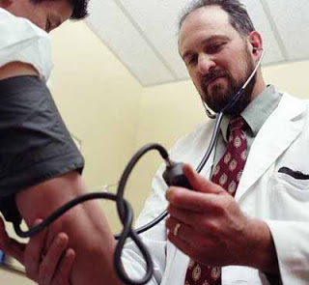
The Medical Assistant then assists the Dr. and staff in the office by performing basic tasks necessary for each exam, to include basic phlebotomy and scheduling of other exams.
Based on the findings of the appointment, and further discussion with Joe, the GP sends Joe for some imaging.

Slide 11
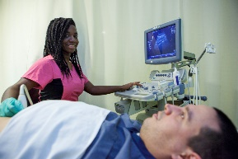
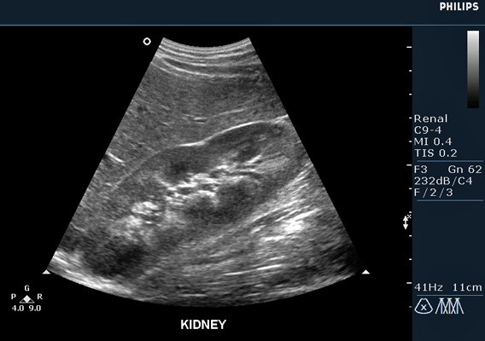
DMS (Diagnostic Medical Sonography)
Since Joe complained about abdominal pain, that is at times severe, his first stop is to the general ultrasound department.
The Sonographer escorts Joe to the exam room. After taking a brief history of his current illness, and checking the request from the Physicians office, a general abdominal ultrasound is performed.

Slide 12
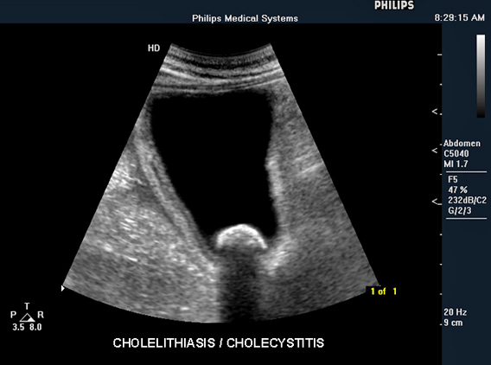
Abdominal ultrasounds

Slide 13
As the exam is completed, Joe states he is feeling ill. He is unable to stand after the exam, feels nauseous, is dizzy and is experiencing difficulty breathing.
The Sonographer calls for assistance. It is decided that Joe should go to the ER so the EMS system is activated to get Joe to the Hospital.

Slide 14
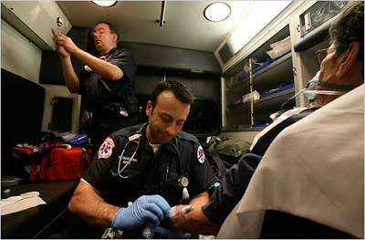
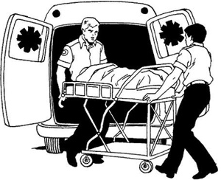
EMT (Emergency Medical Technician)
The ambulance and EMT’s come into the clinic to get Joe.
They get a brief history of the events leading to the EMS call from the Sonographer and then from Joe.
Joe’s vitals are checked and will be monitored during the trip to the ER.

Slide 15
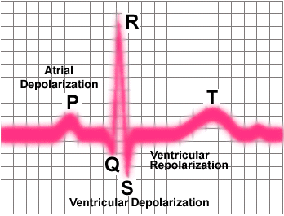
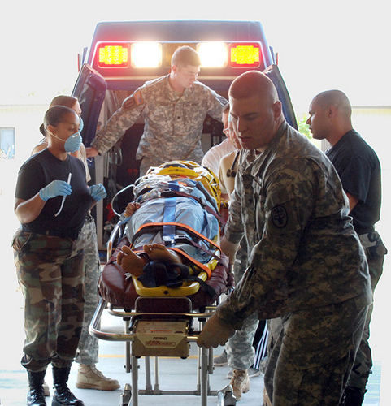
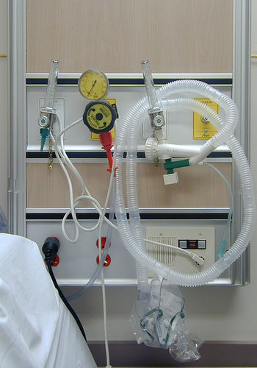
EMT (employed as an Emergency Room Technician)
As Joe is brought into the ER, he is met by ER staff including the ER Technician. This person could be an EMT, MA, NAC or other employee that has been through training.
Joe is brought in the ER bay and a history of his current illness is taken. His vitals are checked and monitored and the ER physician meets with him to go over his history and complaints.
As Joe is having headaches, pains in his legs and difficulty breathing, the ER physician send him on for some further studies.
An EKG was performed to check heart functions

Slide 16
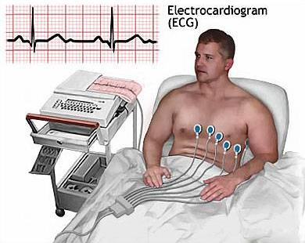
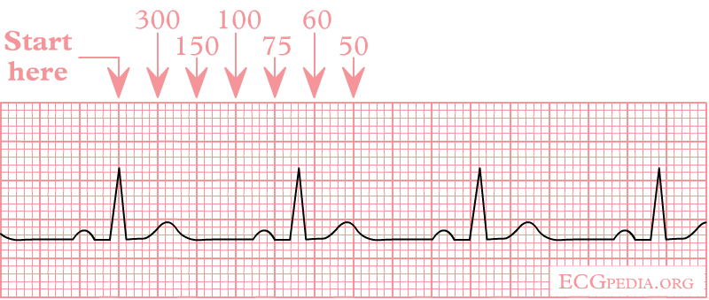
EKG Tech
EKG (electro cardiograms) are common non-invasive tests in the hospital setting.
These can be performed by specialty trained individuals who could be ICT, Echo or Vascular employees, or have gone through the hospital (or college) EKG Tech class, or who are trained on the job by the facility.

Slide 17
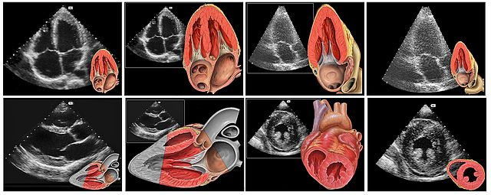
Echocardiography (Non Invasive Cardiovascular)
An Echocardiographer then begins a sonographic exam of Joe’s heart (an echocardiogram)
This sonogram is a non-invasive diagnostic study that will show structure and function of the heart.

Slide 18
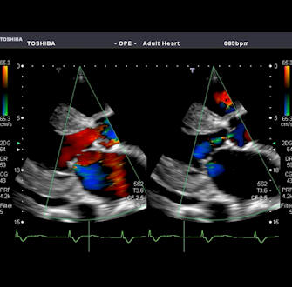
Echo lab

Slide 19
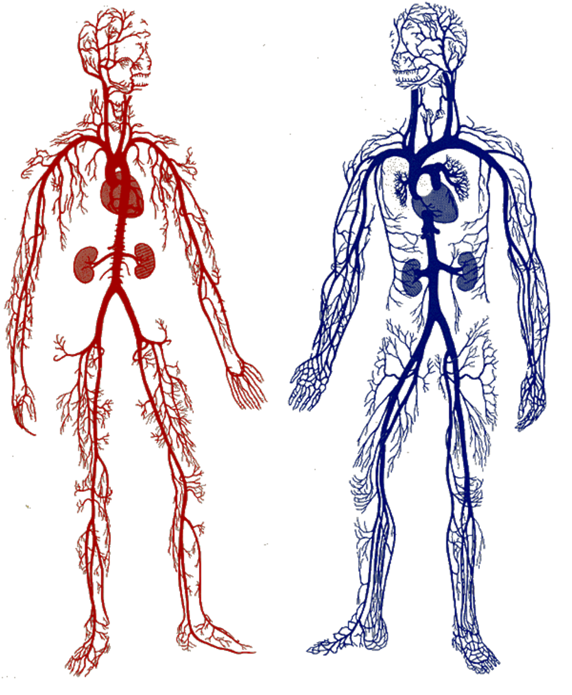
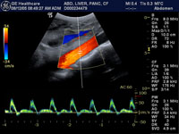
Vascular (Vascular Technology)
A Vascular Technologist takes on the next study.
This ultrasound will focus on the vessels of the arms, legs and neck (carotids) as well as his aorta, checking pressures and structures for blockages or clots.

Slide 20
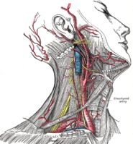
Vascular lab

Slide 21
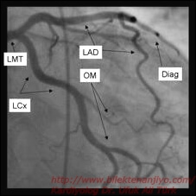
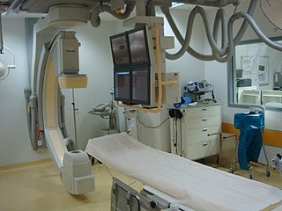
ICT (Invasive Cardiovascular Technologist)
Upon receipt of the Cardiac and Vascular ultrasound results, the ER physician send Joe for further studies.
In the Cath lab, we meet the ICT. In this lab Joe will undergo an arteriography (an angiogram) utilizing contrast media to diagnose and potentially treat disease affected areas of the vascular system.

Slide 22
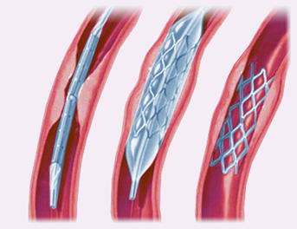
Cath lab

Slide 23
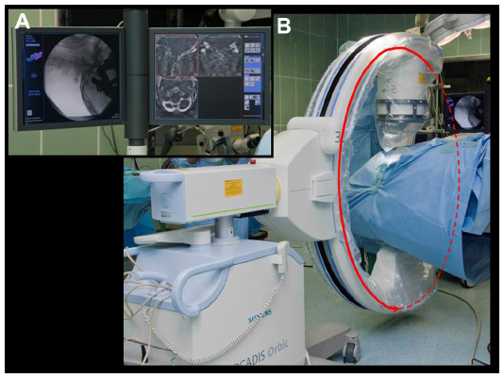
Radiology Technology (X-ray Tech)
Within the cath lab, Joe meets the X-ray techs for the first time.
During the ICT studies, our radiology people need to be present to assist the study with their radiographic machines. In the cath lab, that would be fluoroscopy with the use of a C-arm machine.

Slide 24
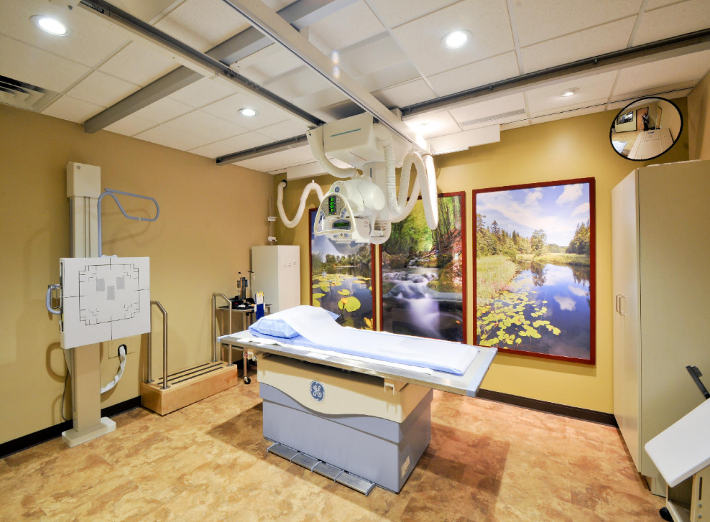
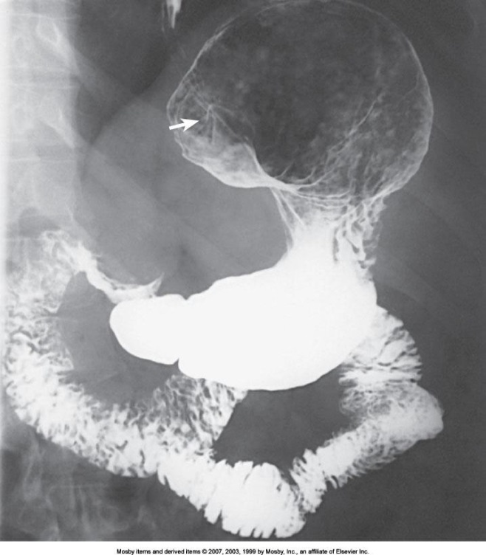
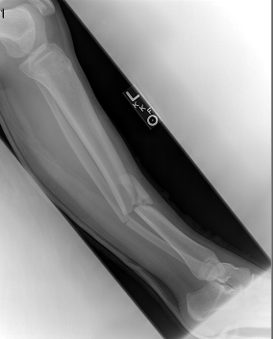
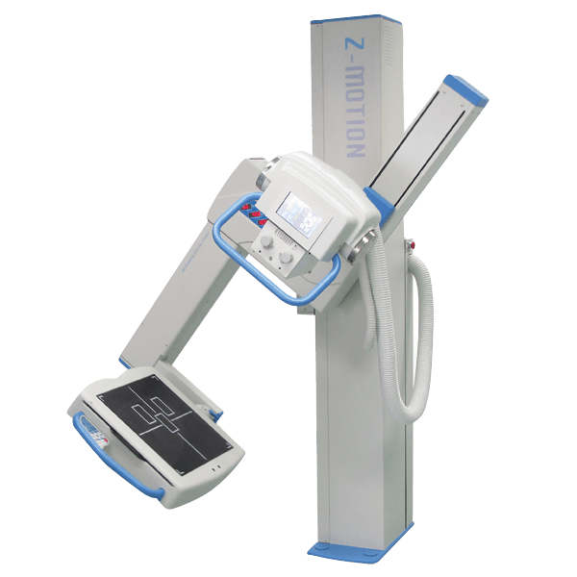
Radiology Department

Slide 25
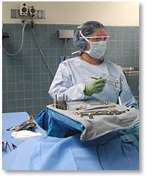
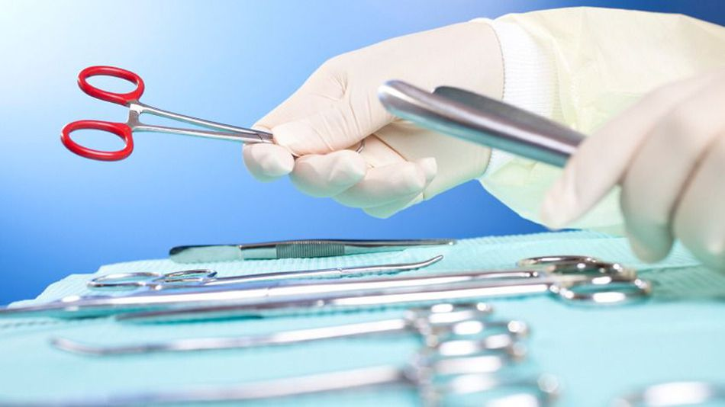
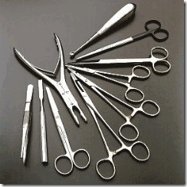
Surgical Technology (Surgical Technologist)
If Joe were to need repair of something that could not be repaired non-invasively, or through minimally invasive techniques (ICT) He would then need to be sent to Surgery.
The Surgical Technologist assists the surgeon during surgery: prepares the room, creates and maintains the sterile field, hands instruments and sterile supplies to the surgeon, assists with retraction and manipulation of the patient tissues, helps close and bandage the patient, then cleans the room and prepares for the next case…. We are considered the “technical specialist” and the doctor’s “right hand”.

Slide 26
Surgery

Slide 27
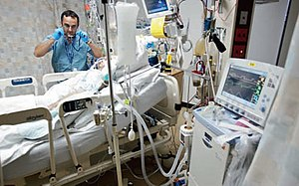
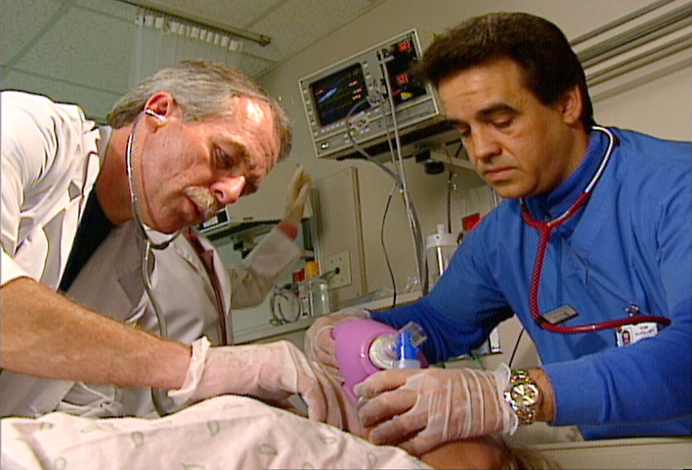
Respiratory (Respiratory Therapist) Bachelor of Applied Science
Upon completion of a surgical event or if the patient is having difficulty breathing, the Respiratory Therapist is called in.
Respiratory therapists assist their patients with delivery of aerosolized medications as well as airway management and ventilator management when the patient is completely dependent upon the ventilator for survival.

Slide 28
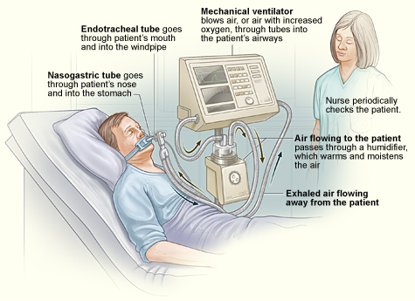
Respiratory Care

Slide 29
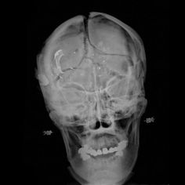
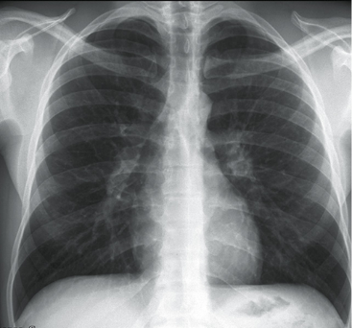
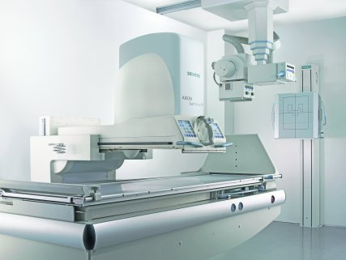
Radiology Technology (X-ray Tech)
The x-ray tech, who we may have met earlier in the ER for diagnosis, the ICT lab for radiographic assistance, or in surgery for diagnosis or line placement views, is called in for a post operative view of Joe’s chest and lungs.
This is critical for line placement, lung volume visualization and diagnosis of potential blood flow issues or pneumonia.

Slide 30
Nursing
Nurses are another vital part of the Patient Care Team. Nurses are State Registered and are considered to be the “Patient Advocate”, in other words, they speak for the patient when the patient cannot speak for themselves.
Nurses work in all areas of the hospital, with the Allied Health members, physicians and other team members.

Slide 31
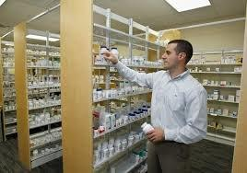
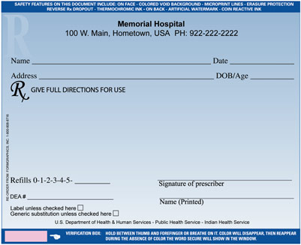
Pharmacy Technician
Throughout Joe’s travel through the health care system, medication is a common treatment for many conditions.
The Pharmacy Technician can work in the hospital or in retail. Their role is to take the prescription, once given to the pharmacist and checked with insurance and previous records, and fill the order.
Pharmacy techs could help compound some medications or transfer from main source to the smaller prescription bottles we are familiar with.
The Pharmacy Technician assists the Pharmacists by coordinating and dispensing prescribed medications

Slide 32
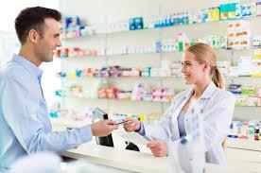
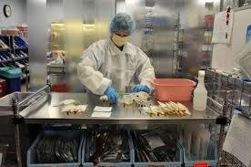
Pharmacy

Slide 33
What was wrong with Joe?
With everything that Joe presented with, it could have been anything.
As Allied Health professionals, we are not the person who diagnoses the patient, that would be the Medical Provider.
We assist the provider with the diagnosis discovery and then the treatment thereof.

Slide 34
Why Spokane Community College?
We have a wide assortment of Health Careers to choose from.
We have a very strong reputation in the community as quality programs.
All of our Instructors are specialists in the industry/fields.
Our College is accredited.
Our programs are Nationally Accredited.
We help you learn a living that keeps on giving!!

Slide 35
Just a little note…..
While IT may be legal in Washington State, IT is NOT allowed in a clinical setting, or on the college campus. You may NOT be under the influence while in the learning environment or while practicing your profession.
Clinical sites require drug screenings and reserve the right to do random screenings, of all employees and students, while you are on the clinical site.
Background checks are performed frequently. Our patients are at their most vulnerable state. We have to make sure that they are protected. What you may have done in the past, or when you were younger, could keep you out of where you want to go……

Slide 36
What can you do to make the process more efficient?
Work towards your goals early…….
A&P’s / Sciences (any sciences….within 5 years of program entrance)
Maths
Medical Terminology, Pathophysiology
Volunteer work/community service
CPR (American Heart Association BLS Provider level)
Blood Borne Pathogens (MUST have the certificate for completion stating 7 hours and preferably “WA State KNOW Curriculum”)

Slide 37
Questions?
Thank you for listening!
We hope to see you in one of our programs in the future!!

